Slide 1
Evaluation and Management of Spinal Cord Emergency and Cervical Spondylotic Myelopathy
James J. Lehman, DC, MBA, FACO
Associate Professor of Clinical Sciences
University of Bridgeport College of Chiropractic
Director
Community Health Clinical Education
University of Bridgeport

Slide 2
Learning Objectives
Recognize signs of spinal cord emergency.

Slide 3
Learning Objectives
Correlate anatomy and the patients’ signs and symptoms in order to identify cervical spondylotic myelopathy (CSM).

Slide 4
Spinal Cord Injuries (SCI)
SCI are critical emergencies that must be recognized and treated early to increase the possibility of preventing permanent loss of function.
Spinal cord emergencies: False reassurance from reflexes. Acad Emerg Med 1998.

Slide 5
History and Clinical Presentation
…can provide the most important information in the assessment of a possible emergency.
Spinal cord emergencies: False reassurance from reflexes. Acad Emerg Med 1998.

Slide 6
Red Flags
Night pain/sweats/fever
Unexpected weight loss
Bowel and bladder dysfunction
Long tract signs
Signs of neurogenic claudication
Weakness and paresthesias in extremities

Slide 7
Cervical Spine Fracture/Dislocation
Suspect upper cervical spine instability
History of roll-over MVA or blow to head

Slide 8
Rust’s Sign
May grab head upon removal of cervical collar
May use hand to lift head when rising from supine position

Slide 9
Rust’s Sign
Patient is attempting to stabilize the head with slight traction and reduce pain
Patient presents guarded movements
Imaging studies must proceed any provocative testing
CT scan is indicated with acute trauma to the cervical spine when radiographic examination is negative.

Slide 10
Odontoid Fracture CT Scan

Slide 11
Rust Sign
Rear-end MVA
Patient is unable to rise from supine posture without holding hand behind head
Suspect moderate to severe sprain/strain

Slide 12
Recognizing Spinal Cord Injuries Differential Diagnosis Spinal cord compression secondary to vertebral fracture or space occupying lesion.

Slide 13
Recognizing Spinal Cord Injuries Differential Diagnosis Spinal cord compression secondary to vertebral fracture or space occupying lesion.

Slide 14
Neoplastic Disease
Metastatic disease most common spinal tumor (25X)
Breast
Lung
Prostate
Kidney
Lymphoma
Primary spinal tumor is most often multiple myeloma in adults

Slide 15
Multiple Myeloma
What clinical signs would you expect when a patient presents with multiple myeloma?

Slide 16
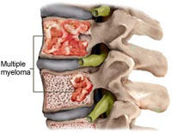

Slide 17
CRAB Criteria

Slide 18
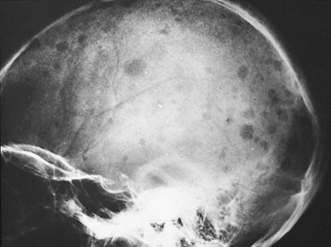

Slide 22
Spinal Infection “Discitis”
Acute onset of neck or back pain
HX of infection
Current fever
Elevated SED rates or WBC count
Frequently misdiagnosed in ER
MRI indicated

Slide 23
Staph Infection of Spine and Osteomyelitis
Recent spinal procedure
Focal severe pain not relieved with rest

Slide 24
Central Canal Spinal Stenosis

Slide 25
Vertebral Anatomy

Slide 26
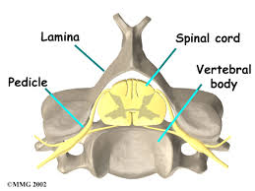

Slide 27
Cervical Vertebra
Vertebral artery
Spinal cord
Zygapophyseal joints
Spinal nerve roots

Slide 28
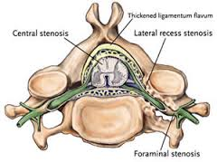

Slide 29
Spinal Canal Measuring
Pavlov’s ratio
Ratio of sagittal dimension of canal and vertebral body
Less than 0.82 is significant for stenosis
Removes effects of radiographic magnification

Slide 30
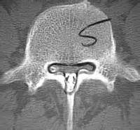
Congenital Spinal Stenosis

Slide 31
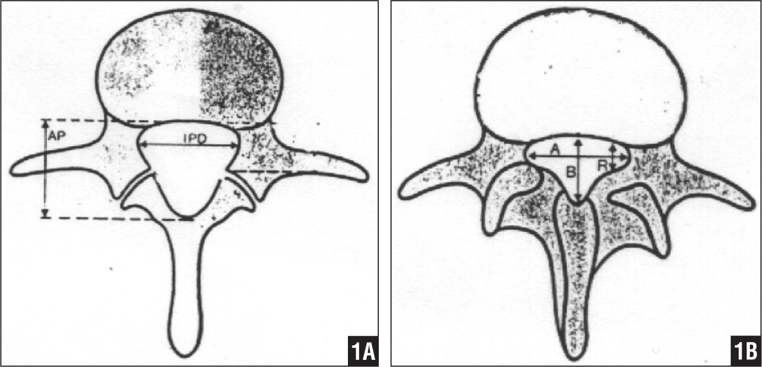

Slide 32
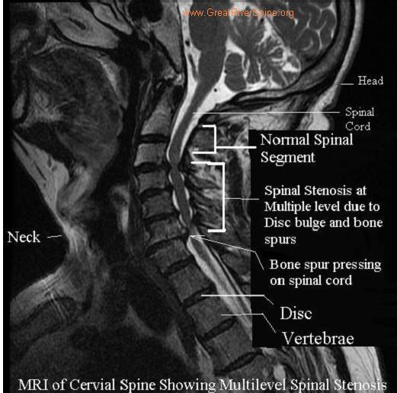

Slide 34
Myelomalacia
Post-traumatic softening of spinal cord due to hemorrhage or inadequate circulation to cord.
Initially, LMNL signs followed by UMNL signs
Often subtle signs initially
Frequently, misdiagnosed
MRI indicated
Spinal decompression might be of benefit

Slide 35
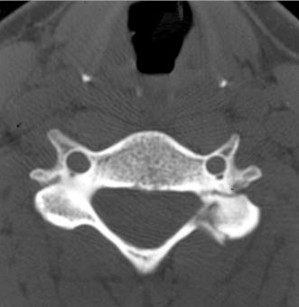
Diagnosis is the key to successful treatment…

Slide 36
Primum Non Nocere
CT scan showing C5 pedicle and facet fracture.

Slide 37
Signs of Cervical Myelopathy (CSM)
Unsteady walking
Disuse of hands
Numbness in the arms and hands
Atrophy
Twitching reflexes or muscles.

Slide 38
Unsteady walking
Everyday walking is a complex process that is a combination of brain and spinal cord input.
With cervical cord compression, an unsteady walking pattern can develop.
Some people can develop a wide based gait. Early signs of this can be tested in the office with tandem gait observation.

Slide 39
Disuse of hands
Another sign of cervical spondylotic myelopathy (CSM) will present itself with hand dysfunction. Ask if patient has a difficult time holding a cup of coffee or buttoning their clothes.

Slide 40
Numbness in the arms and hands
As the cervical spinal cord is compressed, the spinal nerves will be impacted. This can lead to numbness in the arms and hands (paresthesias).
Unlike carpal tunnel syndrome, cervical myelopathy will often involve numbness throughout the arm and hand.
Cervical radiculopathy can cause numbness in the arms and hands but is usually limited to specific dermatomes.

Slide 41
Atrophy
With continued compression of the cervical spinal cord, the innervation to the muscles in the arms and hands can be diminished. As a result, the muscles can diminish in size and demonstrate atrophy of the involved musculature.

Slide 42
Twitching reflexes of muscles
Hyperreflexia is described by the patient as a twitching of the muscles.
The upper and lower extremity reflexes are mediated by the corticospinal tract.
The loss of inhibition results in hyperreflexia and the presence of pathological reflexes.

Slide 43
Cervical Spondylotic Myelopathy: A Common Cause of Spinal Cord Dysfunction in Older Persons
WILLIAM F. YOUNG, M.D., Temple University Hospital, Philadelphia, Pennsylvania
Am Fam Physician. 2000 Sep 1;62(5):1064-1070.

Slide 44
Cervical Spondylotic Myelopathy
Cervical spondylotic myelopathy (CSM) is the most common spinal cord disorder in persons more than 55 years of age in North America and perhaps in the world.

Slide 45
Cervical Spondylotic Myelopathy
The aging process results in degenerative changes in the cervical spine that, in advanced stages, can cause compression of the spinal cord.

Slide 46
Cervical Spondylotic Myelopathy
Symptoms often develop insidiously and are characterized by neck stiffness, arm pain, numbness in the hands, and weakness of the hands and legs.

Slide 47
Cervical Spondylotic Myelopathy
The differential diagnosis includes any condition that can result in myelopathy, such as multiple sclerosis, amyotrophic lateral sclerosis and masses (such as metastatic tumors) that press on the spinal cord.

Slide 48
Cervical Spondylotic Myelopathy
The diagnosis is confirmed by magnetic resonance imaging that shows narrowing of the spinal canal caused by osteophytes, herniated discs and ligamentum flavum hypertrophy.

Slide 49
Cervical Spondylotic Myelopathy
Choice of treatment remains controversial, surgical procedures designed to decompress the spinal cord and, in some cases, stabilize the spine are successful in many patients.
WILLIAM F. YOUNG, M.D Cervical Spondylotic Myelopathy: A Common Cause of Spinal Cord Dysfunction in Older Persons. Am Fam Physician. 2000 Sep 1;62(5):1064-1070.

Slide 50
Cervical Cord Compression
Cervical compression tests and active cervical flexion may elicit signs of myelopathy rather than radiculopathy

Slide 51
Lhermitte’s Sign
Patient may report an electrical shock-like sensation shooting down the spine and any combination of extremities with certain head movements or postures, especially active cervical flexion.

Slide 52
Lhermitte’s Sign
The sign suggests a lesion of the dorsal columns of the cervical cord or of the caudal medulla.

Slide 53
Lhermitte’s Sign
Although often considered a classic finding in multiple sclerosis, it can be caused by compression of the spinal cord in the neck from any cause such as cervical spondylosis, disc herniation, tumor, and Arnold-Chiari malformation.

Slide 54
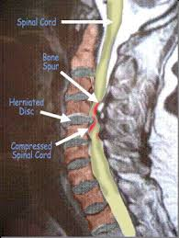

Slide 55
Delayed onset Lhermitte's sign has been reported following head and/or neck trauma.
This occurs ~2 1/2 months following injury, without associated neurological symptoms or pain, and typically resolves within 1 year.
Chan RC. & Steinbock P. (1984). "Delayed onset of Lhermitte's sign following head and/or neck injuries. Report of four cases.". J Neurolosurg 60 (3): 609–12.

Slide 56
Upper Motor Neuron Lesion
Injury of upper motor neurons is common because of the large amount of cortex occupied by the motor areas, and because motor pathways extend all the way from the cerebral cortex to the lower end of the spinal cord.

Slide 57
Upper Motor Neuron Lesion
Damage to the descending motor pathways anywhere along this trajectory gives rise to a set of symptoms called the upper motor neuron syndrome.
Damage to Descending Motor Pathways: The Upper Motor Neuron Syndrome. Neuroscience. 2nd edition. Purves D, Augustine GJ, Fitzpatrick D, et al., editors. Sunderland (MA): Sinauer Associates; 2001.

Slide 58
Upper Motor Neuron Lesion
Damage to the motor cortex or the descending motor axons in the internal capsule causes an immediate flaccidity of the muscles on the contralateral side of the body and face.

Slide 59
Upper Motor Neuron Lesion
This initial period of “hypotonia” after upper motor neuron injury is called spinal shock, and reflects the decreased activity of spinal circuits suddenly deprived of input from the motor cortex and brainstem.
Damage to Descending Motor Pathways: The Upper Motor Neuron Syndrome. Neuroscience. 2nd edition. Purves D, Augustine GJ, Fitzpatrick D, et al., editors. Sunderland (MA): Sinauer Associates; 2001.

Slide 60
Lower Motor Neuron Lesion
The symptoms that arise from damage to the lower motor neurons of the brainstem and spinal cord are referred to as the “lower motor neuron syndrome.”

Slide 61
Lower Motor Neuron Lesion
Damage to lower motor neuron cell bodies or their peripheral axons results in paralysis (loss of movement) or paresis (weakness) of the affected muscles.

Slide 62
Lower Motor Neuron Lesion
In addition to paralysis and/or paresis, the lower motor neuron syndrome includes a loss of reflexes (areflexia) due to interruption of the efferent (motor) limb of the sensory motor reflex arcs.

Slide 63
Lower Motor Neuron Lesion
Damage to lower motor neurons also entails a loss of muscle tone, since tone is in part dependent on the monosynaptic reflex arc that links the muscle spindles to the lower motor neurons

Slide 64
Lower Motor Neuron Lesion
A somewhat later effect is atrophy of the affected muscles due to denervation and disuse.

Slide 65
Lower Motor Neuron Lesion
The muscles involved may also exhibit fibrillations and fasciculations, which are spontaneous twitches characteristic of single denervated muscle fibers or motor units, respectively.

Slide 66
Lower Motor Neuron Lesion
These phenomena arise from changes in the excitability of denervated muscle fibers in the case of fibrillation, and from abnormal activity of injured α motor neurons in the case of fasciculations.

Slide 67
Lower Motor Neuron Lesion
These spontaneous contractions can be readily recognized in an electromyogram, providing an especially helpful clinical tool in diagnosing lower motor neuron disorders
Purves D, Augustine GJ, Fitzpatrick D, et al., editors. The Lower Motor Neuron Syndrome. Neuroscience. 2nd edition. Sunderland (MA): Sinauer Associates; 2001.

Slide 68
Characteristics of Motor Neuron Lesions
Upper (UMNL)
Hyper-reflexia
Pathological reflexes
Increased tone
Spastic paralysis
Clonus
Lower (LMNL)
Hypo-reflexia
Flaccid paralysis/paresis
Loss of tone
Atrophy
Fasciculations
Fibrillations
Reaction of degeneration

Slide 69
Three Part Peripheral Nervous System Examination
Deep Tendon Reflex Testing (Myotatic)
Motor Testing for Strength
Sensory Testing

Slide 70
Active Learning Task
Form groups of 4-5 learners
Select spokesperson
Create a putative SOAP note (10 minutes)
Present your case (2 minutes)

Slide 71
Engaged Learning Exercise
Create a putative SOAP note for a patient presenting with cervical spondylotic myelopathy (CSM).
Please write a narrative for subjective data gleaned from history
List examination procedures and anticipated objective findings
Assessment is CSM
Plan should include your management

Slide 72
References
Spinal cord emergencies: False reassurance from reflexes. Acad Emerg Med 1998.
WILLIAM F. YOUNG, M.D Cervical Spondylotic Myelopathy: A Common Cause of Spinal Cord Dysfunction in Older Persons. Am Fam Physician. 2000 Sep 1;62(5):1064-1070
Chan RC. & Steinbock P. (1984). "Delayed onset of Lhermitte's sign following head and/or neck injuries. Report of four cases.". J Neurolosurg 60 (3): 609–12.
Damage to Descending Motor Pathways: The Upper Motor Neuron Syndrome. Neuroscience. 2nd edition. Purves D, Augustine GJ, Fitzpatrick D, et al., editors. Sunderland (MA): Sinauer Associates; 2001.
Purves D, Augustine GJ, Fitzpatrick D, et al., editors. The Lower Motor Neuron Syndrome. Neuroscience. 2nd edition. Sunderland (MA): Sinauer Associates; 2001.

Slide 73
Suggested Readings
Cervical Spondylotic Myelopathy. http://www.aafp.org/afp/2000/0901/p1064.html
Recognizing Spinal Cord Emergencies. http://www.aafp.org/afp/2001/0815/p631.html

