Slide 1
Whiplash Associated Disorder: The pathway from acute to chronic pain (Hours 3-4)
James J. Lehman, DC, DIANM
Associate Professor of Clinical Sciences
Director
Health Sciences Postgraduate Education Department
University of Bridgeport

Slide 2
Learning Objectives
Able to evaluate and perform a differential diagnosis of a whiplash type injury patient.
Acute whiplash injury (G89.11) (Acute pain due to trauma)
Post-traumatic chronic pain syndrome (G89.21)
Post-traumatic, high-impact chronic pain (G89.21)

Slide 3
Recommendations prior to treating patients with whiplash injuries.
Discover mechanism of injury
Determine history of neck pain prior to whiplash injury
Reveal pain severity with Numerical Pain Rating Scale (NPRS)
Identify the injured tissues and pain generators
Understand biopsychosocial factors
Perform differential diagnosis
Determine a reasonable prognosis
Offer appropriate treatment with the use of a team of health care providers
Avoid nocebo effect and promote placebo effect…

Slide 4
Diagnosis is the key to successful treatment! Richard C. Ackerman, DC, FACO

Slide 5
Is the Whiplash Type Injury in a Chronic or Acute State?

Slide 6
How Do You Grade this Injury?

Slide 7
How Do You Determine if the Patient Will Develop a Chronic Pain Condition?

Slide 8
Patient Presentation
33-year-old female, self-employed lawyer with two associates
She is properly insured with disability, health insurance and med-pay
Rear-ended 7 days prior to initial encounter in your office
Denies prior neck injuries or neck pain
Chief concern of neck stiffness and aching in the lower cervical and upper thoracic spine. “My neck is stiff and it hurts.”
Able to work but distracted because of aching discomfort later in the work day

Slide 9
Differential Diagnosis Process
Intake form with pertinent data regarding injury
Medical records from ER or other providers
Neck Disability Index (NDI)
Patient interview or history taking
Create list of potential diagnoses
Physical examination
Rule-in and rule-out diagnoses
Working diagnosis (es)

Slide 10
Pathoanatomical Lesions in the Whiplash Injury
Cervical Facet joints (Zygapophyseal Joints)
Dorsal Root Ganglion (DRG) and Nerve Roots
Cervical Ligaments
Intervertebral Disc Injuries
Muscle Injuries
Fractures/Dislocations

Slide 11
Whiplash Injury Symptoms
Pain,
dizziness,
visual and auditory disturbances,
temporomandibular joint dysfunction,
photophobia,
dysphonia,
dysphagia,
fatigue,
cognitive difficulties such as concentration and memory loss, anxiety, insomnia, and depression (3)

Slide 12
Diagnosis and prognosis are the keys to successful treatment of whiplash associated disorder.

Slide 13
Subjective Data
Elicit a patient history and record the subjective findings in order to list potential diagnoses and use objective testing to rule-in and rule-out potential conditions.

Slide 14
Post-Whiplash Type Injury Interview
Intake form to cover all injury data (MVI, Slip and fall, lifting, etc.), past medical history, NDI, etc.
Medical records including ER
Focused L-T acronym
Chief concern
Open-end questions
Closed-end questions

Slide 15
Focused Interview or History Taking Process Using an Acronym
Location of pain/injury
Mechanism of injury
New injury/condition
Old injury/condition
Palliative/Provocative
Quality of pain
Radiations/Referred pain
Severity
Timing and Treatment

Slide 16
Subjective Data Identify the Pain Generating Tissue
Location of pain
Use finger point test
Palpate to confirm the pain generating tissue and specific location
Example:
Pain with palpation at right C1-3 posterior cervical muscles, facet capsules and the ligamentum nuchae

Slide 17
Subjective Data Be Specific
Location of pain
Right posterior upper cervical spine C1-3
Ligamentum nuchae C1-3
Potential tissues injured and painful
Cervical muscles (Strain)
Capsular ligaments and ligamentum nuchae (Sprain)
Osseous tissues (Fracture)

Slide 18
List of Potential Diagnoses Based on Subjective Data
Cervical strain
Cervical sprain
Cervical dislocation
Cervical fracture

Slide 19
Persistent Pain: A Chronic Illness
Acute pain usually goes away after an injury or illness resolves. But when pain persists for months or even years, long after whatever started the pain has gone or because the injury continues, it becomes a chronic condition and illness in its own right.
A Call to Revolutionize Chronic Pain Care in America: An Opportunity in Health Care Reform. The Mayday Fund. November 4, 2009. Amended March 4, 2010.

Slide 20
List of Potential Diagnoses Based on Subjective Data
Are these potential diagnoses acute or chronic?
Cervical strain
Cervical sprain
Cervical dislocation
Cervical fracture

Slide 21
Grading of Spinal Injury
Is this whiplash type injury an acute, mild, moderate, or severe soft or hard tissue injury to the cervical spine?
Can you describe the injuries?

Slide 22
Description of Tissue Injuries
Odontoid process fracture. The small fragment is rotated anteriorly and superiorly.
Portions of the ruptured cruciate ligament and of the rectorial membrane are entrapped in the wide fracture gap.
The apical ligament is avulsed. Only the dura is intact.
In addition in this specimen, uncovertebral and facet joint injuries as well as several disc avulsions (cartilaginous endplate separations) were found.

Slide 23
Soft Tissue Injury Grading
Grade 1 sprain of ligament/joint (Mild)
Overstretch or tear up to 5%
Grade 2 sprain of ligament/joint (Moderate)
Tear up to 50%
Grade 3 sprain of ligament/joint (Severe)
Rupture or complete 100% tear
Grade 4 sprain of ligament/joint/bone (Avulsion)
Complete tear with avulsion of bone

Slide 24
Soft Tissue Injury Grading
Grade 1 strain of muscle/tendon (Mild)
Overstretch or tear up to 5%
Grade 2 strain of muscle/tendon (Moderate)
Tear up to 50%
Grade 3 strain of muscle/tendon (Severe)
Rupture or complete 100% tear
Grade 4 strain of muscle/tendon/bone (Avulsion)
Complete tear with avulsion of bone

Slide 25
Case One = WAD I
Patient presents with neck complaints including stiffness or tenderness in the neck regions and no physical signs of injury.
Spitzer WO, Skovron ML, Salmi LR, et al. Scientific monograph of the Quebec Task Force on Whiplash-Associated Disorders: redefining “whiplash” and its management. Spine. 1995;20:1S–73S.
Most likely diagnosis is acute, mild cervical strain
Prognosis is good
Spontaneous recovery within 2-3 weeks is common.

Slide 26
Case Two: WAD II
Patient presents with neck complaints including stiffness or tenderness, and some physical signs of injury, such as point tenderness or trouble turning the head.
Acute, moderate cervical sprain/strain is most likely DX
Prognosis is difficult to predict
Current management does not appear to lessen transition from acute to chronic pain status
Physical and psychological impairment poorly addressed by treatments predictive of poor recovery

Slide 27
Case Three: WAD III
Patient presents with neck complaints including stiffness or tenderness and neurological signs of injury such as deep tendon reflex or motor deficits.
Acute, moderate sprain/strain with resultant cervical radiculopathy
Current management does not appear to lessen transition from acute to chronic pain status
Physical and psychological impairment poorly addressed by treatments predictive of poor recovery

Slide 28
Case Four: WAD IV
Patient presents with neck complaints with a fracture or dislocation of the cervical spine.

Slide 29
List of Potential Diagnoses Based on Subjective Data
Are these potential diagnoses mild, moderate or severe?
Cervical strain
Cervical sprain
Cervical dislocation
Cervical fracture

Slide 30
Objective Data Ruling-in and Ruling-out Diagnoses
Observation
Palpation
Range of motion
Orthopedic testing
Neurological testing
Laboratory

Slide 31
Objective Data Observation
Appearance
Stated age
Well-nourished
Well-developed
Distinguishing findings
Posture
Antalgic
Erect
Scoliosis (functional or structural)
Gait
Smooth or limping

Slide 32
Objective Data Observation of Posture
What do you see with this young patient?
Does she have scoliosis?
If yes, is it structural or functional?
What could be the cause (s) of this postural deviation?

Slide 33
Objective Data Postural Evaluation
Adam’s positon
Increased dorsal rib hump or increased curvature indicates a structural scoliosis
Reduction of spinal curvature indicates a functional scoliosis
What could be a cause (s) of functional scoliosis?

Slide 34
Objective Data Long Sit Testing

Slide 35
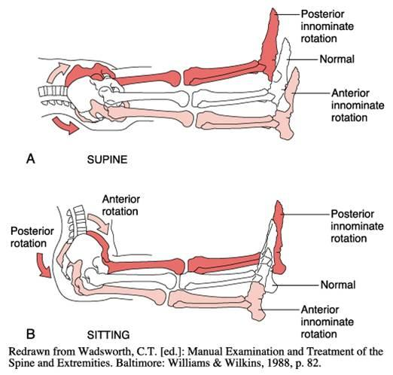

Slide 36
Objective Data Palpation (Flat/Pinching/Static)
Signs of inflammation
Dolar
Rubor
Calor
Tumor Provocative or pain producing
Painful ligaments
Painful, nodules in muscle
Painful muscles

Slide 37
Palpation Cervicogenic Headaches Neurogenic
Neurogenic
Occipital neuralgias
Greater Occipital (2nd Cervical)
Third Occipital

Slide 38
Cervicogenic Headaches Neurogenic
Differentiate Cranial and Occipital neuralgias

Slide 39
Objective Data Range of Motion (ROM)
Active
First ROM
General findings of pain and restriction or full ROM without pain
Passive
Pain and restriction indicates ligament and/or joint injury (Sprain)
Resistive
Pain and restriction indicates muscle and/or tendon injury (Strain)

Slide 40
L’Hermitte’s Sign Spinal Cord Compression Pain
Stabbing or lightning-like pain shooting down the spine and any combination of the extremities
Active or passive flexion or extension of the cervical spine

Slide 41
Objective Data Orthopedic Testing
An orthopedic test is most often a provocative maneuver that reproduces the chief concern pain in order to identify the painful/injured tissue.
An orthopedic test may be positive when palliative.
Describe your findings
Do not list + or – indicators alone
Do not state a diagnosis based upon an orthopedic test alone

Slide 42
Objective Data Orthopedic Testing
Passive compression of the cervical spine in lateral flexion, rotation, and extension produced localized pain at C 5-6 left with radiating pain down the left upper extremity to the thumb and index finger.

Slide 43
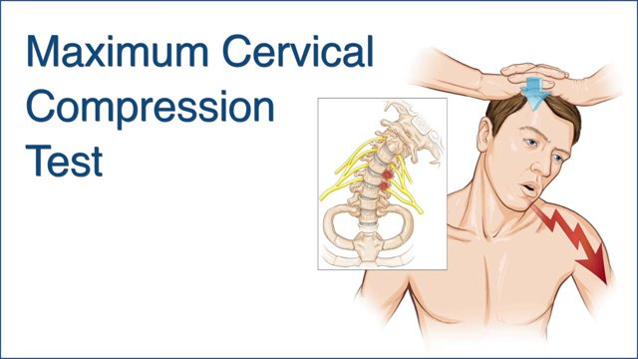
Objective Data Cervical Spine Orthopedic Testing
Cervical compression and distraction
Neutral, flexion and extension cervical compression
Active and passive maximum cervical compression with lateral flexion, rotation and extension

Slide 44
Objective Data Orthopedic Testing
Chart the specific findings in order to determine the injured tissue
Cervical compression + does not tell the story or demonstrate objective findings.

Slide 45
Upper Cervical Transverse Ligament Sprain Injuries Sharp Purser Test
Stand to the side of the patient and stabilize the C2 spinous process using pincer grasp.
Gently apply a posterior translation force from the palm of the hand into the patient's forehead
Assess symptoms for degree of linear translation and/or symptom provocation
Positive test would be reproduction of myelopathic symptoms during forward flexion or displacement during AP movement

Slide 46
Neurological Examination
Mental status
CNS examination
Cranial nerve examination
Three-part peripheral nerve examination
Deep tendon reflexes
Motor function
Sensory perception

Slide 47
Differentiate Upper Motor vs Lower Motor Neuron Lesions
UMNL
Spastic paralysis
Clonus present
Increased deep tendon reflexes
Pathological reflexes present
Weakness with atrophy absent
LMNL
Flaccid paralysis
Clonus absent
Reduced deep tendon reflexes
Pathological reflexes absent
Weakness with atrophy present

Slide 49
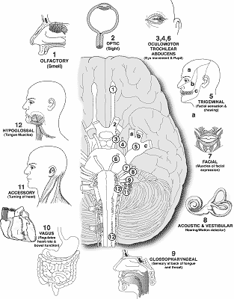

Slide 50
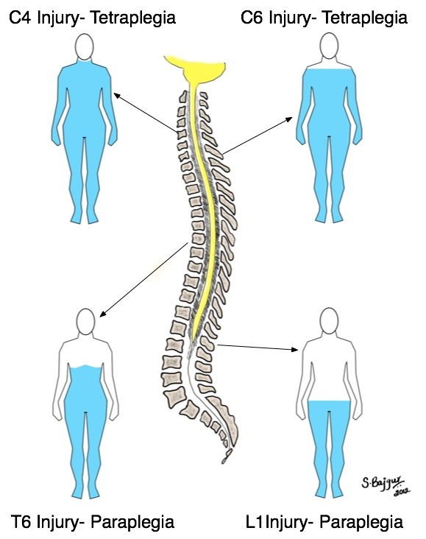

Slide 51
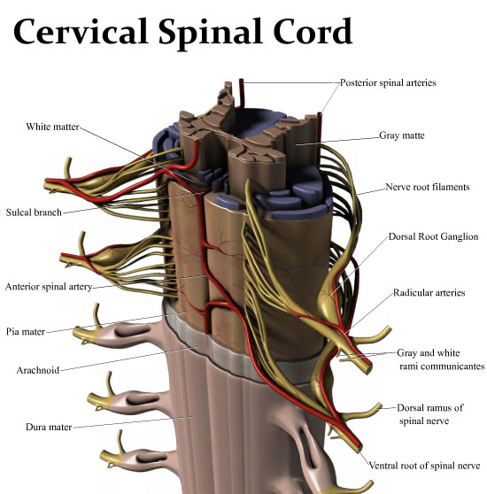

Slide 52
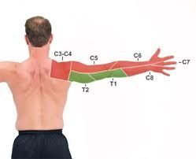

Slide 53
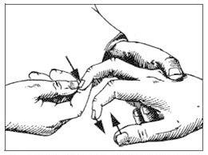

Slide 55
Neuromusculoskeletal Examination Videos Timothy Conwell, DC, FACO
Central Nervous System examination
https://www.youtube.com/watch?v=kZOcz0czWs4
Peripheral Nervous System examination https://www.youtube.com/watch?v=I7YF4vCBisQ
Spine and paraspinal examination https://www.youtube.com/watch?v=HegByhhb8sI

Slide 56
Diagnosis and prognosis are the keys to successful treatment of whiplash associated disorder.

Slide 57
Prognosis Post Whiplash Type Injury End of Healing Stage
Sprained ligaments heal with a cheaper grade of mesenchymal tissue = cicatrix or scar.
A scar left by the formation of new connective tissue over a healing sore or wound.
Scar tissue is avascular, pale, contracted, and firm after the earlier phase of soft tissue healing.

Slide 58
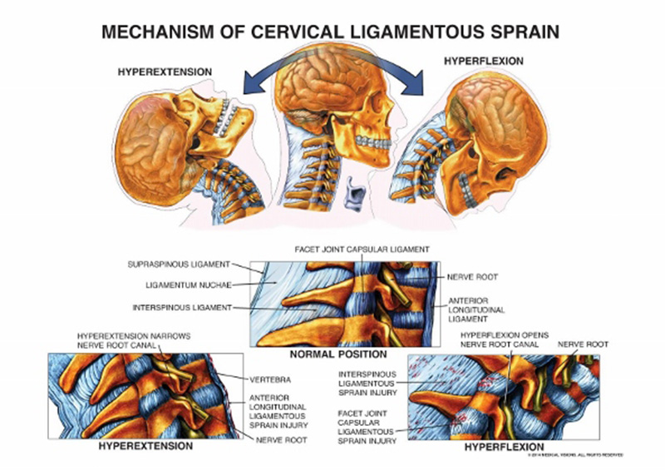

Slide 59
Prognosis Post Whiplash Type Injury
Post-traumatic chronic pain syndrome
Chronic myofascial pain syndrome
Degenerative joint and disc disease or “Cervical Spondylosis”

Slide 60
Digital Motion X-ray Examination Video-fluoroscopy
The videofluoroscopic (or DMX) examination of the cervical spine is a highly accurate test for identifying patients with symptomatic ligamentous instability after whiplash trauma.
The imaging modality should be utilized more widely in the clinical investigation of chronic post-whiplash pain.
Freeman MD, Katz EA, Rosa SL, Gatterman BG, Strömmer EMF, Leith WM. Diagnostic Accuracy of Videofluoroscopy for Symptomatic Cervical Spine Injury Following Whiplash Trauma. Int J Environ Res Public Health. 2020;17(5):1693. Published 2020 Mar 5. doi:10.3390/ijerph17051693.

Slide 61
Cervical Spine Video Fluoroscopy Laxity of Cervical Ligaments
https://www.bing.com/videos/search?&q=dmx+cervical+joint+motion+study&view=detail&mid=5334B2FF765DA5E1BB185334B2FF765DA5E1BB18&FORM=VDRVRV&ajaxhist=0

Slide 62
Cervical Spine Video Fluoroscopy Laxity of Cervical Ligaments
https://www.bing.com/videos/search?&q=dmx+cervical+joint+motion+study&view=detail&mid=2EE7636B941539A156ED2EE7636B941539A156ED&FORM=VDRVSR&ajaxhist=0

Slide 63
Digital Motion X-ray and Post Whiplash Testimonial
https://www.bing.com/videos/search?&q=dmx+cervical+joint+motion+study&view=detail&mid=08381EA990B4B6AAA05B08381EA990B4B6AAA05B&FORM=VDQVAP&ajaxhist=0&rvsmid=2EE7636B941539A156ED2EE7636B941539A156ED

Slide 64
Post Whiplash Cervical Spine Fracture
https://www.bing.com/videos/search?q=dmx+cervical+joint+motion+study&&view=detail&mid=D1F938F5AA32C79EB8A5D1F938F5AA32C79EB8A5&&FORM=VDRVRV

Slide 65
Post Whiplash Injury to the Cervical Spine with Arm Pain MRI Exam
https://www.bing.com/videos/search?q=dmx+cervical+joint+motion+study&&view=detail&mid=9737C11761F38B2E00BE9737C11761F38B2E00BE&rvsmid=D1F938F5AA32C79EB8A5D1F938F5AA32C79EB8A5&FORM=VDQVAP

Slide 66
Prolotherapy
https://video.search.yahoo.com/yhs/search;_ylt=AwrhRoJ7Aydk9A0PMQUPxQt.;_ylu=Y29sbwNiZjEEcG9zAzEEdnRpZAMyNTQzNFlIU0NfMQRzZWMDcGl2cw--?p=prolotherapy+post+whiplash+DMX&type=sdff_9527_FFW_ZZ&hsimp=yhs-3&hspart=iba&grd=1&ei=UTF-8&fr=yhs-iba-3#id=14&vid=5a639c2e6e864201cc6a29fbf6606ea5&action=view
Dextrose prolotherapy is more effective in the treatment of chronic pain com- pared to saline injection or exercise.
Its effect was comparable to that of platelet-rich plasma or steroid injection.
Bae G, Kim S, Lee S, Lee WY, Lim Y. Prolotherapy for the patients with chronic musculoskeletal pain: systematic review and meta-analysis. Anesth Pain Med (Seoul). 2021 Jan;16(1):81-95. doi: 10.17085/apm.20078. Epub 2020 Dec 16. PMID: 33348947; PMCID: PMC7861898

Slide 67
Prolotherapy and Digital Motion X-ray
https://video.search.yahoo.com/yhs/search;_ylt=AwrhRoJ7Aydk9A0PMQUPxQt.;_ylu=Y29sbwNiZjEEcG9zAzEEdnRpZAMyNTQzNFlIU0NfMQRzZWMDcGl2cw--?p=prolotherapy+post+whiplash+DMX&type=sdff_9527_FFW_ZZ&hsimp=yhs-3&hspart=iba&grd=1&ei=UTF-8&fr=yhs-iba-3#id=5&vid=cccbfce13e90e0928ba6d7e0d37b8355&action=view
https://video.search.yahoo.com/yhs/search;_ylt=AwrhRoJ7Aydk9A0PMQUPxQt.;_ylu=Y29sbwNiZjEEcG9zAzEEdnRpZAMyNTQzNFlIU0NfMQRzZWMDcGl2cw--?p=prolotherapy+post+whiplash+DMX&type=sdff_9527_FFW_ZZ&hsimp=yhs-3&hspart=iba&grd=1&ei=UTF-8&fr=yhs-iba-3#id=7&vid=4df1f5faf03bc9d44012f2ba140e67ff&action=view

Slide 68
Diagnosis, Prognosis and Treatment Recommendations
How you advise your patient of the diagnosis, prognosis and treatment may affect the patient response.

Slide 69
Placebo versus Nocebo Effects
The “placebo” effect is related to the perceptions and expectations of the patient
If the intervention is viewed as helpful, it can heal, but, if it is viewed as harmful, it can cause negative effects, which is known as the “nocebo” effect.

Slide 70
Recommendations prior to treating patients with whiplash injuries.
Discover mechanism of injury
Determine history of neck pain prior to whiplash injury
Reveal pain severity with Numerical Pain Rating Scale (NPRS)
Identify the injured tissues and pain generators
Understand biopsychosocial factors (Neck Disability Index [NDI])
Perform differential diagnosis
Determine a reasonable prognosis
Offer appropriate treatment with the use of a team of health care providers
Avoid nocebo effect and promote placebo effect…

Slide 71
Patient Presentation
33-year-old female, self-employed lawyer with two associates
She is properly insured with disability, health insurance and med-pay
Rear-ended 7 days prior to initial encounter in your office
Denies prior neck injuries or neck pain
Chief concern of neck stiffness and aching in the lower cervical and upper thoracic spine
Able to work but distracted because of aching discomfort later in the work day

Slide 72
Engaged Learning Task (30 minutes)
Form groups of 3-4
Select a spokesperson who will provide a brief presentation
Determine appropriate evaluation including history and physical examination
Perform differential diagnosis
Recommend treatment plan
Give prognosis
Chart with SOAP process

Slide 73
Spokesperson Will Present and Defend Your Work
Another group will be selected to question the presentation.
Do you agree with evaluation?
Do you agree with list of potential diagnoses and working diagnosis?
Do you agree with the prognosis and treatment recommendations?

Slide 74
Recommendations prior to treating patients with whiplash injuries.
Discover mechanism of injury
Determine history of neck pain prior to whiplash injury
Reveal pain severity with Numerical Pain Rating Scale (NPRS)
Identify the injured tissues and pain generators
Understand biopsychosocial factors
Perform differential diagnosis
Determine a reasonable prognosis
Offer appropriate treatment with the use of a team of health care providers
Avoid nocebo effect and promote placebo effect…

Slide 75
References
Barnsley L, Lord S, Bogduk N. Whiplash injury. Pain. 1994;58:283–307.
Spitzer WO, Skovron ML, Salmi LR, et al. Scientific monograph of the Quebec Task Force on Whiplash-Associated Disorders: redefining “whiplash” and its management. Spine. 1995;20:1S–73S.
Elliot JM, et al. Characterization of Acute and Chronic Whiplash-Associated Disorders. Journal of Orthopaedic & Sports Physical Therapy, 2009, Volume: 39 Issue: 5 Pages: 312-323.
Jouko Kivioja, Irene Jensen, and Urban Lindgren. Neither the WAD-classification nor the Quebec Task Force follow-up regimen seems to be important for the outcome after a whiplash injury. A prospective study on 186 consecutive patients. Eur Spine J. 2008 Jul; 17(7): 930–935.
Hasue M. Pain and the nerve root. An interdisciplinary approach. Spine. 1993;18:2053-2058.
Jansen J, Bardosi A, Hildebrandt J, Lucke A. Cervicogenic, hemicranial attacks associated with vascular irritation or compression of the cervical nerve root C2. Clinical manifestations and morphological findings. Pain. 1989;39:203-212.
Kaale BR, Krakenes J, Albrektsen G, Wester K. Head position and impact direction in whiplash injuries: associations with MRI-verified lesions of ligaments and membranes in the upper cervical spine. J Neurotrauma. 2005;22:1294-1302.
Kaale BR, Krakenes J, Albrektsen G, Wester K. Whiplash-associated disorders impairment rating: neck disability index score according to severity of MRI findings of ligaments and membranes in the upper cervical spine. J Neurotrauma. 2005;22:466-475.
Jonsson H, Jr, Bring G, Rauschning W, Sahlstedt B. Hidden cervical spine injuries in traffic accident victims with skull fractures. J Spinal Disord. 1991;4:251.
Pettersson K, Hildingsson C, Toolanen G, Fagerlund M, Bjornebrink J. Disc pathology after whiplash injury. A prospective magnetic resonance imaging and clinical investigation. Spine. 1997;22:283-287; discussion 288.263.

Slide 76
References
11. Borchgrevink GE, Kaasa A, McDonagh D, Stiles TC, Haraldseth O, Lereim I. Acute treatment of whiplash neck sprain injuries. A randomized trial of treatment during the first 14 days after a car accident. Spine. 1998;23:25-31.
12. Kasch H, Qerama E, Bach FW, Jensen TS. Reduced cold pressor pain tolerance in non-recovered whiplash patients: a 1-year prospective study. Eur J Pain. 2005;9:561-569.
13. Tjell, C. and U. Rosenhall (1998). “Smooth pursuit neck torsion test: a specific test for cervical dizziness.” Otology & Neurotology 19(1): 76.
14. Treleaven, J., G. Jull, et al. (2003). “Dizziness and unsteadiness following whiplash injury: characteristic features and relationship with cervical joint position error.” Journal of Rehabilitation Medicine 35(1): 36-43.
15. Treleaven, J., G. Jull, et al. (2005). “Smooth pursuit neck torsion test in whiplash-associated disorders: relationship to self-reports of neck pain and disability, dizziness and anxiety.” Journal of Rehabilitation Medicine 37(4): 219-223.
16. Treleaven, J., G. Jull, et al. (2005). “Standing balance in persistent whiplash: a comparison between subjects with and without dizziness.” Journal of Rehabilitation Medicine 37(4): 224-229.
17. Jull, G., D. Falla, et al. (2007). “Retraining cervical joint position sense: The effect of two exercise regimes.” Journal of Orthopaedic Research 25(3): 404-412.
18. Treleaven J, Jull G, Sterling M. Dizziness and unsteadiness following whiplash injury: characteristic features and relationship with cervical joint position error. J Rehabil Med. 2003 Jan;35(1):36--‐43.
19. Sterling M, et al. Sensory hypersensitivity occurs soon after whiplash injury and is associated with poor recovery Pain 104 (2003) 509-517.
20. Adams JH, Doyle D, Ford I, Gennarelli TA, Graham DI, McLellan DR. Diffuse axonal injury in head injury: definition, diagnosis and grading. Histopathology. 1989; 15: 49–59.
21. Walton DM, & Elliott JM. An Integrated Model of Chronic Whiplash-Associated Disorder. Journal of Orthopedic and Sports Physical Therapy. July 2017, Volume 47, Number 7.

