Slide 1
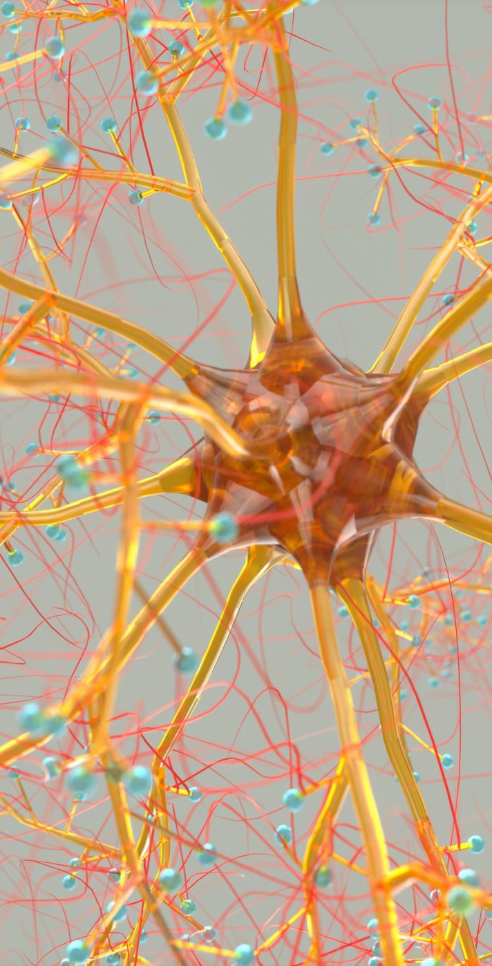
Peripheral Nerve Entrapment and Injuries of the Upper Extremity
James J. Lehman, DC, MBA, DIANM
Associate Professor of Clinical Sciences
University of Bridgeport
School of Chiropractic
Director, Health Sciences Postgraduate Education
Program director: Chiropractic Residency

Slide 2
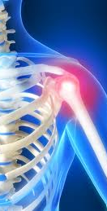
Learning Objectives
Correlate shoulder anatomy and the patients’ signs and symptoms.
Locate the shoulder lesion(s) and
Properly record the findings.

Slide 3

Learning Objectives
Elicit a patient history and record the subjective findings in order to perform differential diagnosis of a shoulder injury and use objective testing to rule-in and rule-out shoulder conditions.

Slide 4

Learning Objectives
Perform a shoulder evaluation and record the objective findings in order to make an assessment of a shoulder injury to the axillary nerve.

Slide 5
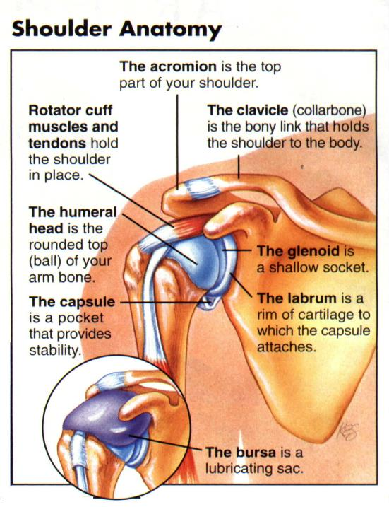

Slide 6
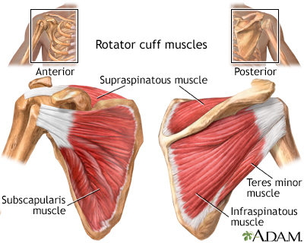
Peripheral Nerve Entrapment and Injury in the Upper Extremity
Athletic injuries to the shoulder most commonly involve the rotator cuff, glenohumeral joint, and acromioclavicular joint.
Hirasawa Y. Injuries to peripheral nerve in sport. Semin Orthop. 1988;3: 240-248.

Slide 7

Peripheral Nerve Injuries
Although less common, peripheral nerve injuries about the shoulder during athletic competition have increased along with the general interest in recreational athletics.
Hirasawa Y. Injuries to peripheral nerve in sport. Semin Orthop. 1988;3: 240-248.

Slide 8
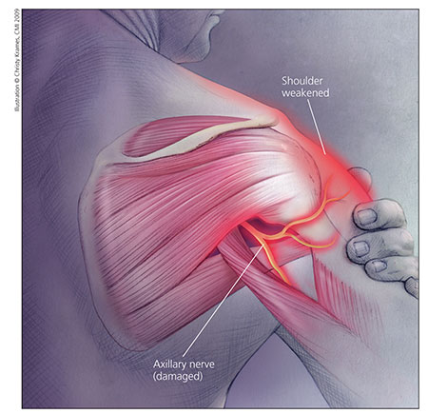
Axillary Nerve Compression
The axillary nerve is the most commonly injured nerve around the shoulder in both athletes and nonathletes.
Gregg JR, Labosky D, Harty M, et al. Serratus anterior paralysis in the
young athlete. J Bone Joint Surg Am. 1979;61:825-832.

Slide 9
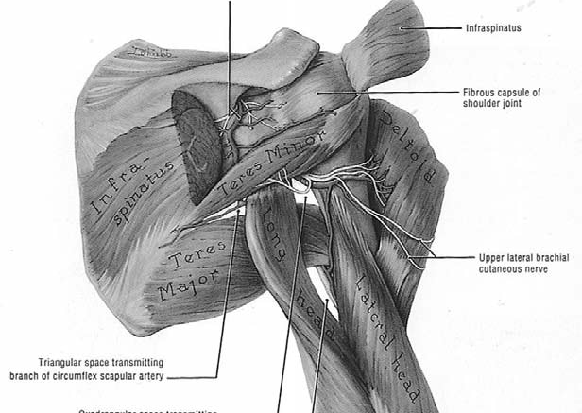

Slide 10
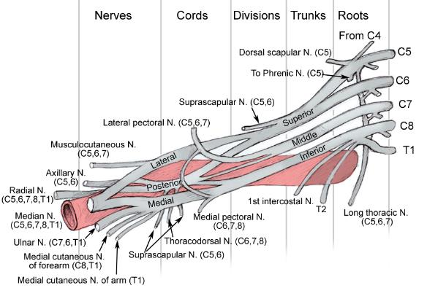
Axillary Nerve Compression
The axillary nerve originates from the posterior cord of the brachial plexus near the coracoid and is composed of fibers from the fifth and sixth cervical nerve roots

Slide 11
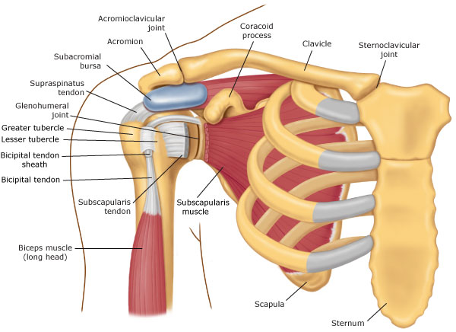

Slide 12
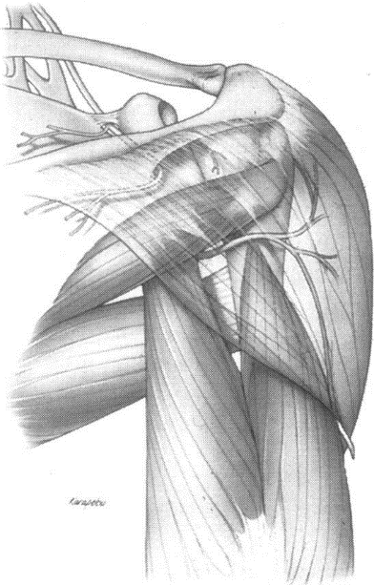
Axillary Nerve Compression
The nerve passes through the quadrilateral space close to the inferior shoulder joint capsule.

Slide 13
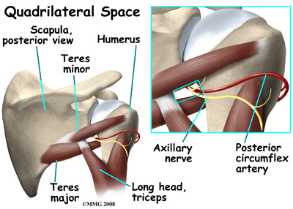

Slide 14
Axillary Nerve Compression
The nerve then divides into anterior and posterior branches, which supply the anterior and posterior portions of the deltoid muscles. A small branch that arises posteriorly innervates the teres minor and posterior deltoid muscles and supplies the skin overlying the deltoid muscle insertion.

Slide 15
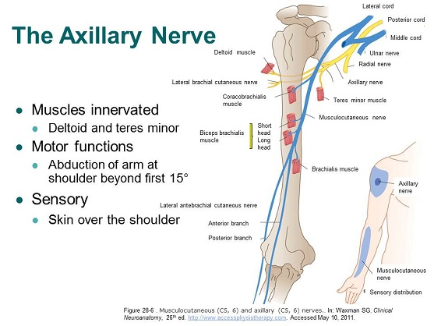

Slide 16
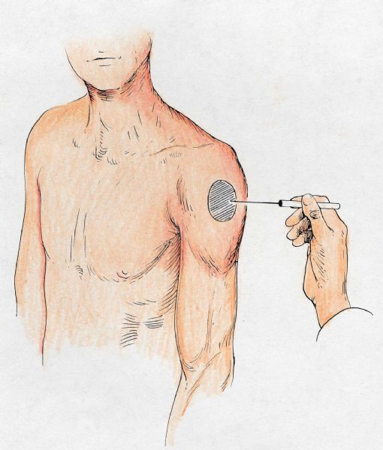

Slide 17
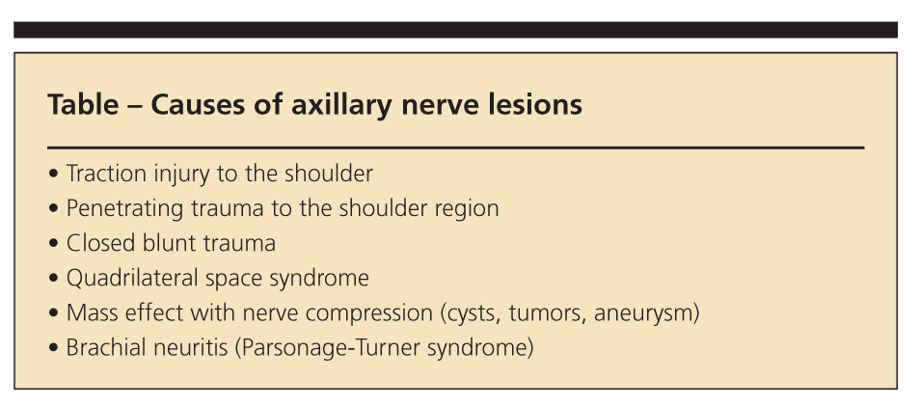

Slide 18
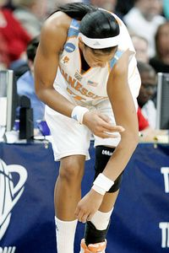
Axillary Nerve Compression
Axillary nerve injuries most commonly occur after anterior
shoulder dislocation, a common athletic injury.
Katzman BM, Bozentka DJ. Peripheral nerve injuries secondary to
missiles. Hand Clin. 1999;15:233-244.

Slide 19
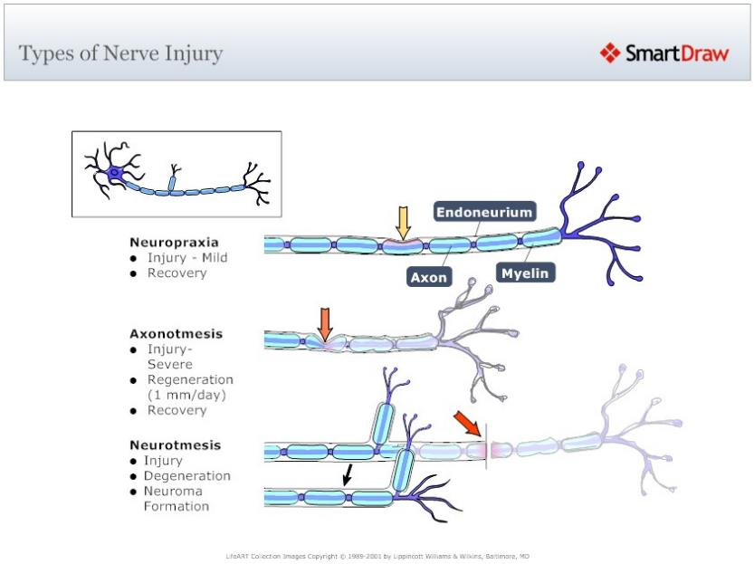

Slide 20
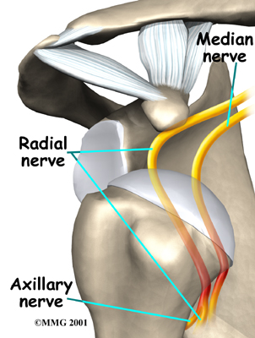
Axillary Nerve Compression
Inferior dislocations, luxatio erectae, have an even higher rate of axillary nerve palsy, reported as high as 60%.
Mallon WJ, Bassett FH III, Goldner RD. Luxatio erecta: the inferior glenohumeral dislocation. J Orthop Trauma. 1990;4:19-24.

Slide 21
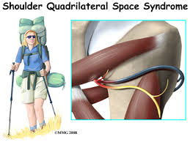
Axillary Nerve Compression
Acute axillary neuropathy has also been associated with backpacking, usually in inexperienced
hikers.
Katzman BM, Bozentka DJ. Peripheral nerve injuries secondary to missiles. Hand Clin. 1999;15:233-244.

Slide 22
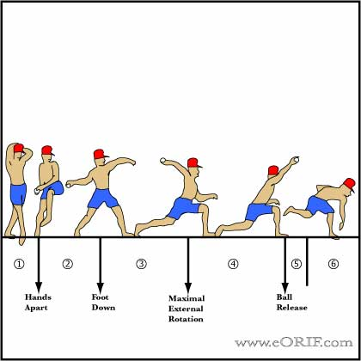
Chronic Axillary Nerve Compression
Quadrilateral space syndrome represents a chronic compression
syndrome of the axillary nerve in throwing athletes.

Slide 23
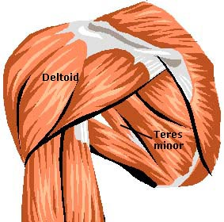
Axillary Nerve Compression
Fibrous bands at the inferior edge of the teres minor have been implicated, as have randomly oriented fibrous bands found in the quadrilateral space.

Slide 24
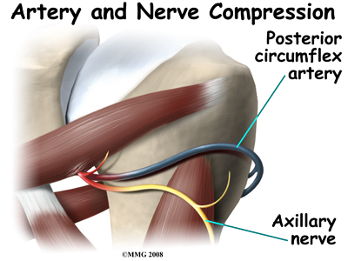
Axillary Nerve Compression
Axillary nerve entrapment may occur insidiously in the quadrilateral space without history of trauma.

Slide 25
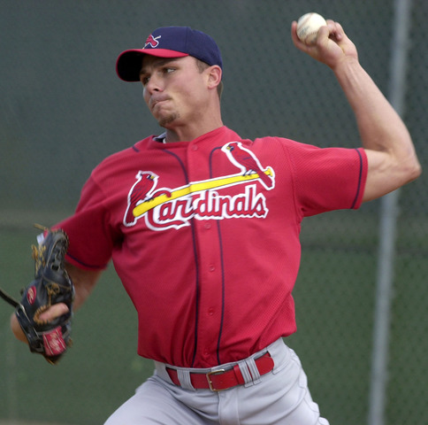
Axillary Nerve Compression
Both the axillary nerve and the posterior humeral circumflex artery are compressed in the quadrilateral space when the arm is placed in the abducted, externally rotated or throwing position.
Redler MR, Ruland LJ IH, McCue FC IH. Quadrilateral space syndrome in a throwing athlete. Am J Sports Med. 1986;14:511-513.

Slide 26
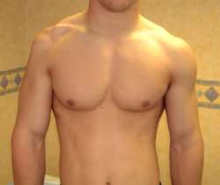
Acute Axillary Nerve Compression
In the acute setting, the athlete classically presents with weakness in abduction, decreased sensation along the deltoid muscle insertion, progressive atrophy of the deltoid muscle, and subluxation of the glenohumeral joint.

Slide 27
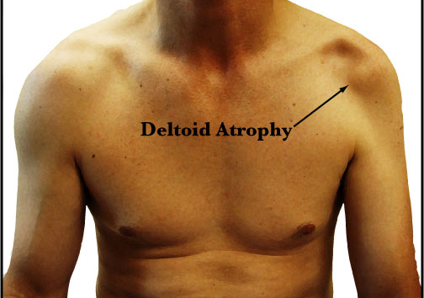

Slide 28
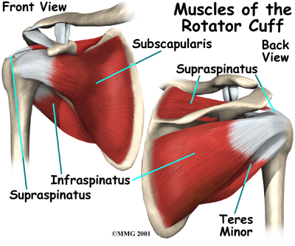
Acute Axillary Nerve Compression
Pain is not a prominent complaint, and deltoid weakness is often masked by surrounding muscle groups that compensate for its function.
Alnot JY. Traumatic brachial plexus palsy in the adult: retro- and infraclavicular lesions. Clin Orthop. 1988;237:9-16.

Slide 29
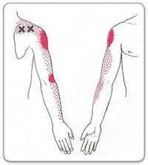
Quadrilateral Space Syndrome (QSS)
The athlete who has QSS will typically complain of vague pain in the shoulder and around the shoulder that can radiate as far distally as the forearm in a nondermatomal pattern.

Slide 30
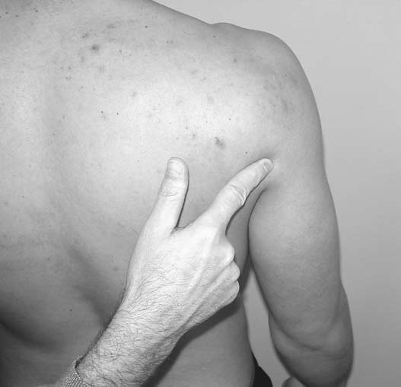
Location of Quadrilateral Space
There is often isolated tenderness in response to palpation over the quadrilateral space.

Slide 31
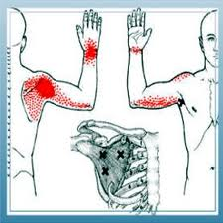
Quadrilateral Space Syndrome
Active range of motion for external rotation of the shoulder is typically full, but is painful at the end-range.

Slide 32
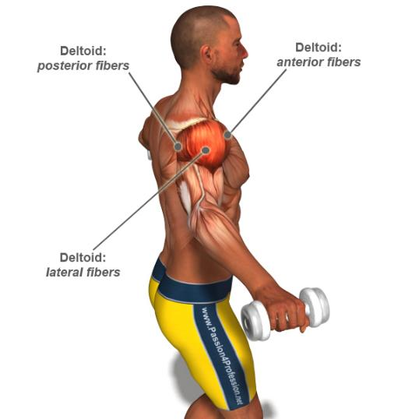
Axillary Nerve Compression
Conservative management consisting of observation and physical therapy is successful in managing most axillary nerve injuries in athletes.
Bateman JE. Nerve injuries about the shoulder in sports. J Bone Joint Surg
Am. 1967;49:785-792.

Slide 33
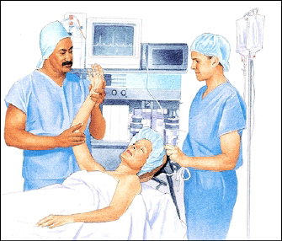
Conservative Management
At least six months of conservative management is recommended before surgical intervention is performed.
Dugas JR, Weiland AJ. Vascular pathology in the throwing athlete. Hand Clin. 2000;16:477-485.

Slide 34
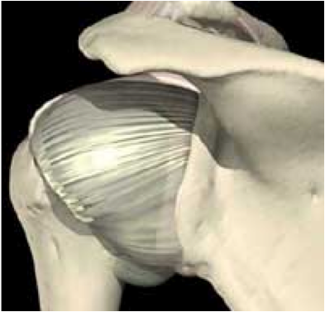
Quadrilateral Space Syndrome
Hoskins et al. suggested that the posterior capsule should be addressed as part of the cause of a dysfunctional arthrokinematic pattern of motion.
Hoskins WT, Pollard HP, McDonald AJ. Quadrilateral space syndrome: a case study and review of the literature. Br J Sports Med. 2005;39:e9.

Slide 35
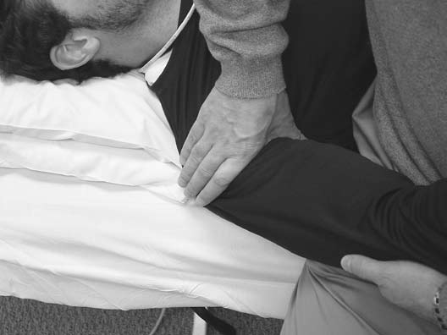

Slide 36
Case Report
A 57 year-old male professor woke today with severe neck pain and stiffness after sleeping on a new, memory foam, contoured pillow. In addition, he was unable to abduct, internally or externally rotate his left shoulder due to severe, sharp, stabbing pain in the area of the mid-deltoid muscle. He rated the severity at 10/10 with a previous 10 being severe muscle spasms due to dehydration.

Slide 37
Case Report
He had never experienced a similar episode of left shoulder pain but due to a MVA in 1987, which fractured seven teeth, sprained his hands and spine and ruptured two cervical discs (C4-5-6), he has experienced painful episodes of neck pain. Chiropractic spinal manipulation and massage, hot showers and stretching normally reduces the neck pain and stiffness.

Slide 38
Active Learning Task
List 5 additional questions necessary to gain additional subject data
List orthopedic and neurological testing necessary to gain additional objective data
List 5 differential diagnoses
Record your working diagnosis
Present and defend your work

Slide 39


