Slide 1

Spinal Cord Emergency and Cervical Spondylotic Myelopathy
James J. Lehman, DC, MBA, FACO
Associate Professor of Clinical Sciences
University of Bridgeport College of Chiropractic
Director
Community Health Clinical Education
University of Bridgeport

Slide 2
Learning Objectives
Recognize signs of spinal cord emergency.
Correlate anatomy and the patients’ signs and symptoms in order to identify cervical spondylotic myelopathy (CSM).

Slide 3
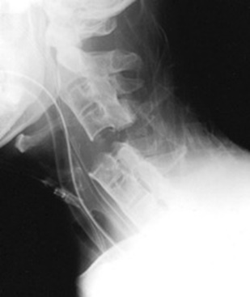
Spinal Cord Injuries (SCI)
SCI are critical emergencies that must be recognized and treated early to increase the possibility of preventing permanent loss of function.
Spinal cord emergencies: False reassurance from reflexes. Acad Emerg Med 1998.

Slide 4
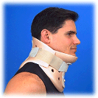
History and Clinical Presentation
…can provide the most important information in the assessment of a possible emergency.

Slide 5

Red Flags
Night pain/sweats/fever
Unexpected weight loss
Bowel and bladder dysfunction
Long tract signs
Signs of neurogenic claudication
Weakness and paresthesias in extremities

Slide 6
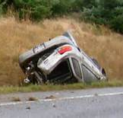
Cervical Spine Fracture/Dislocation
Suspect upper cervical spine instability
History of roll-over MVA or blow to head

Slide 7
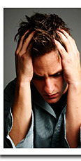
Rust’s Sign
May grab head upon removal of cervical collar
May use hand to lift head when rising from supine position

Slide 8
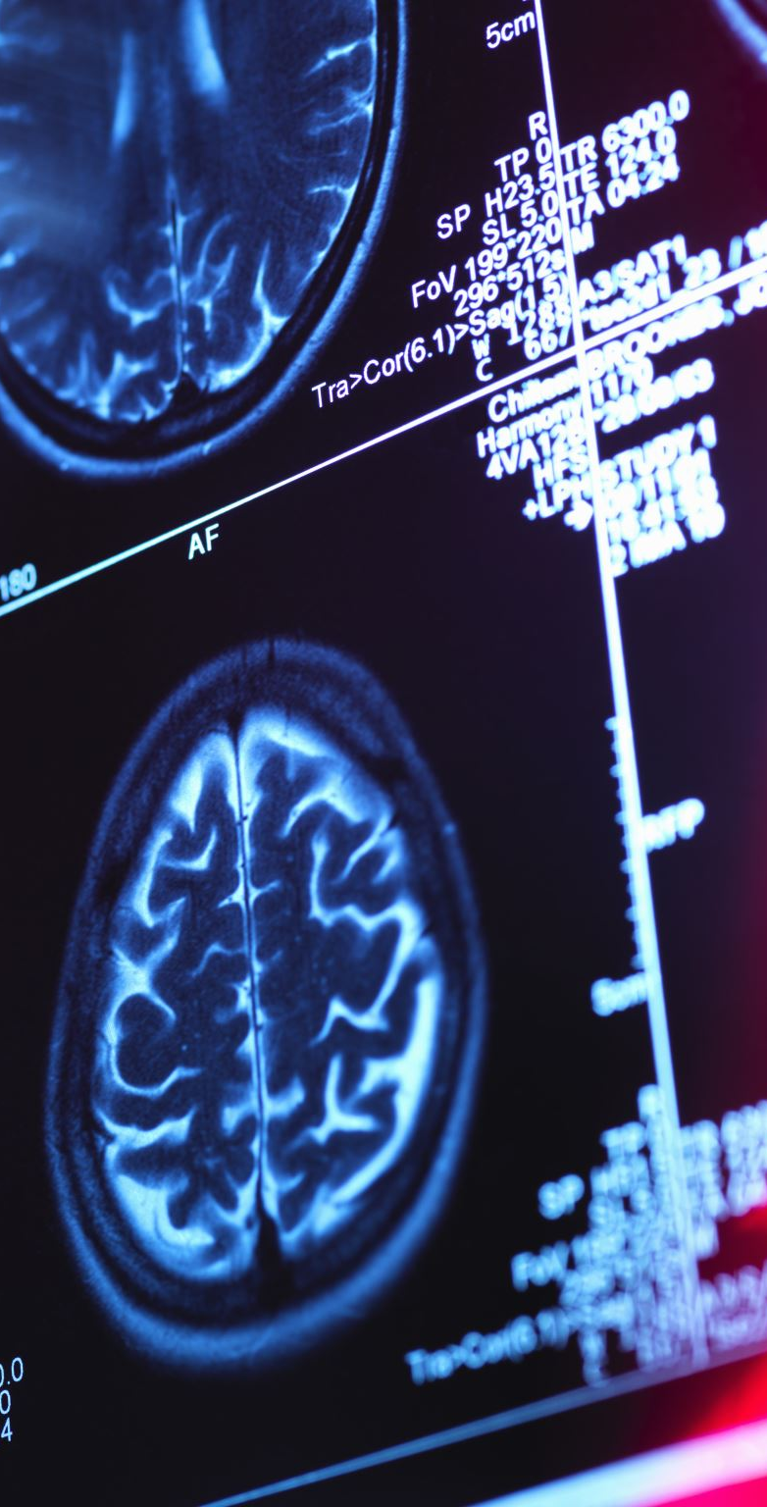
Rust’s Sign
Patient is attempting to stabilize the head with slight traction and reduce pain
Patient presents guarded movements
Imaging studies must proceed any provocative testing
CT scan is indicated with acute trauma to the cervical spine when radiographic examination is negative.

Slide 9
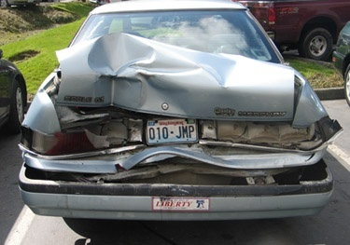
Rust Sign
Rear-end MVA
Patient is unable to rise from supine posture without holding hand behind head
Suspect moderate to severe sprain/strain

Slide 10
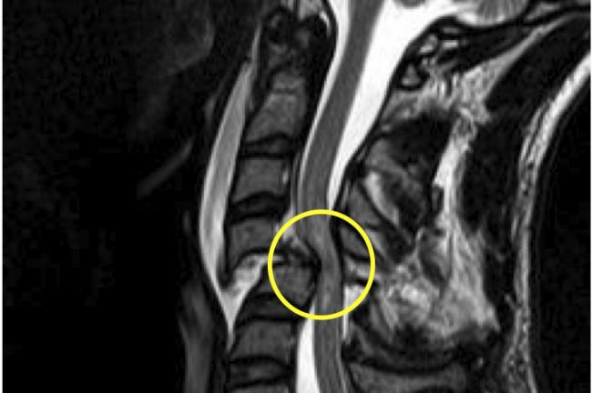
Recognizing Spinal Cord Injuries Differential Diagnosis
Spinal cord compression secondary to vertebral fracture or space occupying lesion.

Slide 11
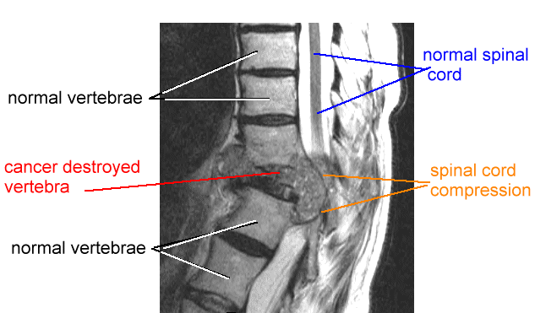
Recognizing Spinal Cord Injuries Differential Diagnosis
Spinal cord compression secondary to vertebral fracture or space occupying lesion.

Slide 12
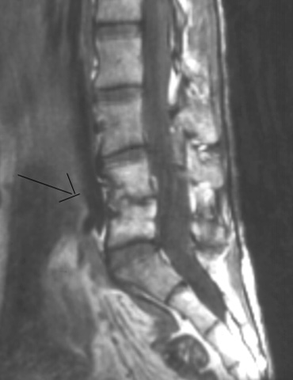
Spinal Infection
“Discitis”
Acute onset of neck or back pain
HX of infection
Current fever
Elevated SED rates or WBC count
Frequently misdiagnosed in ER
MRI indicated

Slide 13
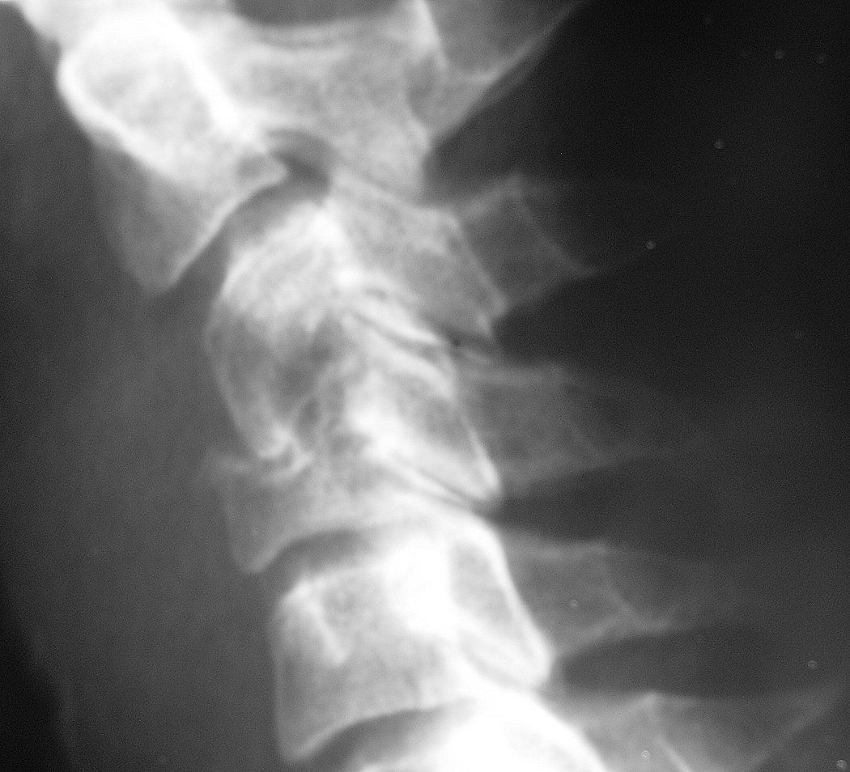
Staph Infection of Spine and Osteomyelitis
Recent spinal procedure
Focal severe pain not relieved with rest

Slide 14
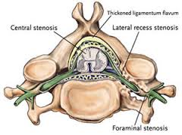

Slide 15
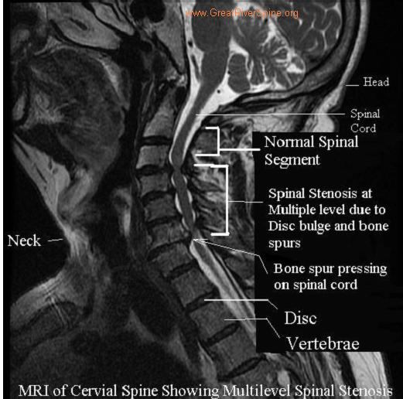

Slide 16
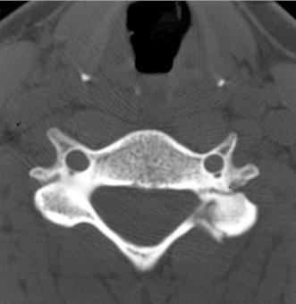
Diagnosis is the key to successful treatment…

Slide 17
Primum Non Nocere
CT scan showing C5 pedicle and facet fracture.

Slide 18

Question
SCI are critical emergencies that must be recognized and treated early to increase the possibility of preventing permanent loss of function. True or False

Slide 19

Signs of Myelopathy (CSM)
Unsteady walking
Disuse of hands
Numbness in the arms and hands
Atrophy
Twitching reflexes or muscles.

Slide 20
Unsteady walking
Everyday walking is a complex process that is a combination of brain and spinal cord input.
With cervical cord compression, an unsteady walking pattern can develop.
Some people can develop a wide based gait. Early signs of this can be tested in the office with tandem gait observation.

Slide 21

Disuse of hands
Another sign of cervical spondylotic myelopathy (CSM) will present itself with hand dysfunction. Ask if patient has a difficult time holding a cup of coffee or buttoning their clothes.

Slide 22

Numbness in the arms and hands
As the cervical spinal cord is compressed, the spinal nerves will be impacted. This can lead to numbness in the arms and hands (paresthesias).
Unlike carpal tunnel syndrome, cervical myelopathy will often involve numbness throughout the arm and hand.
Cervical radiculopathy can cause numbness in the arms and hands but is usually limited to specific dermatomes.

Slide 23
Atrophy
With continued compression of the cervical spinal cord, the innervation to the muscles in the arms and hands can be diminished. As a result, the muscles can diminish in size and demonstrate atrophy of the involved musculature.

Slide 24

Twitching reflexes of muscles
Hyperreflexia is described by the patient as a twitching of the muscles.
The upper and lower extremity reflexes are mediated by the corticospinal tract.
The loss of inhibition results in hyperreflexia and the presence of pathological reflexes.

Slide 25
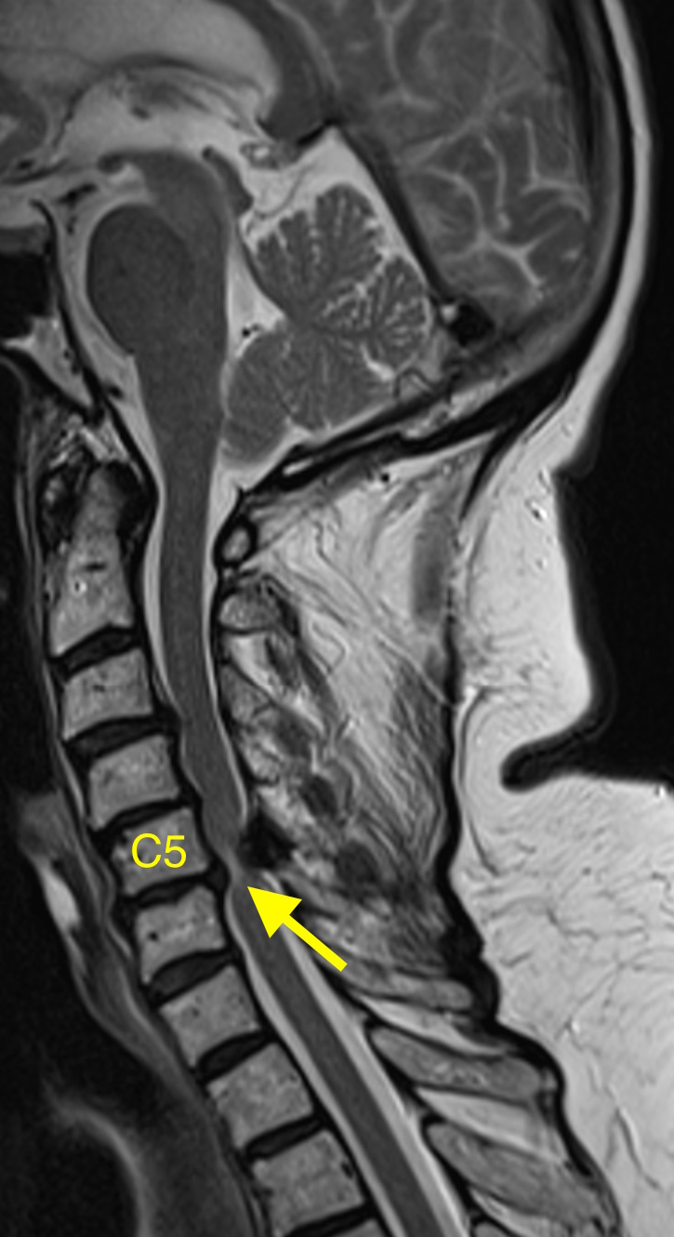
Cervical Spine Myelopathy and Radiculopathy
https://video.search.yahoo.com/yhs/search?fr=yhs-mnet-001&ei=UTF-8&hsimp=yhs-001&hspart=mnet&param1=4056&param2=84481&p=cervical+spine+myelopathy+video+youtube&type=type9097303-spa-4056-84481#id=6&vid=2146e43e8bc5d53ce7d274307d5d9c7f&action=click

Slide 26

Cervical Spondylotic Myelopathy: A Common Cause of Spinal Cord Dysfunction in Older Persons
WILLIAM F. YOUNG, M.D., Temple University Hospital, Philadelphia, Pennsylvania
Am Fam Physician. 2000 Sep 1;62(5):1064-1070.

Slide 27
Cervical Spondylotic Myelopathy
Cervical spondylotic myelopathy (CSM) is the most common spinal cord disorder in persons more than 55 years of age in North America and perhaps in the world.

Slide 28
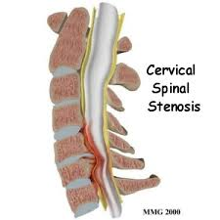
Cervical Spondylotic Myelopathy
The aging process results in degenerative changes in the cervical spine that, in advanced stages, can cause compression of the spinal cord.

Slide 29
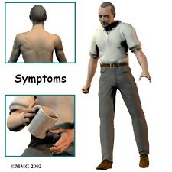
Cervical Spondylotic Myelopathy
Symptoms often develop insidiously and are characterized by neck stiffness, arm pain, numbness in the hands, and weakness of the hands and legs.

Slide 30
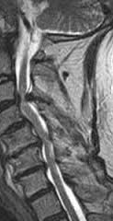
Cervical Spondylotic Myelopathy
The diagnosis is confirmed by magnetic resonance imaging that shows narrowing of the spinal canal caused by osteophytes, herniated discs and ligamentum flavum hypertrophy.

Slide 31
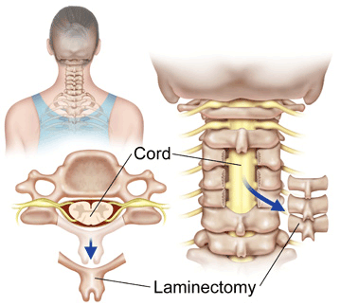
Cervical Spondylotic Myelopathy
Choice of treatment remains controversial, surgical procedures designed to decompress the spinal cord and, in some cases, stabilize the spine are successful in many patients.
WILLIAM F. YOUNG, M.D Cervical Spondylotic Myelopathy: A Common Cause of Spinal Cord Dysfunction in Older Persons
Am Fam Physician. 2000 Sep 1;62(5):1064-1070.

Slide 32
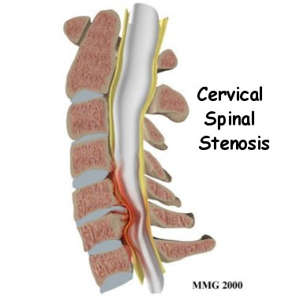
Cervical Cord Compression
Cervical compression tests and active cervical flexion may elicit signs of myelopathy rather than radiculopathy

Slide 33
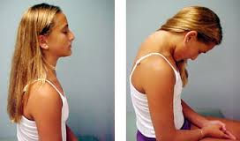
Lhermitte’s Sign
Patient may report an electrical shock-like sensation shooting down the spine and any combination of extremities with certain head movements or postures, especially active cervical flexion.

Slide 34
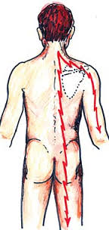
Lhermitte’s Sign
The sign suggests a lesion of the dorsal columns of the cervical cord or of the caudal medulla.

Slide 35
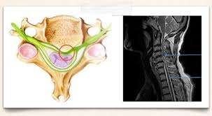
Lhermitte’s Sign
Although often considered a classic finding in multiple sclerosis, it can be caused by compression of the spinal cord in the neck from any cause such as cervical spondylosis, disc herniation, tumor, and Arnold-Chiari malformation.

Slide 36
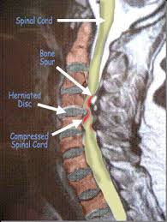

Slide 37
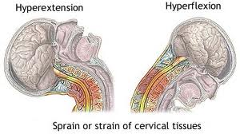
Delayed onset Lhermitte's sign has been reported following head and/or neck trauma.
This occurs ~2 1/2 months following injury, without associated neurological symptoms or pain, and typically resolves within 1 year.
Chan RC. & Steinbock P. (1984). "Delayed onset of Lhermitte's sign following head and/or neck injuries. Report of four cases.". J Neurolosurg 60 (3): 609–12.

Slide 38
Question
The aging process results in degenerative changes in the cervical spine that, in advanced stages, can cause compression of the spinal cord because of cervical spondylotic myelopathy. True or False

Slide 39
Characteristics of Motor Neuron Lesions
Upper (UMNL)
Hyper-reflexia
Pathological reflexes
Increased tone
Spastic paralysis
Clonus
Lower (LMNL)
Hypo-reflexia
Flaccid paralysis/paresis
Loss of tone
Atrophy
Fasciculations
Fibrillations
Reaction of degeneration

Slide 40
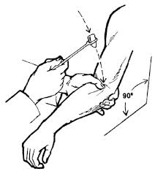
Three Part Peripheral Nervous System Examination
Deep Tendon Reflex Testing (Myotatic)
Motor Testing for Strength
Sensory Testing

Slide 41
Cervical Myelopathy
A Surgeon’s Perspective
https://video.search.yahoo.com/yhs/search?fr=yhs-mnet-001&ei=UTF-8&hsimp=yhs-001&hspart=mnet&param1=4056&param2=84481&p=cervical+spine+myelopathy+video+youtube&type=type9097303-spa-4056-84481#id=9&vid=ef745c6f5f0f577b8d5f8e759e467043&action=view

Slide 42
Suggested Readings
Cervical Spondylotic Myelopathy. http://www.aafp.org/afp/2000/0901/p1064.html
Recognizing Spinal Cord Emergencies. http://www.aafp.org/afp/2001/0815/p631.html

Slide 43


