Slide 1

Spinal Manipulation and
Cauda Equina Syndrome
James J. Lehman, DC, DIANM
University of Bridgeport
School of Chiropractic
Associate Professor of Clinical Sciences

Slide 2
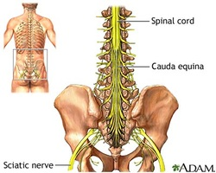
Learning Objectives
1. Be able to evaluate and manage Cauda Equina Syndrome (CES)
2. Know how to differentiate radiculopathy from CES

Slide 3
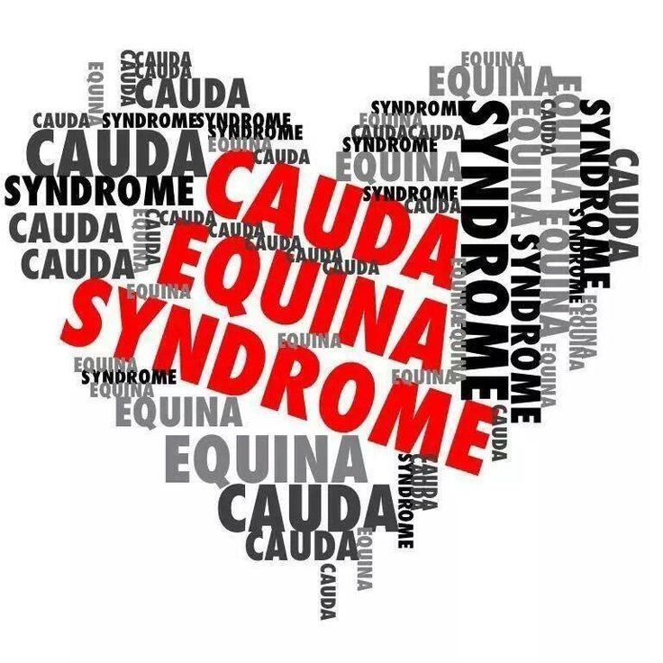

Slide 4
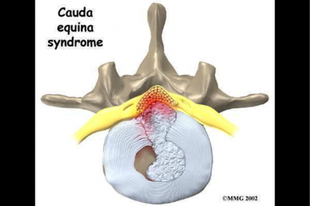
Discussion
Have you diagnosed a cauda equina syndrome (CES)?
Do you know anyone that experienced CES?
Do you feel confident making a diagnosis of CES?
Do you have any specific questions regarding CES?

Slide 5
Cauda Equina Syndrome
A Patient’s Perspective
https://www.youtube.com/watch?v=j0Tjq_FXO6k

Slide 6
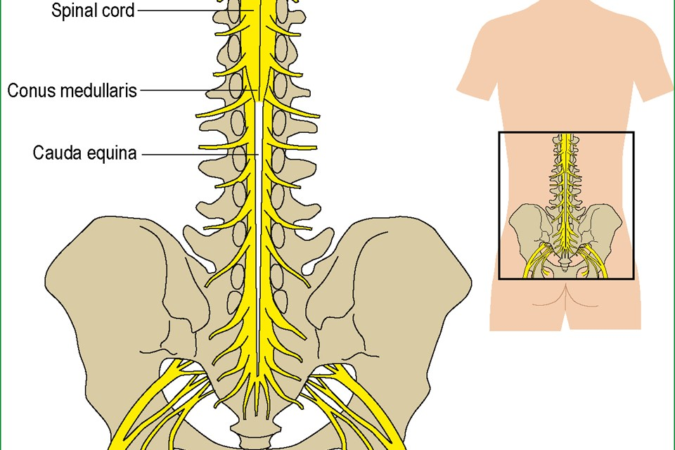
Review of Anatomy
Cauda equina = horse tail

Slide 7
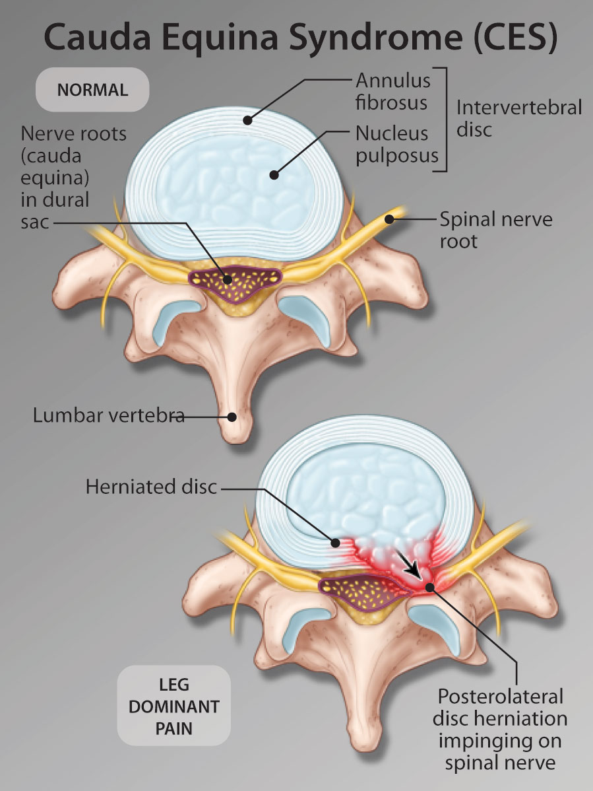
Review

Slide 8
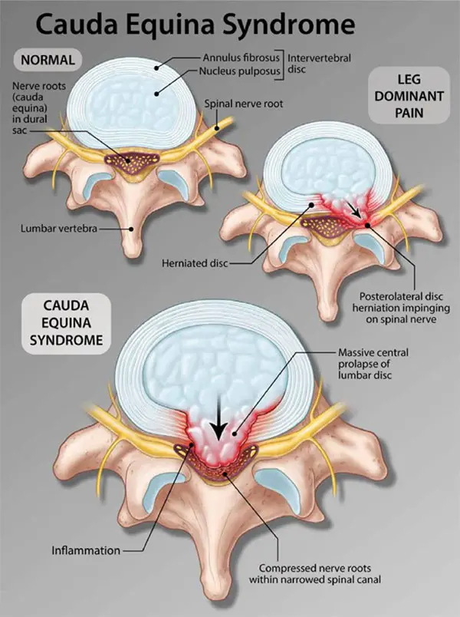

Slide 9
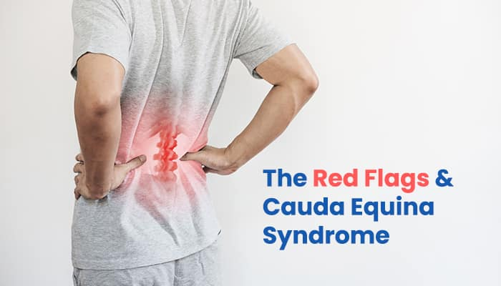

Slide 10
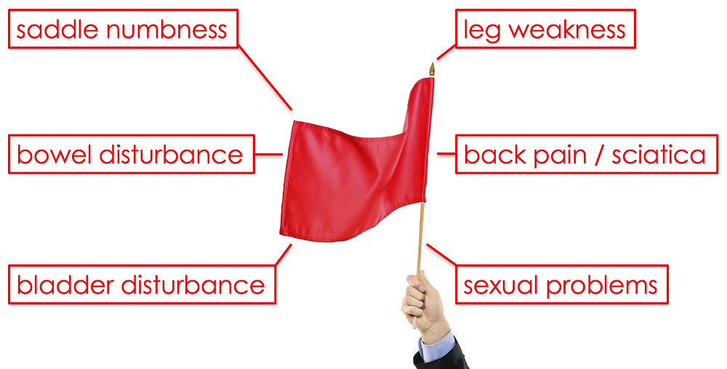

Slide 11
Two Stages of Cauda Equina Syndrome
Based on Urinary Symptoms
Stage One
CES-Incomplete (CES-I), characterized by symptoms such as altered urinary sensation, loss of desire to void, poor urinary stream, and the need to strain in order to urinate.
Stage Two
1﻿ CES-Retention (CES-R), in which bladder control is totally lost.

Slide 12
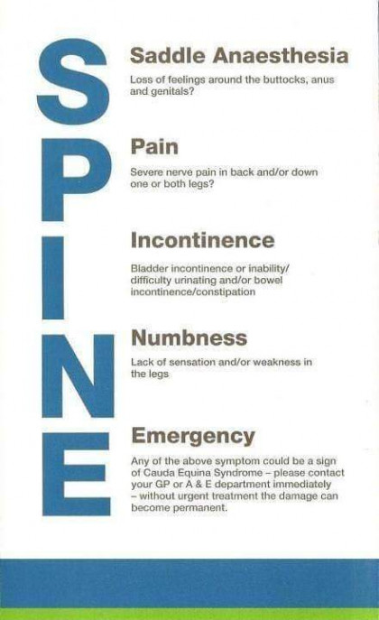

Slide 13
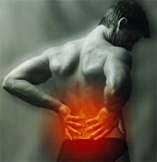
Subjective Data
Low back pain is the usual chief concern

Slide 14
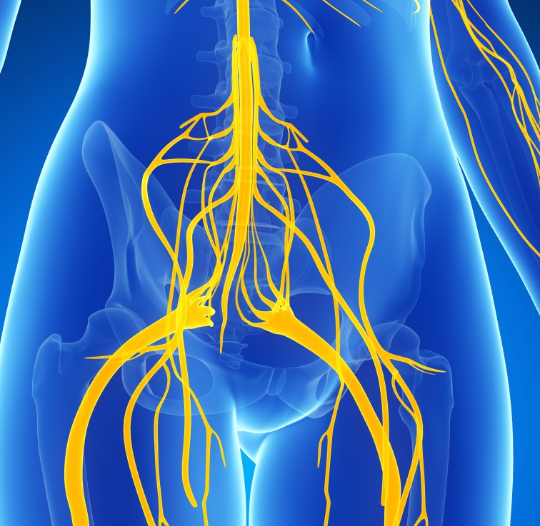
Subjective Data
Patient experiences a change in symptoms that includes the lower extremities

Slide 15

History Taking
Chief Concern is usually “My back hurts”
Frequently, the patient has been treated by you or another provider for lower back pain.
Are there any new problems or changes in symptoms?
Numbness down both legs?
Loss of feeling in rectal area when wiping?
Difficult urination?
When did you last urinate?
How was the flow?

Slide 16
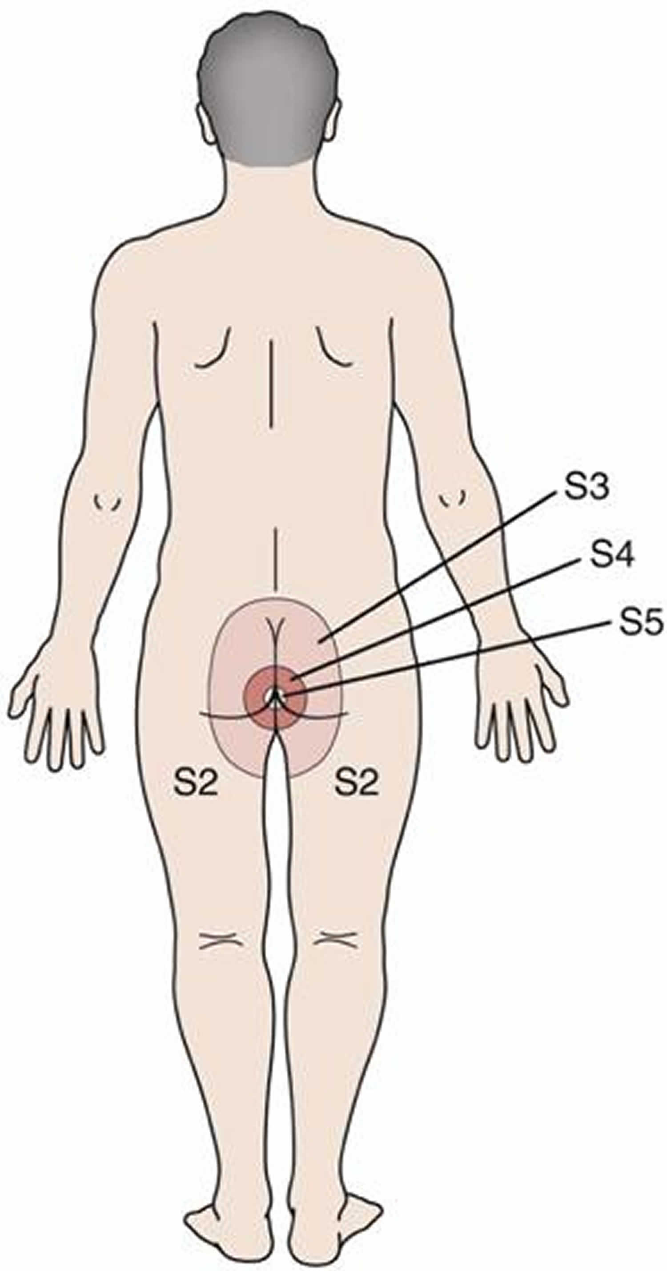
Physical Examination
Gait evaluation
Slump test or Straight Leg Raise
Three-part peripheral nerve examination
  Sensory
  Motor
  Deep tendon reflexes
  Pathological reflexes

Slide 17
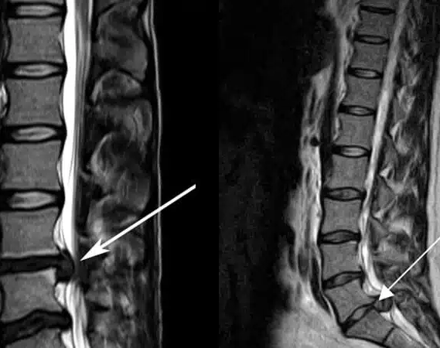
Objective Findings
Bowel and/or bladder dysfunction
Saddle anesthesia
Lower extremity motor deficit
Lower extremity sensory deficit
Sciatic type pain or radicular pain unilateral or bilateral

Slide 18
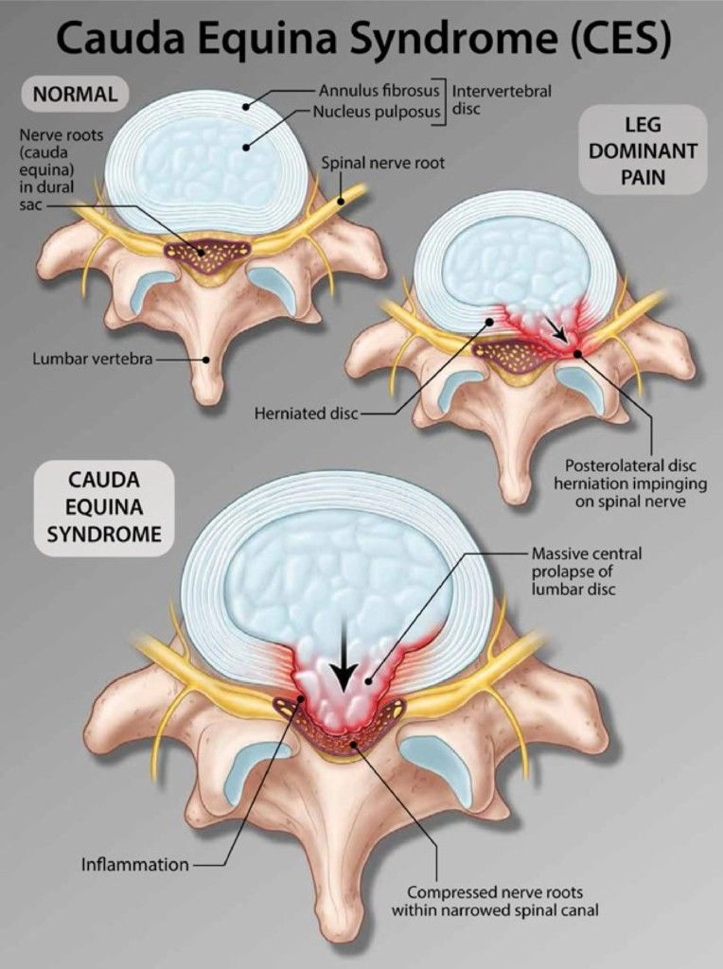
Assessment
Cauda equina syndrome
Incomplete
Complete Retention

Slide 19


Plan
Emergent MRI
Neurosurgical Consult

Slide 20

Review Cauda Equina Video
https://video.search.yahoo.com/yhs/search?fr=yhs-mnet-001&ei=UTF-8&hsimp=yhs-001&hspart=mnet&param1=4056&param2=84481&p=cauda+equina+syndrome+video&type=type9097303-spa-4056-84481#id=2&vid=1c966bde339490869cb0c8556abefc57&action=click

Slide 21
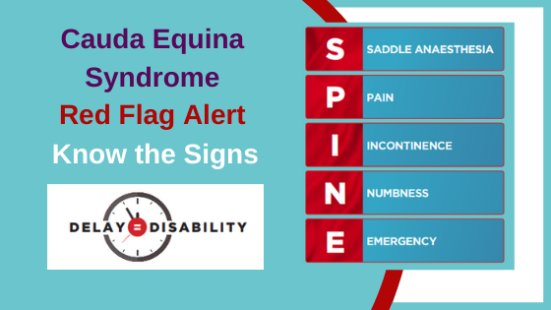

Slide 22
Cauda Equina Syndrome
A surgical emergency
https://www.youtube.com/watch?v=8rRq5QqoK3o

Slide 23
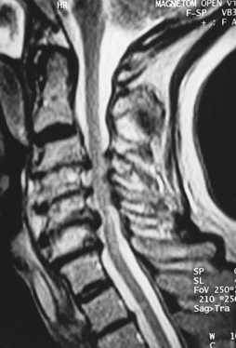
Cervical Spondylotic Myelopathy
https://video.search.yahoo.com/yhs/search?fr=yhs-mnet-001&ei=UTF-8&hsimp=yhs-001&hspart=mnet&param1=4056&param2=84481&p=cervical+myelopathy+symptoms+spinal+cord+video+youtube&type=type9097303-spa-4056-84481#id=1&vid=b26e533f02593d621777c2b657aec2fe&action=view

Slide 24
A Neurological Perspective of Cauda Equina Syndrome
https://www.youtube.com/watch?v=W-Y4Xc1gLmA

Slide 25
Cauda Equina Syndrome
Discussion

Slide 26


