Slide 1
Differential Diagnosis of Anterior Knee Pain
James J. Lehman, DC, FACO
Associate Professor of Clinical Sciences
Director, Community Health Clinical Education Program
University of Bridgeport

Slide 2
Dr. James J. Lehman
PowerPoint presentations: Bridgeport.edu/nmsm
Cell: 505-238-9501
Email: jlehman@Bridgeport.edu

Slide 3
Learning Objectives
Identify injured and painful tissues through careful assessment and intelligent use of neuromusculoskeletal testing and document the findings.
Rule-in and rule-out neuromusculoskeletal condition that might present as anterior knee pain.
Implement the scientific method and integrate the use of an evaluation protocol practiced by evidence-based and patient-centered chiropractic physicians.

Slide 4
Knee Pain Incidence
Knee pain accounts for approximately one third of musculoskeletal problems seen in primary care settings.
Rosenblatt RA, Cherkin DC, Schneeweiss R, Hart LG. The content of ambulatory medical care in the United States. An interspecialty comparison. N Engl J Med. 1983;309:892–7.

Slide 5
Knee Pain Incidence
This complaint is most prevalent in physically active patients, with as many as 54 percent of athletes having some degree of knee pain each year.
Rosenblatt RA, Cherkin DC, Schneeweiss R, Hart LG. The content of ambulatory medical care in the United States. An interspecialty comparison. N Engl J Med. 1983;309:892–7.

Slide 6
Description of Knee Pain
The patient's description of knee pain is helpful in focusing the differential diagnosis.
Bergfeld J, Ireland ML, Wojtys EM, Glaser V. Pinpointing the cause of acute knee pain. Patient Care. 1997;31(18):100–7.

Slide 7
Pain Characteristics
It is important to clarify the characteristics of the pain, including its onset (rapid or insidious), location (anterior, medial, lateral, or posterior knee), duration, severity, and quality (e.g., dull, sharp, achy).

Slide 8
Location of Pain
Have the patient point to the painful site.
Fortin JD & Falco FJ. The Fortin finger test: An indicator of sacroiliac pain. August 1997. American journal of orthopedics (Belle Mead, N.J.) 26(7):477-80

Slide 9
Detailed History
Location
Mechanism of injury
New or old condition
Palliative or Provocative
Quality of Pain
Radiation or Referred
Severity
Timing or Treatment

Slide 10
Medical History
A history of knee injury or surgery is important.
The patient should be asked about previous attempts to treat knee pain, including the use of medications, supporting devices, and physical therapy.
The physician also should ask if the patient has a history of gout, pseudogout, rheumatoid arthritis, or other degenerative joint disease.
CALMBACH WL & Hutchens M. Evaluation of Patients Presenting with Knee Pain: Part I. History, Physical Examination, Radiographs, and Laboratory Tests. Am Fam Physician. 2003 Sep 1;68(5):907-912.

Slide 11
Diagnosis is the Key to Successful Treatment
Knee anatomy
Common pain patterns in knee injuries
Features of frequently encountered causes of knee pain
Specific physical examination skills

Slide 14
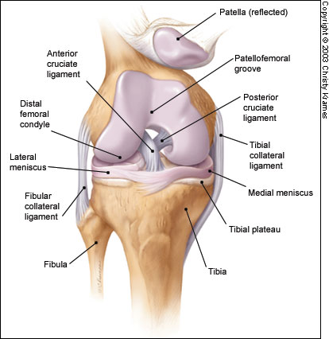

Slide 15
Differential Diagnosis
The differential diagnosis of knee pain is extensive but can be narrowed with a detailed history, a focused physical examination and, when indicated, the selective use of appropriate imaging and laboratory studies.
Calmbach WL & Hutchens M. Evaluation of Patients Presenting with Knee Pain: Part I. History, Physical Examination, Radiographs, and Laboratory Tests. Am Fam Physician. 2003 Sep 1;68 (5):907-912.

Slide 17
Location of Pain
Anterior knee pain
Patellar subluxation or dislocation
Tibial apophysitis (Osgood-Schlatter lesion)
Jumper's knee (patellar tendonitis)
Patellofemoral pain syndrome (PFA) (Runner’s Knee) (chondromalacia patellae) (O sign)

Slide 19
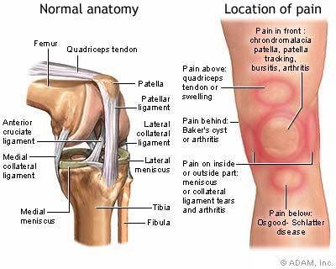

Slide 20
Patellar Dislocation

Slide 22
Patellar Subluxation
Patellar subluxation is the most likely diagnosis in a teenage girl who presents with giving-way episodes of the knee.
Walsh WM. Knee injuries. In: Mellion MB, Walsh WM, Shelton GL, eds. The team physician's handbook. 2d ed. St. Louis: Mosby, 1990:554–78.

Slide 23
Patellar Subluxation
This injury occurs more often in girls and young women because of an increased quadriceps angle (Q angle), usually greater than 15 degrees.
CALMBACH WL & Hutchens M. Evaluation of Patients Presenting with Knee Pain: Part II. Differential Diagnosis. Am Fam Physician. 2003 Sep 1;68(5):917-922.

Slide 25
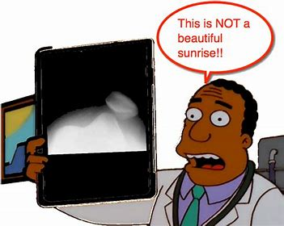

Slide 29
Osgood Schlatter Disease
Usually an overuse type injury to the tibial tubercle apophyses
Activity-related pain that is aggravated by jumping, squatting, and kneeling
X-rays shows tubercle enlargement and fragmentation

Slide 30
Osgood Schlatter’s Disease
A teenage boy who presents with anterior knee pain localized to the tibial tuberosity is likely to have tibial apophysitis, or Osgood-Schlatter lesion.
Dunn JF. Osgood-Schlatter disease. Am Fam Physician. 1990;41:173–6.
4. Stanitski CL. Anterior knee pain syndromes in the adolescent. Instr Course Lect. 1994;43:211–20.

Slide 31
Osgood Schlatter’s Disease
The typical patient is a 13- or 14-year-old boy (or a 10- or 11-year-old girl) who has recently gone through a growth spurt.
Tandeter HB, Shvartzman P, Stevens MA. Acute knee injuries: use of decision rules for selective radiograph ordering. Am Fam Physician. 1999;60:2599–608.

Slide 32
Osgood Schlatter Disease
Anterior knee pain approximately 2-3 inches inferior to the patella
This injury is considered to be an avulsion fracture.

Slide 33
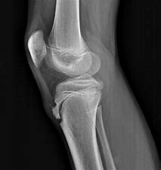

Slide 34
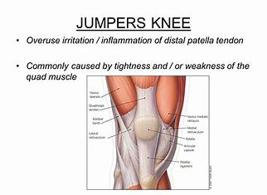

Slide 35
Patellar Tendonitis or Jumper’s Knee
Jumper's knee (irritation and inflammation of the patellar tendon) most commonly occurs in teenage boys, particularly during a growth spurt.
Walsh WM. Knee injuries. In: Mellion MB, Walsh WM, Shelton GL, eds. The team physician's handbook. 2d ed. St. Louis: Mosby, 1990:554–78.
Tandeter HB, Shvartzman P, Stevens MA. Acute knee injuries: use of decision rules for selective radiograph ordering. Am Fam Physician. 1999;60:2599–608.

Slide 36
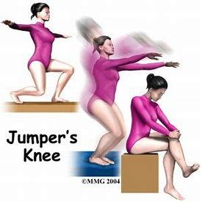

Slide 37
Jumper’s Knee
The patient reports vague anterior knee pain that has persisted for months and worsens after activities such as walking down stairs or running.
CALMBACH WL & Hutchens M. Evaluation of Patients Presenting with Knee Pain: Part II. Differential Diagnosis. Am Fam Physician. 2003 Sep 1;68(5):917-922.

Slide 38
Jumper’s Knee
On physical examination, the patellar tendon is tender, and the pain is reproduced by resisted knee extension.
There is usually no effusion.
Radiographs are not indicated.

Slide 42
Peterson W. Patellofemoral pain in athletes. Open Acces J Sports Med. 2017 Jun 12;8:143-154
This disorder may arise proximally by internal rotation of the femur or distally by internal rotation of the tibia, or both.
Internal rotation of the femur might be the result of weakness of the hip muscles.
Foot abnormalities might be cause for internal rotation of the tibia (rear-foot eversion or pes pronatus).
The valgus mal-alignment may lead to lateral patella mal-tracking.

Slide 43
Patellofemoral Pain Syndrome (PFA) Runners Knee

Slide 44
Patellofemoral Pain Syndrome (PFA)

Slide 45
O Sign

Slide 46
Clarke’s Sign or Patellofemoral Scrape Test

Slide 47
Patellofemoral Pain Syndrome (PFA) Runner’s Knee Chondromalacia Patellae

Slide 48
Internal Derangements of the Knee (IDK)
IDK often means “I don’t know.”

Slide 51
Pain Characteristics
The patient's description of knee pain is helpful in focusing the differential diagnosis.
It is important to clarify the characteristics of the pain, including its onset (rapid or insidious), location (anterior, medial, lateral, or posterior knee), duration, severity, and quality (e.g., dull, sharp, achy).
Aggravating and alleviating factors also need to be identified. If knee pain is caused by an acute injury, the physician needs to know whether the patient was able to continue activity or bear weight after the injury or was forced to cease activities immediately.
Bergfeld J, Ireland ML, Wojtys EM, Glaser V. Pinpointing the cause of acute knee pain. Patient Care. 1997;31(18):100–7.

Slide 52
Mechanical Symptoms CALMBACH WL & Hutchens M. Evaluation of Patients Presenting with Knee Pain: Part I. History, Physical Examination, Radiographs, and Laboratory Tests. Am Fam Physician. 2003 Sep 1;68(5):907-912.
The patient should be asked about mechanical symptoms, such as locking, popping, or giving way of the knee.
A history of locking episodes suggests a meniscal tear.
A sensation of popping at the time of injury suggests ligamentous injury, probably complete rupture of a ligament (third-degree tear).
Episodes of giving way are consistent with some degree of knee instability and may indicate patellar subluxation or ligamentous rupture.

Slide 53
Effusion CALMBACH WL & Hutchens M. Evaluation of Patients Presenting with Knee Pain: Part I. History, Physical Examination, Radiographs, and Laboratory Tests. Am Fam Physician. 2003 Sep 1;68(5):907-912.
The timing and amount of joint effusion are important clues to the diagnosis.
Rapid onset (within two hours) of a large, tense effusion suggests rupture of the anterior cruciate ligament or fracture of the tibial plateau with resultant hemarthrosis, whereas slower onset (24 to 36 hours) of a mild to moderate effusion is consistent with meniscal injury or ligamentous sprain.
Recurrent knee effusion after activity is consistent with meniscal injury.

Slide 54
Mechanism of Injury CALMBACH WL & Hutchens M. Evaluation of Patients Presenting with Knee Pain: Part I. History, Physical Examination, Radiographs, and Laboratory Tests. Am Fam Physician. 2003 Sep 1;68(5):907-912.
A direct blow to the knee can cause serious injury.
Anterior force applied to the proximal tibia with the knee in flexion (e.g., when the knee hits the dashboard in an automobile accident) can cause injury to the posterior cruciate ligament.
The medial collateral ligament is most commonly injured as a result of direct lateral force to the knee (e.g., clipping in football); this force creates a valgus load on the knee joint and can result in rupture of the medial collateral ligament.
Conversely, a medial blow that creates a varus load can injure the lateral collateral ligament.

Slide 55
Mechanism of Injury CALMBACH WL & Hutchens M. Evaluation of Patients Presenting with Knee Pain: Part I. History, Physical Examination, Radiographs, and Laboratory Tests. Am Fam Physician. 2003 Sep 1;68(5):907-912.
Noncontact forces also are an important cause of knee injury.
Quick stops and sharp cuts or turns create significant deceleration forces that can sprain or rupture the anterior cruciate ligament.
Hyperextension can result in injury to the anterior cruciate ligament or posterior cruciate ligament.
Sudden twisting or pivoting motions create shear forces that can injure the meniscus.
A combination of forces can occur simultaneously, causing injury to multiple structures.

Slide 57
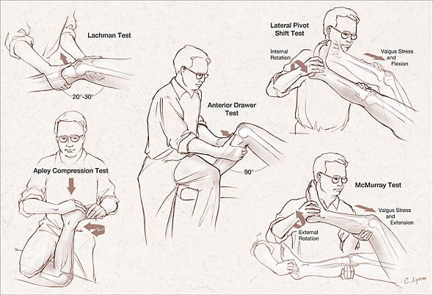

Slide 58
Thessaly Test
https://www.bing.com/videos/search?q=thessaly+test&&view=detail&mid=2BA37CDE822A17F7F0FC2BA37CDE822A17F7F0FC&&FORM=VRDGAR
KarachaliosT, Hantes M, Zibis AH, Zachos V, Karantanas AH, & Malizos KN. Diagnostic Accuracy of a New Clinical Test (the Thessaly Test) for Early Detection of Meniscal Tears. THE JOURNAL OF BONE & JOINT SURGERY · JBJS.ORG VOLUME 87-A · NUMBER 5 · MAY 2005.

Slide 59
Tests Performed by Primary Care Providers
Statistical test | Thessaly Test | McMurray’s Test | Apley’s Test | Joint line tenderness Test | Recorded clinical history | p-value
Sensitivity | 0.66 (0.57 to 0.74) | 0.58 (0.49 to 0.67) | 0.53 (0.44 to 0.62) | 0.77 (0.68 to 0.84) | 0.65 (0.56 to 0.74) | 0.001
Specificity | 0.39 (0.29 to 0.50) | 0.56 (0.45 to 0.66) | 0.53 (0.42 to 0.63) | 0.26 (0.18 to 0.36) | 0.43 (0.33 to 0.54) | < 0.001
LR+ | 1.08 (0.88 to 1.33) | 1.33 (1.01 to 1.75) | 1.12 (0.85 to 1.46) | 1.04 (0.89 to 1.21) | 1.16 (0.93 to 1.43) | –
LR– | 0.87 (0.61 to 1.25) | 0.74 (0.56 to 0.98) | 0.90 (0.69 to 1.17) | 0.89 (0.57 to 1.41) | 0.80 (0.57 to 1.11) | –
OR | 1.24 (0.71 to 2.18) | 1.79 (1.04 to 3.09) | 1.24 (0.73 to 2.12) | 1.16 (0.63 to 2.13) | 1.45 (0.84 to 2.49) | –
PPV | 0.47 (0.40 to 0.55) | 0.53 (0.45 to 0.62) | 0.50 (0.41 to 0.58) | 0.45 (0.38 to 0.51) | 0.48 (0.40 to 0.55) | 0.598
NPV | 0.47 (0.35 to 0.58) | 0.50 (0.40 to 0.60) | 0.45 (0.35 to 0.55) | 0.46 (0.33 to 0.60) | 0.49 (0.39 to 0.60) | 0.96

Slide 60
Tests Performed by Musculoskeletal Specialists
Location | Test |  |  |  | Recorded clinical history | p-value
 | Thessaly Test | McMurray’s Test | Apley’s Test | Joint line tenderness Test
Sensitivity | 0.62 (0.52 to 0.71) | 0.63 (0.53 to 0.72) | 0.43 (0.34 to 0.52) | 0.83 (0.75 to 0.89) | 0.76 (0.67 to 0.83) | < 0.001
Specificity | 0.55 (0.44 to 0.66) | 0.63 (0.53 to 0.73) | 0.72 (0.61 to 0.80) | 0.39 (0.29 to 0.49) | 0.60 (0.50 to 0.70) | < 0.001
LR+ | 1.38 (1.05 to 1.81) | 1.72 (1.26 to 2.33) | 1.52 (1.04 to 2.21) | 1.36 (1.14 to 1.62) | 1.89 (1.46 to 2.46) | –
LR– | 0.69 (0.51 to 0.93) | 0.50 (0.44 to 0.78) | 0.80 (0.65 to 0.97) | 0.44 (0.28 to 0.69) | 0.40 (0.29 to 0.57) | –
OR | 2.00 (1.14 to 3.50) | 2.93 (1.66 to 5.19) | 1.91 (1.08 to 3.38) | 3.08 (1.67 to 5.67) | 4.69 (2.66 to 8.29) | –
PPV | 0.55 (0.46 to 0.64) | 0.57 (0.48 to 0.66) | 0.59 (0.48 to 0.69) | 0.50 (0.43 to 0.57) | 0.62 (0.54 to 0.69) | 0.227
NPV | 0.52 (0.41 to 0.62) | 0.57 (0.47 to 0.67) | 0.49 (0.41 to 0.58) | 0.64 (0.51 to 0.76) | 0.66 (0.55 to 0.76) | 0.075

Slide 61
4 Major Ligaments of the Knee

Slide 62
Internal Derangement of the Knee Tests

Slide 63
Lateral Pivot Shift Test for IDK
A positive test may result in a gentle slide (Grade 1), or in a more severe jerk (Grade 2), or clunk (Grade 3).
The grade of the pivot shift has been shown to correlate with patient-reported functional instability and clinical outcomes.
https://www.youtube.com/watch?v=cy20eA9qTlM

Slide 64
Pes Anserine Bursitis

Slide 65
Iliotibial Band Syndrome

Slide 66
Iliotibial Pain Syndrome

Slide 67
Iliotibial Band Syndrome

Slide 69
References
CALMBACH WL & Hutchens M. Evaluation of Patients Presenting with Knee Pain: Part I. History, Physical Examination, Radiographs, and Laboratory Tests. Am Fam Physician. 2003 Sep 1;68(5):907-912.
CALMBACH WL & Hutchens M. Evaluation of Patients Presenting with Knee Pain: Part II. Differential Diagnosis. Am Fam Physician. 2003 Sep 1;68(5):917-922.
ROTH E, MIROCHNA M, and HARSHA D. Adolescent with Knee Pain. American Family Physician. Volume 86, Number 6 ◆ September 15, 2012
KarachaliosT, Hantes M, Zibis AH, Zachos V, Karantanas AH, & Malizos KN. Diagnostic Accuracy of a New Clinical Test (the Thessaly Test) for Early Detection of Meniscal Tears. THE JOURNAL OF BONE & JOINT SURGERY · JBJS.ORG VOLUME 87-A · NUMBER 5 · MAY 2005.

