Slide 1
"A Compendium of Federally Qualified Health Center Experiences: The Connecticut Experiences."
James J. Lehman, DC, FACO
Associate Professor of Clinical Sciences
University of Bridgeport College of Chiropractic
Director, Community Health Clinical Education
University of Bridgeport

Slide 2
Learning Objectives
First hour
Realize the steps necessary to integrate chiropractic services into a Community Health Center/FQHC
Second hour
Comprehend the differential diagnosis and prognosis for a patient suffering with chronic pain syndrome vs chronic pain illness.

Slide 3
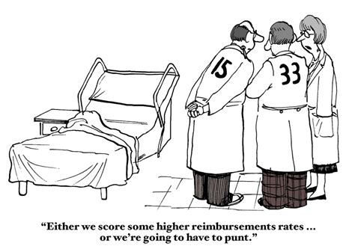

Slide 4


Slide 5


Slide 6
Primary Care 2025 Predictions
The resulting policies accelerated the evolution of PCMHs into CCHHs, which provide primary care to 85% of the population.
This care is fully capitated in 2025.
About 10% of the population receives fee-for-service (FFS) “concierge” care aimed at the very rich, who have insurance but pay additional fees for special services; 5% of the population remains uninsured in 2025 and gets primary care, if and when they get it, from emergency rooms and community health centers (CHCs).
Institute for Alternative Futures. Primary Care 2025: A Scenario Exploration. Alexandria, VA. January 2012. Available from http://www.altfutures.org/pubs/pc2025/IAF-PrimaryCare2025Scenarios.pdf.

Slide 7


Slide 8


Slide 9


Slide 10

Barriers to Entry and Chiropractic Integration
Medicaid covered 60% of CHC patients
Medicaid in Connecticut was not funded to cover chiropractic services

Slide 11

Barriers to Entry and Chiropractic Integration
Primary care providers were the gatekeepers in CHC primary care sites
Primary care providers had never referred to a chiropractor (1972)
Primary care providers expressed significant concerns regarding use of chiropractors

Slide 12

Credentialing
In order to be credentialed as members of the medical staff, chiropractors were required to be chiropractic specialists.

Slide 13


Slide 14


Slide 15
Community Health Center
Pilot Study
Nine (9) months in Meriden Primary Care facility
PCPs to refer adult patients with chronic pain
One UBCC, DC faculty member to provide care and supervise students
Teams of (3) fourth-year, chiropractic students provided hands-on treatment
Determine change in functionality, referral pattern changes, patient and provider satisfaction

Slide 16
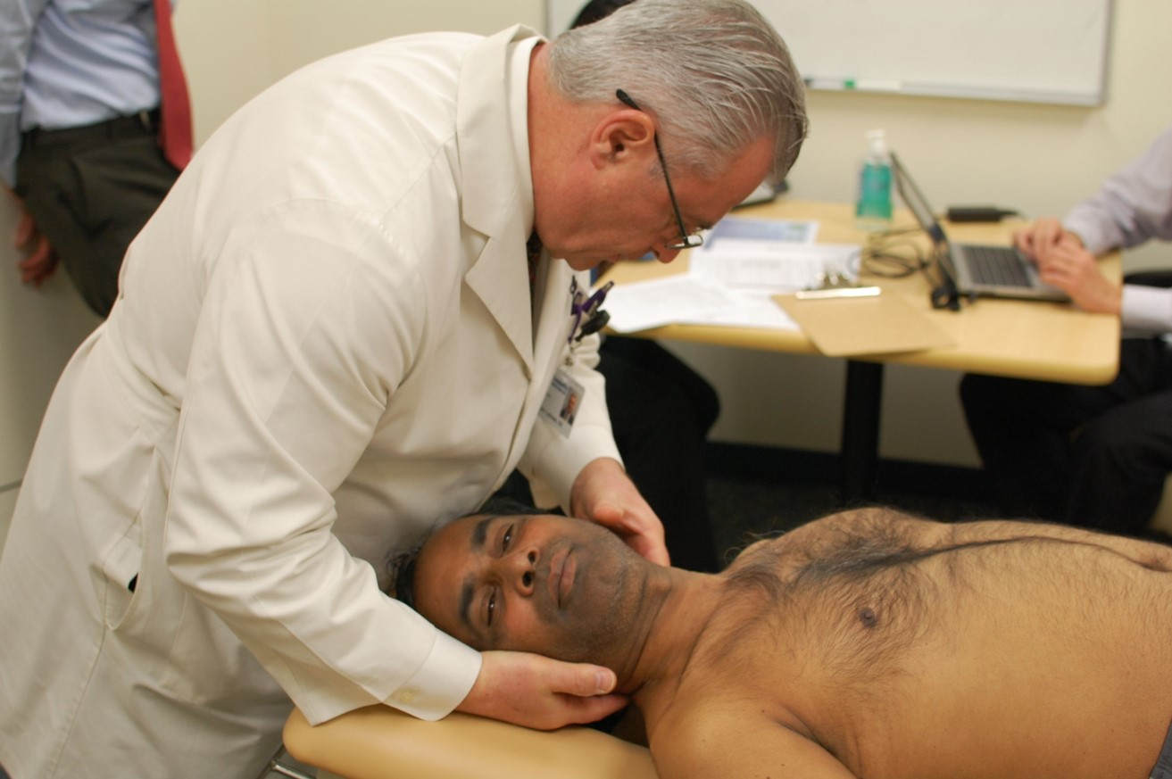
Pilot Study Outcomes
PCPs referred adult, chronic pain patients
98.5% patient satisfaction
High level of provider satisfaction
Statistically significant improvement in functionality

Slide 17

Following a six-month pilot study, the Community Health Center, Inc. of Middletown, Connecticut accepted board-certified chiropractic specialists to the medical staff.

Slide 18

Community Health Center Tasks
Petition HRSA to expand scope of practice and scope of reimbursement to include chiropractic services for Medicaid patients
Petition Connecticut to pay CHC for Medicaid patients receiving chiropractic services

Slide 19

Community Health Center Tasks
Education

Slide 20

Community Health Center Tasks
Chiropractic Credentialing

Slide 21
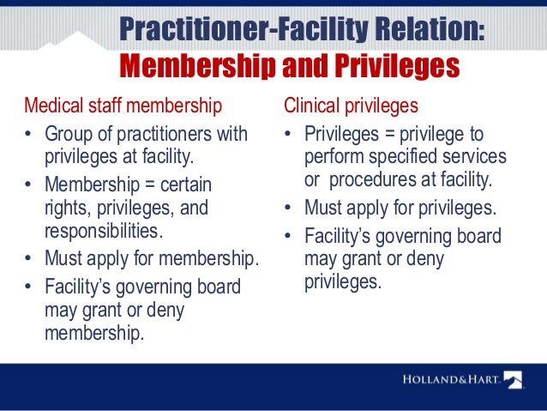
Community Health Center Tasks
Chiropractic Privileges

Slide 22
Integration
Chiropractic specialists were credentialed as members of the medical staff with evaluation and management privileges plus specific chiropractic services.

Slide 23

Chiropractic Integration
Full access and use of the electronic medical record

Slide 24

Chiropractic Integration
Seamless referral process, which reduces stress for patients

Slide 25
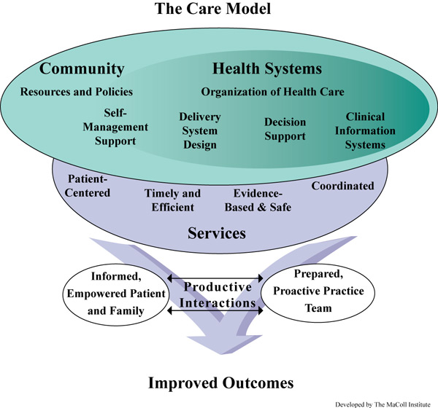

Slide 26
Chiropractic Integration Outcomes
Increased referrals to chiropractic providers
Reduced referrals to orthopedic surgeons
Increased patient satisfaction
Chronic pain patients experienced improved function
Reduced use of opioids
Primary care provider satisfaction with chiropractic services

Slide 27
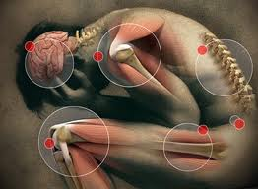
Neuromusculoskeletal Conditions Treated
Acute and chronic pain:
  Spinal pain
  Cervicogenic headaches
  Myofascial pain syndromes
  Piriformis syndrome and sciatica
  Nerve root radiculopathy and brachial plexopathy
  Peripheral compression neuropathies
  Coccygodynia

Slide 28
Chiropractic Services
Procedures
Spinal and extremity manipulation
Soft tissue treatments
Physiological therapeutics

Slide 29

Chiropractic Services
Prevention and Wellness
  Smoking cessation
  Nutrition and hydration
  Specific exercise programs
  Posture

Slide 30
Primary Diagnostic Codes
G89.4 Chronic Pain Syndrome
G89.21 Chronic Pain Post-traumatic
G89.11 Acute Pain Post-traumatic

Slide 31
Billing and Coding
E/M
  99213 Intermediate evaluation and management of established patient
CPT
  98940 CMT spinal 1-2 regions
  98941 CMT spinal 3-4 regions
  98943 CMT extra spinal
  97140 Manual therapy techniques (soft tissue treatments)

Slide 32
Patient Comments
I like the chiropractor because now I know what is wrong.
The chiropractors make me feel better.
I don’t want to take the drugs anymore.
We need more chiropractors!

Slide 33
Patient Outcomes
Reduced use of opioids
Improved quality of life
Patient satisfaction
Provider satisfaction
Improved function

Slide 34
“We have found that the integration of chiropractic services enabled our patients to experience less pain and promoted healthy living. Hopefully, other community health centers in Connecticut and across the country will use our model to reduce chronic pain and improve quality of life.”
Margaret Flinter, Ph.D.
Senior Vice President and Clinical Director
Community Health Center, Inc.

Slide 35

Chiropractic Specialty Training
Selected Neuromusculoskeletal Medicine training

Slide 36

Chiropractic Specialty Training
300-hour program for practicing chiropractors
  50 hours of live, seminar training
  250 hours of Advanced Online Clinical Training

Slide 37
University of Bridgeport
Residency in neuromusculoskeletal medicine

Slide 38
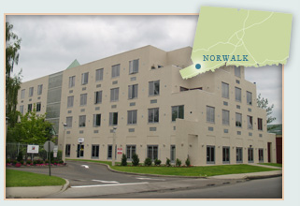
Chiropractic Specialty Training
Three-year, full-time residency
Primary care sites
Credentialed as a member of the medical staff of an FQHC/Community Health Center
Function as a chiropractic specialist on a primary care team

Slide 39
Chiropractic Specialty Training
Board Certification with the Academy of Chiropractic Orthopedists

Slide 40
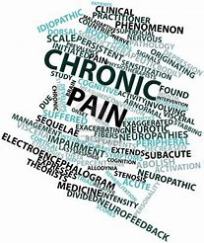
Differential Diagnosis
Chronic pain syndrome vs chronic pain illness

Slide 41
Chronic Pain
Chronic pain—commonly defined as pain persisting longer than six months—affects an estimated 70 million Americans and is a tragically overlooked public health problem.
The burden of chronic pain is greater than that of diabetes, heart disease and cancer combined.
Ongoing pain can also undermine overall physical, psychological, and social well-being, and is a major cause of disability and costly health care utilization.
A Call to Revolutionize Chronic Pain Care in America: An Opportunity in Health Care Reform

Slide 42

Chronic pain (syndrome) is pain that occurs on at least half the days for six months or more (2016).

Slide 43
Inadequate Pain Treatment
Currently, large numbers of Americans receive inadequate pain prevention, assessment, and treatment, in part because of financial incentives that work against the provision of the best, most individualized care; unrealistic patient expectations; and a lack of valid and objective pain assessment measures.
A Call to Revolutionize Chronic Pain Care in America: An Opportunity in Health Care Reform

Slide 44
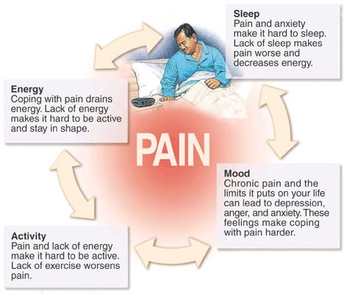

Slide 45
Chronic Pain and Central Sensitization
Central sensitization is a condition of the nervous system that is associated with the development and maintenance of chronic pain.
When central sensitization occurs, the nervous system goes through a process called wind-up and gets regulated in a persistent state of high reactivity.
This persistent, or regulated, state of reactivity lowers the threshold for what causes pain and subsequently comes to maintain pain even after the initial injury might have healed.
Phillips, K. & Clauw, D. J. (2011). Central pain mechanisms in chronic pain states – maybe it is all in their head. Best Practice Research in Clinical Rheumatology, 25, 141-154.

Slide 46
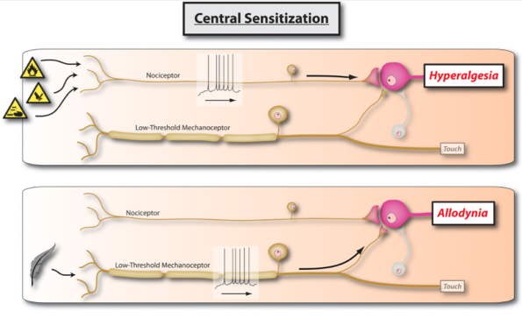
Chronic Pain and Central Sensitization
Sensory Function Disturbances
  Hypersensitivity (decreased pain threshold) to pressure, thermal, electrocutaneous
  Spinal cord hypersensitivity (central sensitization)
Sterling M, Kenardy J. Physical and psychological aspects of whiplash: Important considerations for primary care assessment. Man her. 2008;13:93-102.

Slide 47
Chronic Pain Illness
Most people in pain, including those with chronic symptoms, go to primary care providers to get relief.
But current systems of care do not adequately train or support internists, family physicians and pediatricians, the other health care providers who provide primary care in meeting the challenge of treating pain as a chronic illness.
A Call to Revolutionize Chronic Pain Care in America: An Opportunity in Health Care Reform

Slide 48

Supports the development of a system of patient-centered integrated pain management practices based on a biopsychosocial model of care that enables physicians and patients to access the full spectrum of pain treatment options…

Slide 49
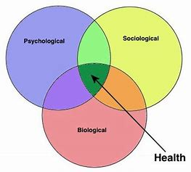
Chronic Pain Illness

Slide 50

Chronic Pain Syndrome
Pain occurs on 4 days per week for more 6 months or longer
Appropriate care following injury
Higher level of education
Control of employment
Low to moderate pain scale scores
Coping skills
Short- term disability
Properly insured

Slide 51

Post-traumatic Chronic Pain Illness
Pain on a daily basis for more than 6 months
Inappropriate care or delayed care following injury
Lower level of education
Loss of minimum wage job(s)
Extremely high pain scale scores
Emotionally charged
Disability

Slide 52
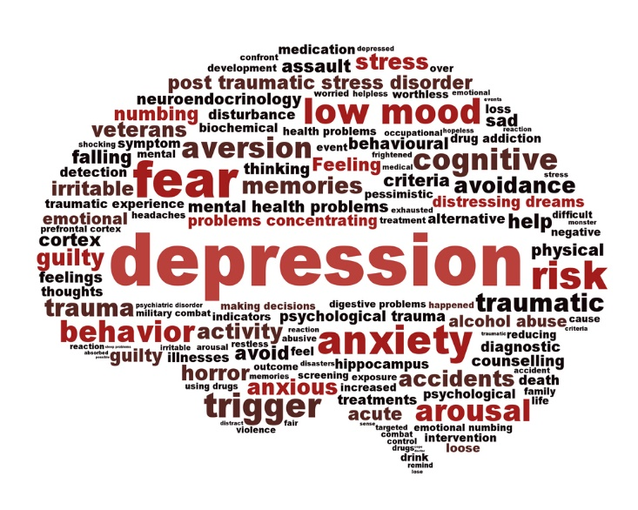
Psychological Factors and Chronic Pain Illness
Affective disorders
Anxiety
Depression
Behavioral abnormalities (fear of movement)
Posttraumatic stress

Slide 53
Pain management by primary care physicians, pain physicians, chiropractors, and acupuncturists: a national survey.
Breuer B¹, Cruciani R, Portenoy RK.
South Med J. 2010 Aug;103(8):738-47.
OBJECTIVES:
Chronic pain is a serious public health problem and is treated by diverse health care providers. In order to enhance policies and programs to improve pain care, we collected information about the distribution of pain patients among four major groups of pain management providers: primary care physicians (PCPs), pain physicians, chiropractors, and acupuncturists, and the variation in the attitudes and practices of these providers with respect to some common strategies used for pain.
METHODS:
National mail survey of PCPs, pain physicians, chiropractors, and acupuncturists (ntotal = 3,000).
RESULTS:
Eight hundred seventeen responses were usable (response rate, 29%). Analyses weighted to obtain nationally representative data showed that PCPs treat approximately 52% of chronic pain patients, pain physicians treat 2%, chiropractors treat 40%, and acupuncturists treat 7%. Of the chronic pain patients seen for evaluation, the percentages subsequently treated on an ongoing basis range from 51% (PCPs) to 63% (pain physicians). Pain physicians prescribe long-acting opioids such as methadone, antidepressants or anti-convulsants, and other nontraditional analgesics approximately 50-100% more often than PCPs. Twenty-nine percent of PCPs and 16% of pain physicians reported prescribing opioids less often than they deem appropriate because of regulatory oversight concerns. Of the four groups, PCPs are least likely to feel confident in their ability to manage musculoskeletal pain and neuropathic pain, and are least likely to favor mandatory pain education for all PCPs.

Slide 54

Interdisciplinary team…
Ideally, most patients with severe persistent pain would obtain pain care from an interdisciplinary team, as opposed to a specialist who might focus on a narrow range of treatments and have a restricted view of how pain is affecting the patient.

Slide 55
Primary Care Team
In the primary care setting, the team most often includes a primary care practitioner, nurse, and mental health clinician but should include chiropractic specialists.

Slide 56


Slide 57
Chronic Pain Illness Response to Chiropractic Care
Temporary pain reduction (1-3 days) from 10/10 to 8/10
Rates improvement at 50% of 100%
Claims that treatment improves Quality of Life (QOL)
Reduces ER visits
Reduces need for drugs
Normally, treatment frequency is 1-4 times per month for life

Slide 58
American Society of Addiction Medicine
Addiction is a primary, chronic and relapsing brain disease characterized by an individual pathologically pursuing reward and/or relief by substance use and other behaviors. American Society of Addiction Medicine. (2011). Public Policy Statement: Definition of Addiction. Chevy Chase, MD: American Society of Addiction Medicine.
In 2012, 259 million prescriptions were written for opioids, which is more than enough to give every American adult their own bottle of pills. Centers for Disease Control and Prevention. (2014). Opioid Painkiller Prescribing, Where You Live Makes a Difference. Atlanta, GA: Centers for Disease Control and Prevention. Available at http://www.cdc.gov/vitalsigns/opioid-prescribing/.
Four in five new heroin users started out misusing prescription painkillers. Jones CM. Heroin use and heroin use risk behaviors among nonmedical users of prescription opioid pain relievers - United States, 2002-2004 and 2008-2010. Drug Alcohol Depend. 2013 Sep 1;132(1-2):95-100.
94% of respondents in a 2014 survey of people in treatment for opioid addiction said they chose to use heroin because prescription opioids were “far more expensive and harder to obtain.” Cicero TJ, Ellis MS, Surratt HL, Kurtz SP. The changing face of heroin use in the United States: a retrospective analysis of the past 50 years. JAMA Psychiatry. 2014;71(7):821-826.

Slide 59

Integration of Chiropractic Specialists is Part of the Solution to Preventing Opioid Addictions

