Slide 1
Statin Myopathy:
A common cause of chronic pain
James J. Lehman, DC, MBA, FIANM
Associate Professor of Clinical Sciences
School of Chiropractic
Director
Community Health Clinical Education
University of Bridgeport

Slide 2
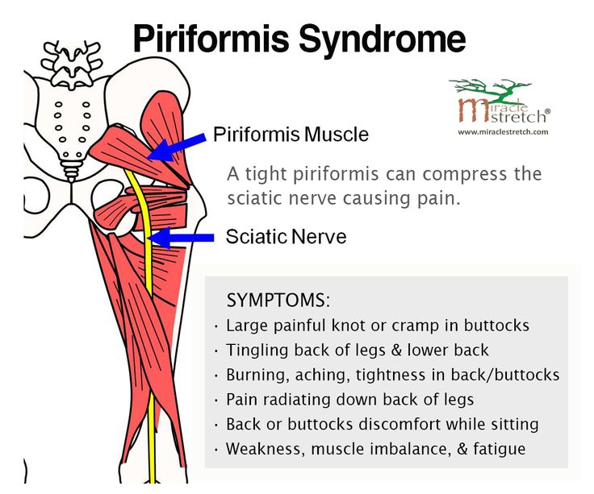
Learning Objectives
Organize a clinical thought process while performing a neuromusculoskeletal evaluation of a patient with statin myopathy and piriformis syndrome.

Slide 3
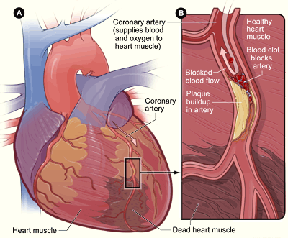
The Cholesterol Myth: Heart of the Matter
https://www.bing.com/videos/search?q=statin+myth&&view=detail&mid=7586F582B3662CE860707586F582B3662CE86070&&FORM=VDRVRV

Slide 4
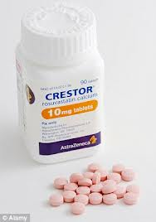
The Statins Myth: Heart of the Matter
https://www.bing.com/videos/search?q=statin+myth&&view=detail&mid=763A485DE18A1067084C763A485DE18A1067084C&&FORM=VDRVRV

Slide 5
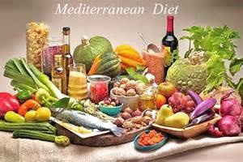
Numbers Needed to Treat for Statins vs the Mediterranean Diet
https://www.acatoday.org/News-Publications/ACA-News-Archive/ArtMID/5721/ArticleID/106/NNT-for-Statins-vs-the-Mediterranean-Diet

Slide 6
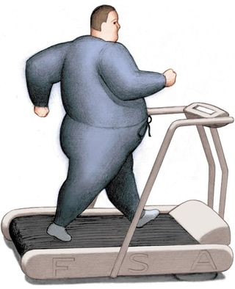
Mediterranean Diet and Exercise

Slide 7

Opening Statement …
Diagnosis is the key to successful treatment!

Slide 8
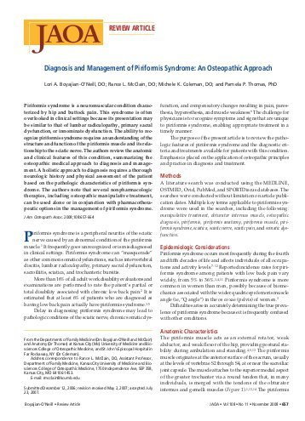

Slide 9
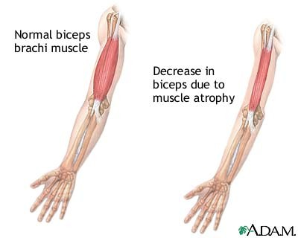
Myopathy
The myopathies are neuromuscular disorders in which the primary symptom is muscle weakness due to dysfunction of muscle fiber.

Slide 10
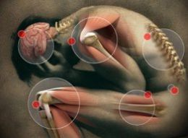
Myopathy
Other symptoms of myopathy can include muscle cramps, stiffness, and spasm.

Slide 11
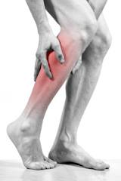
Myopathy
Myopathies can be inherited (such as the muscular dystrophies) or acquired (such as common muscle cramps).
NIH: National Institute of Neurological Disorders and Stroke. What is Myopathy. http://www.ninds.nih.gov/disorders/myopathy/myopathy.htm.

Slide 12
Statins (or HMG-CoA reductase inhibitors) are a class of drugs used to lower cholesterol levels by inhibiting the enzyme HMG-CoA reductase, which plays a central role in the production of cholesterol in the liver, which produces about 70 percent of total cholesterol in the body.
Lewington S, Whitlock G, Clarke R et al. (December 2007). "Blood cholesterol and vascular mortality by age, sex, and blood pressure: a meta-analysis of individual data from 61 prospective studies with 55,000 vascular deaths". Lancet 370 (9602): 1829–39.

Slide 13
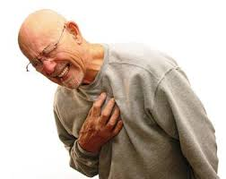
Cholesterol and Cardiovascular Disease
Increased cholesterol levels have been associated with cardiovascular disease (CVD).
Lewington S, Whitlock G, Clarke R et al. (December 2007). "Blood cholesterol and vascular mortality by age, sex, and blood pressure: a meta-analysis of individual data from 61 prospective studies with 55,000 vascular deaths". Lancet 370 (9602): 1829–39.

Slide 14
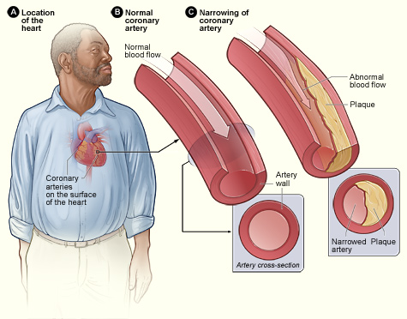

Slide 15
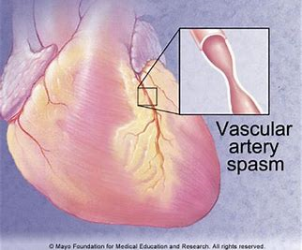

Slide 16
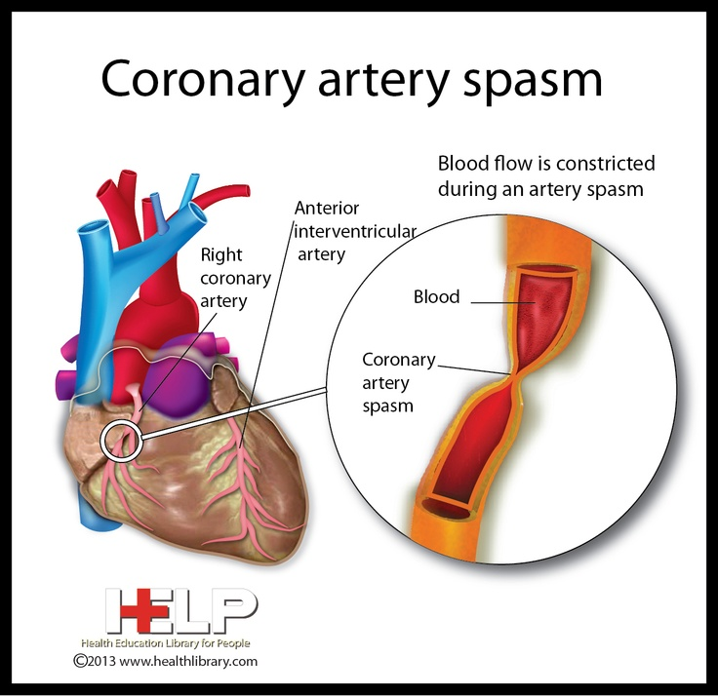

Slide 17
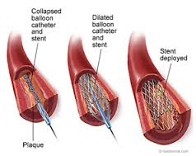
Angioplasty
Angioplasty can restore blood flow to the heart. During the procedure, a thin, flexible catheter (tube) with a balloon at its tip is threaded through a blood vessel to the affected artery. Once in place, the balloon is inflated to compress the plaque against the artery wall. This restores blood flow through the artery.

Slide 18
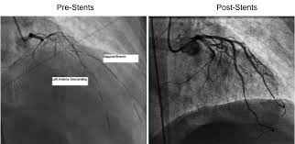
Pre and Post Stent Images

Slide 19
Benefits of Statins
Statins appear to drive down the risk of heart attack or stroke by lowering the levels of fatty deposits circulating in the bloodstream. Research suggests that the drugs dampen inflammatory processes that can prompt deposits of plaque to break away from blood vessel walls and cause sudden blockages of arteries leading to the heart or brain.
JOHN D. ABRAMSON. Harvard School of Medicine

Slide 20
Adverse Drug Reactions
However, the popular profile of statins in terms of efficacy has been maligned by its adverse events. The myotoxicity, ranging from mild myopathy to serious rhabdomyolysis, associated with HMG-CoA reductase inhibitors, during treatment of hypercholesterolaemia is of paramount importance.
Tiwari A, Bansal V, Chugh A, Mookhtiar K. Statins and myotoxicity: a therapeutic limitation. Expert Opin Drug Saf. 2006 Sep;5(5):651-66.

Slide 21
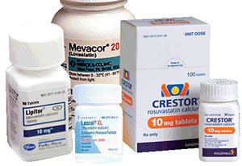
Caveat Emptor
Perhaps more dangerous, statins provide false reassurances that may discourage patients from taking the steps that actually reduce cardiovascular disease.
Abramson JD & Redberg RF. Don’t Give More Patients Statins. NYT. November 13, 2013.

Slide 22
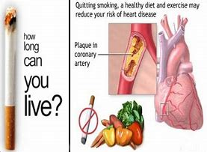
Caveat Emptor
According to the World Health Organization, 80 percent of cardiovascular disease is caused by smoking, lack of exercise, an unhealthy diet, and other lifestyle factors.
Abramson JD & Redberg RF. Don’t Give More Patients Statins. NYT. November 13, 2013.

Slide 23
Caveat Emptor
Statins give the illusion of protection to many people, who would be much better served, for example, by simply walking an extra 10 minutes per day.
JOHN D. ABRAMSON and RITA F. REDBERG. Don’t Give More Patients Statins. NYT. Published: November 13, 2013

Slide 24
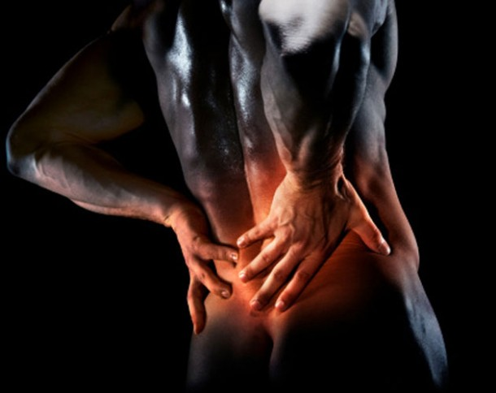
Physician Denial
Eighty-seven percent of patients reportedly spoke to their physician about the possible connection between statin use and their symptom.

Slide 25
Physician Denial
Patients reported that they and not the doctor most commonly initiated the discussion regarding the possible connection of drug to symptom (98% vs 2% cognition survey, 96% vs 4% neuropathy survey, 86% vs 14% muscle survey; p < 10(-8) for each).
Physicians were reportedly more likely to deny than affirm the possibility of a connection.

Slide 26
Physician Denial
CONCLUSIONS
Since low reporting rates are considered to contribute to delays in identification of adverse drug reactions (ADRs), findings from this study suggest that additional putative cases may be identified by targeting patients as reporters, potentially speeding recognition of ADRs.
Golomb BA, McGraw JJ, Evans MA, Dimsdale JE. Drug Saf. 2007;30(8):669-75. Physician response to patient reports of adverse drug effects: implications for patient-targeted adverse effect surveillance.

Slide 27
Muscle-Related Adverse Effects(MAE)
Three hundred fifty-four patients (age range 34-86 yrs) who self-reported muscle-related problems associated with statin therapy.
Pharmacotherapy. 2010 Jun;30(6):541-53.

Slide 28
Muscle-Related Adverse Effects(MAE)
Patients with perceived statin-associated MAEs completed a survey assessing statin drugs and dosages; characteristics of the MAEs; time course of onset, resolution, or recurrence; and impact on quality of life (QOL).

Slide 29
Quality of Life
The best way of approaching quality of life measurement is to measure the extent to which people's 'happiness requirements' are met (those requirements which are a necessary, although not sufficient, condition of anyone's happiness) those 'without which no member of the human race can be happy.'
McCall, S.: 1975, 'Quality of Life', Social Indicators Research 2, pp 229-248.

Slide 30
Muscle-Related Adverse Effects(MAE)
Higher potency statins reproduced MAEs in 100% of 39 rechallenges versus 73% (29/40) with lower potency rechallenges (p<0.01).
Time course of onset after statin initiation varied (median 14 wks); some MAEs occurred after long-term symptom-free use.
Cham S, Evans MA, Denenberg JO, Golomb BA. Statin-associated muscle-related adverse effects: a case series of 354 patients. Pharmacotherapy. 2010 Jun;30(6):541-53.

Slide 31

Muscle-Related Adverse Effects(MAE)
Recurrence with rechallenge had a significantly shorter latency to onset (median 2 wks).
The MAEs adversely affected all assessed functional and QOL domains.

Slide 32
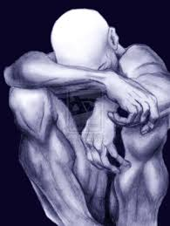
Muscle-Related Adverse Effects(MAE)
CONCLUSION:
This study complements available information on the properties and natural history of statin-associated MAEs, affirming dose dependence and strong QOL impact.
Cham S, Evans MA, Denenberg JO, Golomb BA. Statin-associated muscle-related adverse effects: a case series of 354 patients. Pharmacotherapy. 2010 Jun;30(6):541-53.

Slide 33
Muscle-Related Adverse Effects(MAE)
CONCLUSION:
The data indicating a dose-dependent relationship between MAE risk and recurrence suggest lower potency statins or discontinuation may bear consideration for ameliorating symptoms.
Cham S, Evans MA, Denenberg JO, Golomb BA. Statin-associated muscle-related adverse effects: a case series of 354 patients. Pharmacotherapy. 2010 Jun;30(6):541-53.

Slide 34
Case Report
A 63 year-old professor experienced a myocardial infarct on February 16, 2013. He endured severe chest and upper thoracic pain for a period of 3 hours due to complete occlusion of the left anterior descending coronary artery (LAD), which is known as the “widow maker.” Aspirin and nitroglycerine in the ER did not reduce the pain and morphine reduced the pain from 10/10 to 9.7/10.

Slide 35
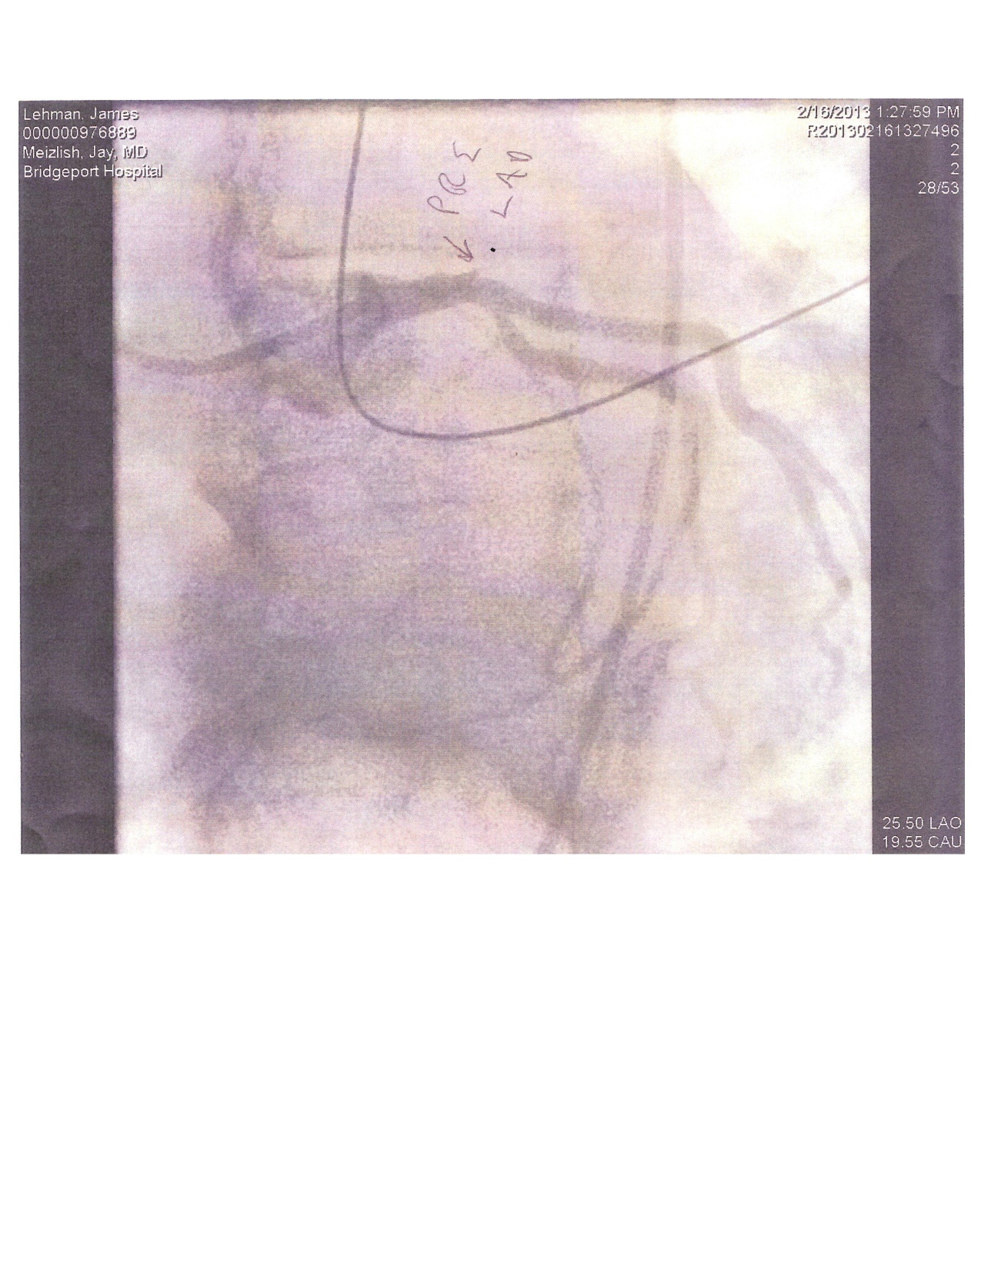

Slide 36
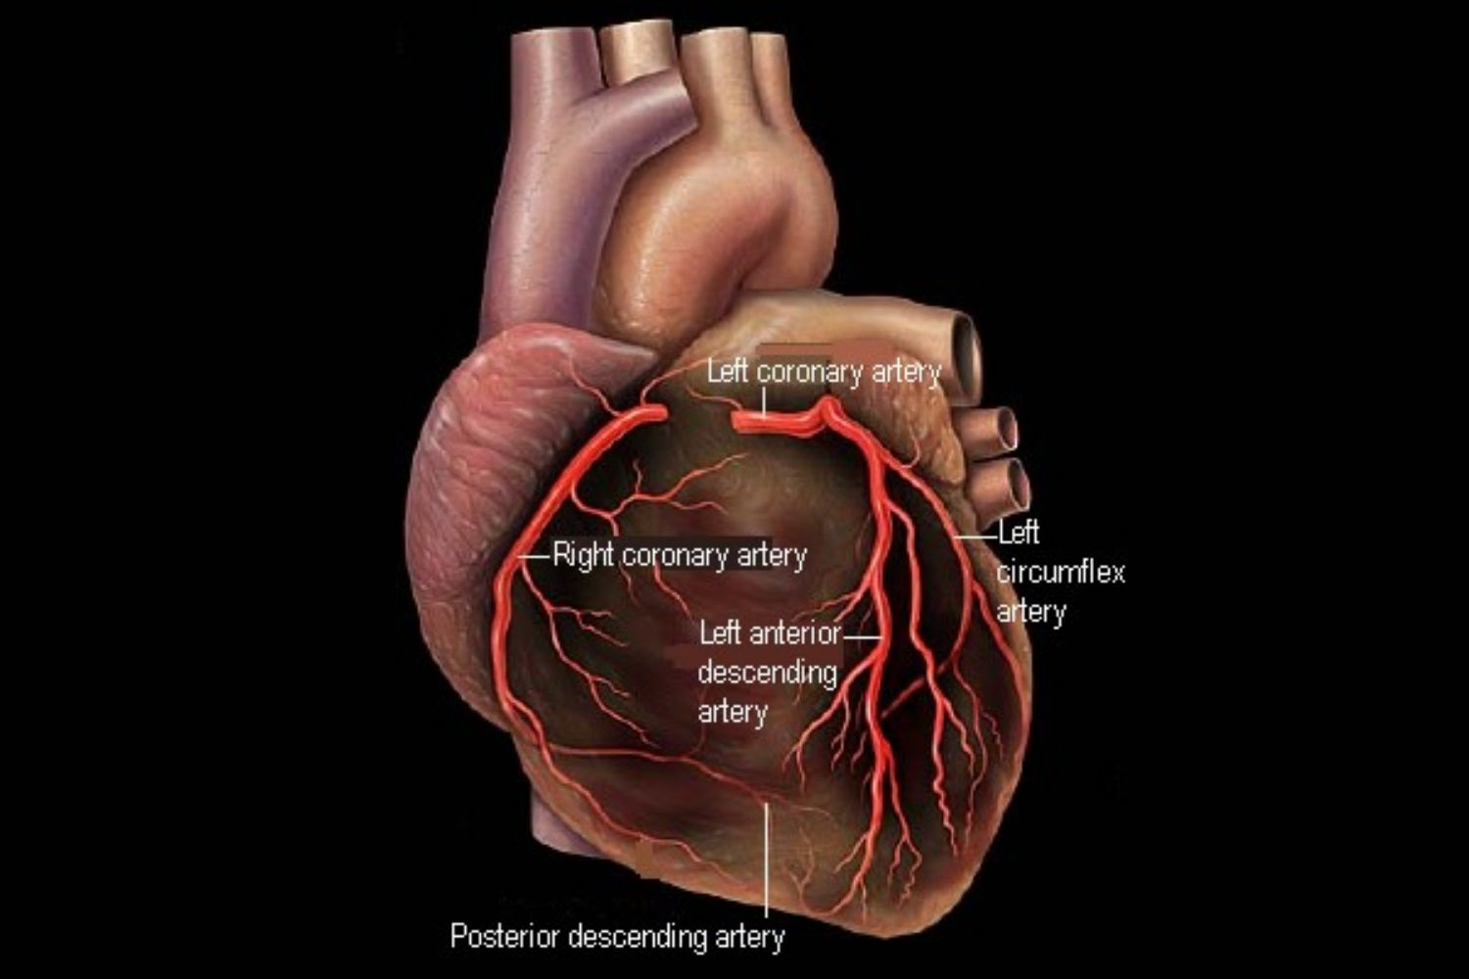

Slide 37
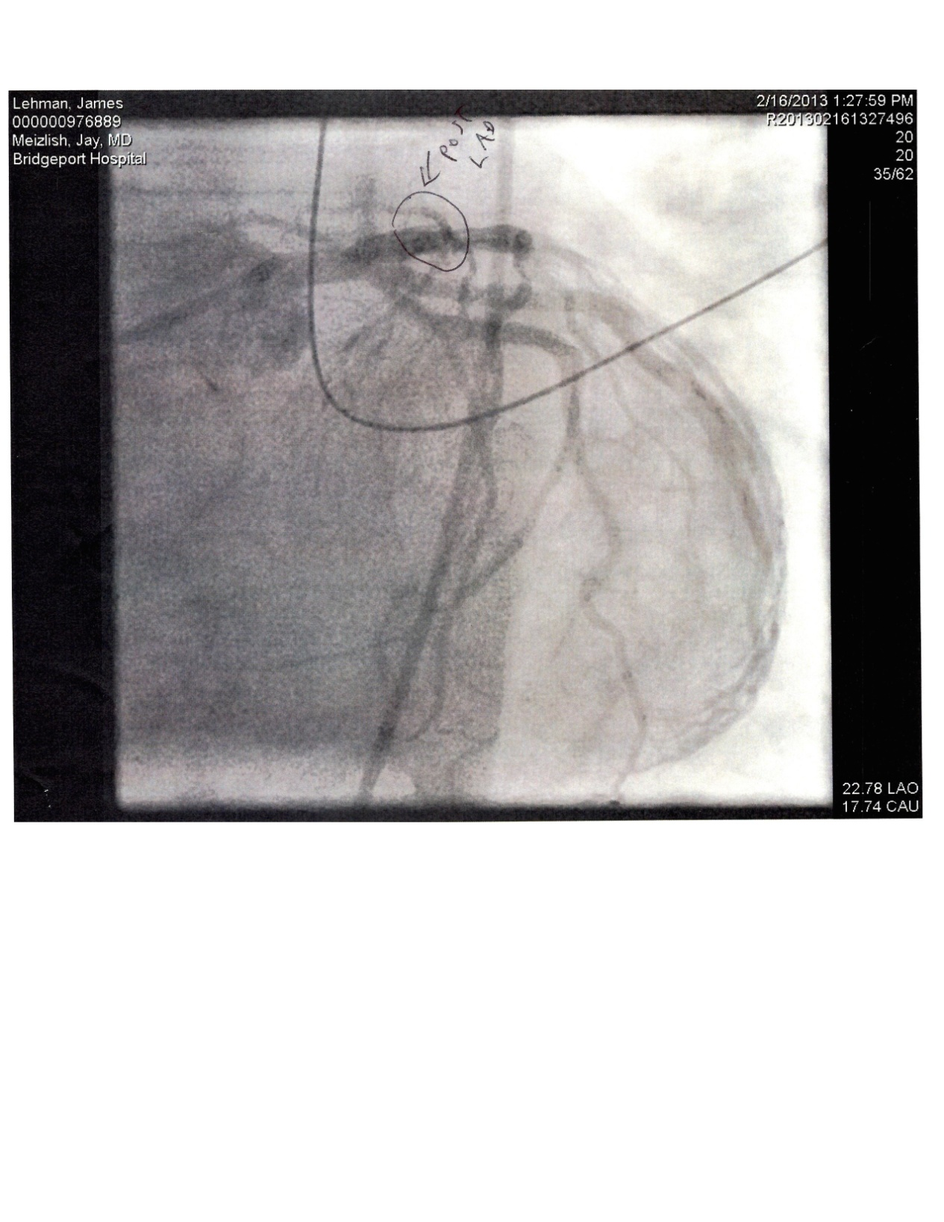
Case Report
Angioplasty (One stent implant) restored circulation and the patient recovered without signs of permanent heart damage.

Slide 39
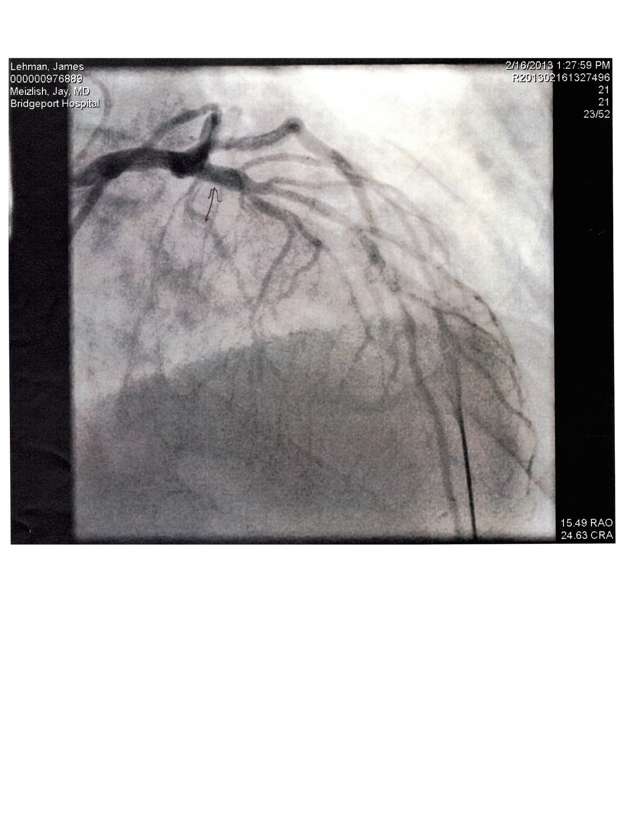

Slide 40
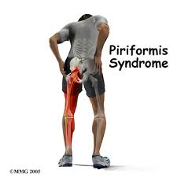
Muscle Pain and Piriformis Syndrome
Approximately 2-4 weeks post surgery the patient experienced severe muscle pains and piriformis syndrome

Slide 41
Clinical Challenge
Please list the subjective and objective findings that would differentiate lumbar radiculopathy and piriformis syndrome due to piriformis compression of the sciatic nerve.

Slide 42
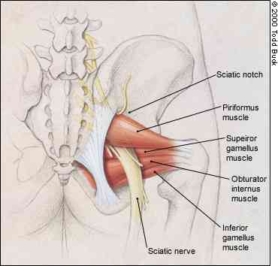
Piriformis Syndrome
Piriformis syndrome is a neuromuscular condition characterized by a constellation of symptoms that includes hip and buttock pain. The pain is often referred down the back of the leg, sometimes into the medial foot.
Kirschner JS, Foye PM, Cole JL. Piriformis syndrome, diagnosis and treatment. Muscle Nerve. 2009;40(1):10-18. doi: 10.1002/mus.21318.

Slide 43
Symptoms of Piriformis Syndrome
Pain in buttocks and affected limb with sitting and rising to stand from seated or squatting position
Pain and/or paresthesias from sacral area to affected limb
Change of position does not relieve pain completely
Increasing pain after sitting for longer than 15-20 minutes (most common symptom)

Slide 44
Symptoms of Piriformis Syndrome
Weakness in ipsilateral lower extremity
Contralateral SIJ pain
Headaches
Neck pain
Abdominal, pelvic, and inguinal pain
Dyspareunia in women
Pain with bowel movements

Slide 45
Signs of Piriformis Syndrome
Tenderness in region of SIJ, greater sciatic notch, and piriformis muscle
Palpable mass in ipsilateral buttock
Asymmetrical weakness of affected limb
Presence of Pace, Piriformis, Frieberg, Lasegue, and Beatty signs
Ipsilateral leg length inequality
Gluteal atrophy (chronic cases only)

Slide 46
Evaluation and Management of Drug Induced Myopathy and Piriformis Syndrome
Statin holiday and determine response
Resume statin medications with reduced dosage and determine response
Change from one statin medication to another and determine response
If patient is allergic to statins it might be necessary to discontinue and switch to niacin
Dietary changes, regular exercise, and stress control is mandatory

Slide 47
Piriformis Syndrome and drug induced myopathy
Piriformis syndrome is an uncommon cause of sciatica. It is frequently posttraumatic or in relation with anatomic abnormalities; its diagnosis is often difficult, and it needs the exclusion of common causes of sciatica. Piriformis syndrome caused by drug-induced myopathy in relation with use of statin has not been described before. We report the case of a 60-year-old woman with a history of dyslipidemia treated by atorvastatin since 3 years, who complained of a chronic pain in the left buttock radiating to the posterior thigh and knee that had been increasing during the previous 3 months. At physical examination, the patient has lameness at walking. The lumbar spine was not tender and had full range of motion. Findings on all radicular provocation tests were normal, and tests stretching the piriformis muscle were positive. Radiographs of the pelvis and lumbar spine were unremarkable. Magnetic resonance images of the lumbar spine and pelvis was performed, showing high signal intensity in T2-weighted sequences of the piriformis muscle. Treatment with atorvastatin was occasionally discontinued, and the patient reports an improvement of the sciatic pain. Reintroduction of atorvastatin was associated with relapse of the sciatic pain. Thus, clinical features and magnetic resonance imaging findings confirm that sciatic pain was related with piriformis myopathy as an adverse effect of statin.
Wafa Hamdi, et al. Piriformis Muscle Syndrome An Unusual Adverse Effect of Atorvastatin
Journal of clinical rheumatology: practical reports on rheumatic & musculoskeletal diseases 19(3). March 2013

Slide 48
Statin-induced myopathies
Available from:https://scinapse.io/papers/2050971140
2011 in Pharmacological Reports
Abstract Statins are considered to be safe, well tolerated and the most efficient drugs for the treatment of hypercholesterolemia, one of the main risk factor for atherosclerosis, and therefore they are frequently prescribed medications. The most severe adverse effect of statins is myotoxicity, in the form of myopathy, myalgia, myositis or rhabdomyolysis. Clinical trials commonly define statin toxicity as myalgia or muscle weakness with creatine kinase (CK) levels greater than 10 times the normal upper limit. Rhabdomyolysis is the most severe adverse effect of statins, which may result in acute renal failure, disseminated intravascular coagulation and death. The exact pathophysiology of statin-induced myopathy is not fully known. Multiple pathophysiological mechanisms may contribute to statin myotoxicity. This review focuses on a number of them. The prevention of statin-related myopathy involves using the lowest statin dose required to achieve therapeutic goals and avoiding polytherapy with drugs known to increase systemic exposure an...

Slide 49
Discussion
Describe your experiences with the evaluation and management of patient’s presenting for painful neuromusculoskeletal conditions and taking statin medications…

Slide 50
Closing Statement …
Diagnosis is the key to successful treatment!

Slide 51


