Slide 1
How to receive enhanced payments for chiropractic services from Medicare and Medicaid
James J. Lehman, DC, MBA, FIANM
Fellow International Academy of Neuromusculoskeletal Medicine
Associate Professor of Clinical Sciences
School of Chiropractic
Director, Community Health Clinical Education
University of Bridgeport

Slide 2
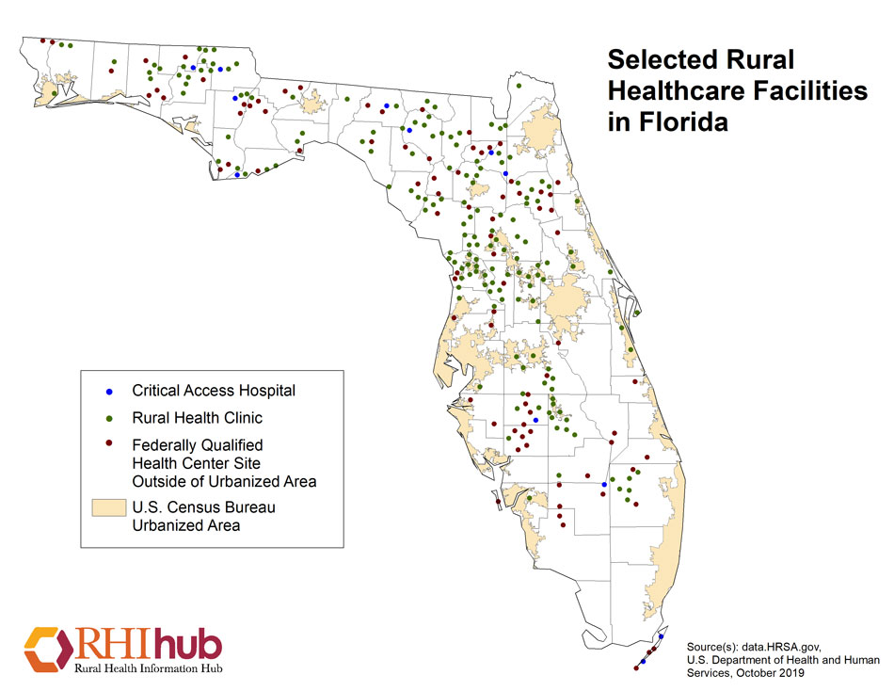
Florida Rural Healthcare Facilities
12 Critical Access Hospitals
163 Rural Health Clinics
84 Federally Qualified Health Center sites located outside of Urbanized Areas
27 short term hospitals located outside of Urbanized Areas

Slide 3

Enhanced Medicaid and Medicare Payments
FQHC 2020 Medicare enhanced rate $173 per visit
RHC 2020 Medicare enhanced rate $84 per visit

Slide 4

Enhanced Medicaid and Medicare Payments
FQHC and RHC negotiated Medicaid rate range
$130-150 per visit

Slide 5
Learning Objectives
First 90 minutes
Realize the steps necessary to integrate chiropractic services into a Community Health Center/FQHC and Rural Health Centers
Final 30 minutes
Comprehend the need for chiropractors to provide differential diagnosis and prognosis for patients suffering with chronic pain syndrome vs chronic pain illness/high impact chronic pain.

Slide 6
Why Chiropractic Services Should be Integrated into Federally Qualified Health Centers and Rural Health Centers

Slide 7
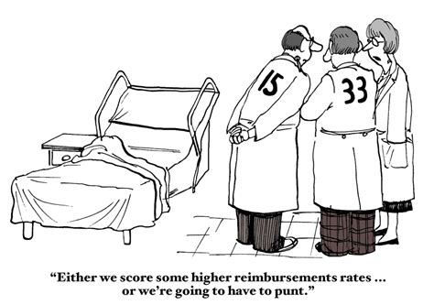

Slide 8


Slide 9


Slide 10
Primary Care 2025 Predictions
The resulting policies accelerated the evolution of PCMHs into CCHHs, which provide primary care to 85% of the population.
This care is fully capitated in 2025.
About 10% of the population receives fee-for-service (FFS) “concierge” care aimed at the very rich, who have insurance but pay additional fees for special services; 5% of the population remains uninsured in 2025 and gets primary care, if and when they get it, from emergency rooms and community health centers (CHCs).
Institute for Alternative Futures. Primary Care 2025: A Scenario Exploration. Alexandria, VA. January 2012. Available from http://www.altfutures.org/pubs/pc2025/IAF-PrimaryCare2025Scenarios.pdf.

Slide 11


Slide 12


Slide 13


Slide 14
Barriers to Entry and Chiropractic Integration
Medicaid covered 60% of CHC patients
Medicaid in Connecticut was not funded to cover chiropractic services

Slide 15

Barriers to Entry and Chiropractic Integration
Primary care providers were the gatekeepers in CHC primary care sites
Primary care providers had never referred to a chiropractor (1972)
Primary care providers expressed significant concerns regarding use of chiropractors

Slide 16

Credentialing
In order to be credentialed as members of the medical staff, chiropractors were required to be chiropractic specialists.

Slide 17


Slide 18


Slide 19
Community Health Center
Pilot Study
Nine (9) months in Meriden Primary Care facility
PCPs to refer adult patients with chronic pain
One UBCC, DC faculty member to provide care and supervise students
Teams of (3) fourth-year, chiropractic students provided hands-on treatment
Determine change in functionality, referral pattern changes, patient and provider satisfaction

Slide 20
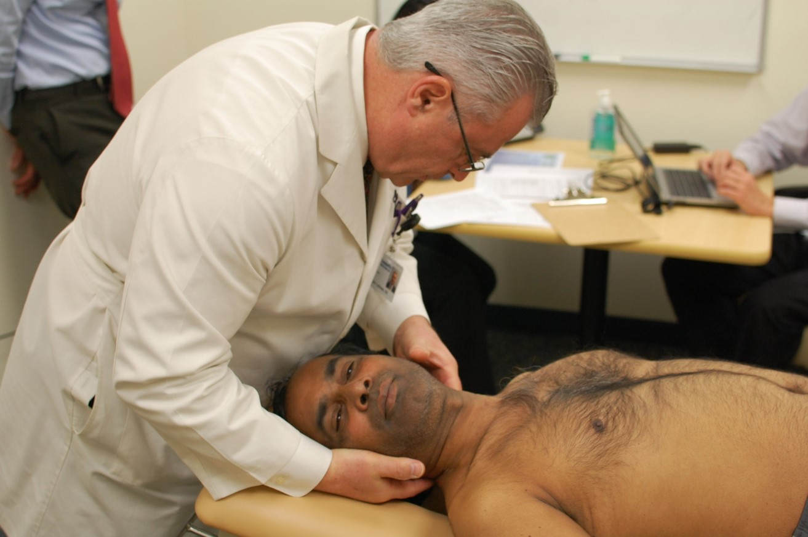
Pilot Study Outcomes
PCPs referred adult, chronic pain patients
98.5% patient satisfaction
High level of provider satisfaction
Statistically significant improvement in functionality

Slide 21

Following a six-month pilot study, the Community Health Center, Inc. of Middletown, Connecticut accepted board-certified chiropractic specialists to the medical staff.

Slide 22

Community Health Center Tasks
Petition HRSA to expand scope of practice and scope of reimbursement to include chiropractic services for Medicaid patients
Petition Connecticut to pay CHC for Medicaid patients receiving chiropractic services

Slide 23

Community Health Center Tasks
Education

Slide 24

Community Health Center Tasks
Chiropractic Credentialing

Slide 25
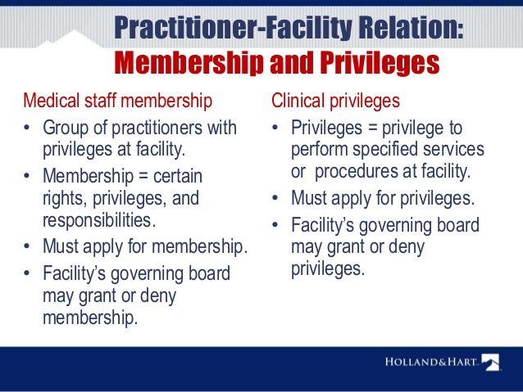
Community Health Center Tasks
Chiropractic Privileges

Slide 26
Integration
Chiropractic specialists were credentialed as members of the medical staff with evaluation and management privileges plus specific chiropractic services.

Slide 27

Chiropractic Integration
Full access and use of the electronic medical record

Slide 28

Chiropractic Integration
Seamless referral process, which reduces stress for patients

Slide 29
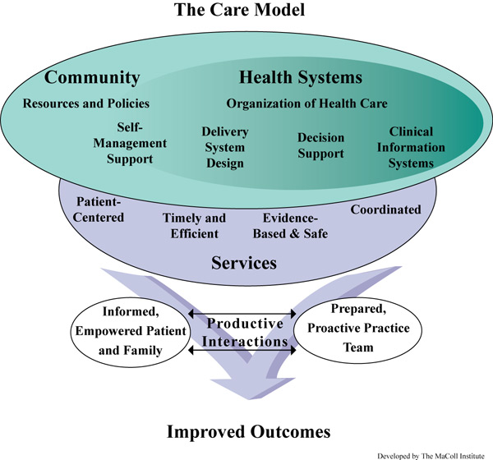

Slide 30
Chiropractic Integration Outcomes
Increased referrals to chiropractic providers
Reduced referrals to orthopedic surgeons
Increased patient satisfaction
Chronic pain patients experienced improved function
Reduced use of opioids
Primary care provider satisfaction with chiropractic services

Slide 31
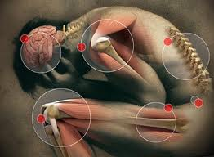
Neuromusculoskeletal Conditions Treated
Acute and chronic pain:
  Spinal pain
  Cervicogenic headaches
  Myofascial pain syndromes
  Piriformis syndrome and sciatica
  Nerve root radiculopathy and brachial plexopathy
  Peripheral compression neuropathies
  Coccygodynia

Slide 32
Chiropractic Services
Procedures
Spinal and extremity manipulation
Soft tissue treatments
Physiological therapeutics

Slide 33

Chiropractic Services
Prevention and Wellness
  Smoking cessation
  Nutrition and hydration
  Specific exercise programs
  Posture

Slide 34
Primary Diagnostic Codes
G89.4 Chronic Pain Syndrome
G89.21 Chronic Pain Post-traumatic
G89.11 Acute Pain Post-traumatic

Slide 35
Billing and Coding
E/M
  99213 Intermediate evaluation and management of established patient
CPT
  98940 CMT spinal 1-2 regions
  98941 CMT spinal 3-4 regions
  98943 CMT extra spinal
  97140 Manual therapy techniques (soft tissue treatments)

Slide 36
Patient Comments
I like the chiropractor because now I know what is wrong.
The chiropractors make me feel better.
I don’t want to take the drugs anymore.
We need more chiropractors!

Slide 37
Patient Outcomes
Reduced use of opioids
Improved quality of life
Patient satisfaction
Provider satisfaction
Improved function

Slide 38
“We have found that the integration of chiropractic services enabled our patients to experience less pain and promoted healthy living. Hopefully, other community health centers in Connecticut and across the country will use our model to reduce chronic pain and improve quality of life.”
Margaret Flinter, Ph.D.
Senior Vice President and Clinical Director
Community Health Center, Inc.

Slide 39

Chiropractic Specialty Training
Selected Neuromusculoskeletal Medicine training

Slide 40

Chiropractic Specialty Training
300-hour program for practicing chiropractors
  50 hours of live, seminar training
  250 hours of Advanced Online Clinical Training

Slide 41
University of Bridgeport
Residency in neuromusculoskeletal medicine

Slide 42

Chiropractic Specialty Training
Three-year, full-time residency
Primary care sites (21 in Connecticut and New Jersey)
Credentialed as a member of the medical staff of an FQHC/Community Health Center
Function as a chiropractic specialist on a primary care team

Slide 43
Chiropractic Specialty Training
Board Certification with the Academy of Chiropractic Orthopedists/International Academy of Neuromusculoskeletal Medicine

Slide 44
Minnesota Rural Health Care
According to data.HRSA.gov, as of October 2019 Minnesota had:
78 Critical Access Hospitals
99 Rural Health Clinics
13 Federally Qualified Health Center sites located outside of Urbanized Areas
25 short term hospitals located outside of Urbanized Areas
How to receive enhanced payments for chiropractic services from Medicare and Medicaid."

Slide 45

Differential Diagnosis
Chronic pain syndrome vs chronic pain illness

Slide 46
Chronic Pain
Chronic pain—commonly defined as pain persisting longer than six months—affects an estimated 70 million Americans and is a tragically overlooked public health problem.
The burden of chronic pain is greater than that of diabetes, heart disease and cancer combined.
Ongoing pain can also undermine overall physical, psychological, and social well-being, and is a major cause of disability and costly health care utilization.
A Call to Revolutionize Chronic Pain Care in America: An Opportunity in Health Care Reform

Slide 47

Chronic pain (syndrome) is pain that occurs on at least half the days for six months or more (2016).

Slide 48
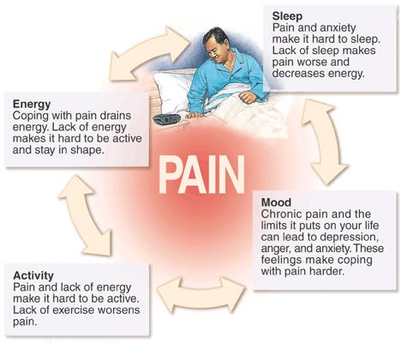

Slide 49
Chronic Pain and Central Sensitization
Central sensitization is a condition of the nervous system that is associated with the development and maintenance of chronic pain.
When central sensitization occurs, the nervous system goes through a process called wind-up and gets regulated in a persistent state of high reactivity.
This persistent, or regulated, state of reactivity lowers the threshold for what causes pain and subsequently comes to maintain pain even after the initial injury might have healed.
Phillips, K. & Clauw, D. J. (2011). Central pain mechanisms in chronic pain states – maybe it is all in their head. Best Practice Research in Clinical Rheumatology, 25, 141-154.

Slide 50
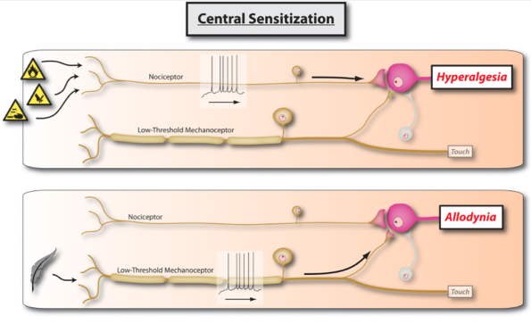
Chronic Pain and Central Sensitization
Sensory Function Disturbances
  Hypersensitivity (decreased pain threshold) to pressure, thermal, electrocutaneous
  Spinal cord hypersensitivity (central sensitization)
Sterling M, Kenardy J. Physical and psychological aspects of whiplash: Important considerations for primary care assessment. Man her. 2008;13:93-102.

Slide 51
Chronic Pain Illness
Most people in pain, including those with chronic symptoms, go to primary care providers to get relief.
But current systems of care do not adequately train or support internists, family physicians and pediatricians, the other health care providers who provide primary care in meeting the challenge of treating pain as a chronic illness.
A Call to Revolutionize Chronic Pain Care in America: An Opportunity in Health Care Reform

Slide 52
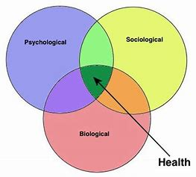
Chronic Pain Illness

Slide 53

Chronic Pain Syndrome
Pain occurs on 4 days per week for more 6 months or longer
Appropriate care following injury
Higher level of education
Control of employment
Low to moderate pain scale scores
Coping skills
Short- term disability
Properly insured

Slide 54

Post-traumatic Chronic Pain Illness
Pain on a daily basis for more than 6 months
Inappropriate care or delayed care following injury
Lower level of education
Loss of minimum wage job(s)
Extremely high pain scale scores
Emotionally charged
Disability

Slide 55

Psychological Factors and Chronic Pain Illness
Affective disorders
Anxiety
Depression
Behavioral abnormalities (fear of movement)
Posttraumatic stress

Slide 56

Supports the development of a system of patient-centered integrated pain management practices based on a biopsychosocial model of care that enables physicians and patients to access the full spectrum of pain treatment options…

Slide 57
Inadequate Pain Treatment
Currently, large numbers of Americans receive inadequate pain prevention, assessment, and treatment, in part because of financial incentives that work against the provision of the best, most individualized care; unrealistic patient expectations; and a lack of valid and objective pain assessment measures.
A Call to Revolutionize Chronic Pain Care in America: An Opportunity in Health Care Reform

Slide 58
PCP and Chronic Pain…
…primary care practitioners are an early step in the pain care journey, treating 52 percent of chronic pain patients in the United States based on a national mail survey of primary care physicians, physician pain specialists, chiropractors, and acupuncturists (Breuer et al., 2010).

Slide 59

Interdisciplinary team…
Ideally, most patients with severe persistent pain would obtain pain care from an interdisciplinary team, as opposed to a specialist who might focus on a narrow range of treatments and have a restricted view of how pain is affecting the patient.

Slide 60
Primary Care Team
In the primary care setting, the team most often includes a primary care practitioner, nurse, and mental health clinician but should include chiropractic specialists.

Slide 61


Slide 62
Prevalence and Profile of High-Impact Chronic Pain in the United States
The multidimensional nature of chronic pain is not reflected by definitions based solely on pain duration, resulting in high prevalence estimates limiting effective policy development.
The newly proposed concept of high-impact chronic pain (HICP) incorporates both disability and pain duration to identify a more severely impacted portion of the chronic pain population yet remains uncharacterized at the population level.
Pitcher M. et al. Prevalence and Profile of High-Impact Chronic Pain in the United States. J Pain. 2019 Feb;20(2):146-160.

Slide 63
Prevalence and Profile of High-Impact Chronic Pain in the United States
Overall, chronic pain, defined as pain experienced on most days or every day in the previous 3 months, was strongly associated with an increased risk of disability after controlling for other chronic health conditions (odds ratio = 4.43; 95% confidence interval = 3.73-5.26), where disability was more likely in those with chronic pain than in those with stroke or kidney failure, among others.

Slide 64
Prevalence and Profile of High-Impact Chronic Pain in the United States
HICP affected 4.8% of the U.S. adult population, or approximately 10.6 million individuals, in 2011.
The HICP population reported more severe pain and more mental health and cognitive impairments than persons with chronic pain without disability, and was also more likely to report worsening health, more difficulty with self-care, and greater health care use.

Slide 65
Prevalence and Profile of High-Impact Chronic Pain in the United States
HICP clearly represents a more severely impacted portion of the chronic pain population.
Understanding this heterogeneity will contribute to developing more effective legislation promoting safe and cost-effective approaches to the prevention and treatment of chronic pain.

Slide 66
Prevalence and Profile of High-Impact Chronic Pain in the United States
HICP is a powerful new classification that differentiates those with debilitating chronic pain from those with less impactful chronic pain. By addressing the multidimensionality of chronic pain, this classification will improve clinical practice, research, and the development of effective health policy.

Slide 67


Slide 68


