Slide 1

Chiropractic Resident Training
James J. Lehman, DC, DIANM
Program Director
Neuromusculoskeletal Medicine Resident Training Program

Slide 2

Disclosure
My travel expenses were covered by Bioposture.com

Slide 3


Native of Belleville, Illinois

Slide 4
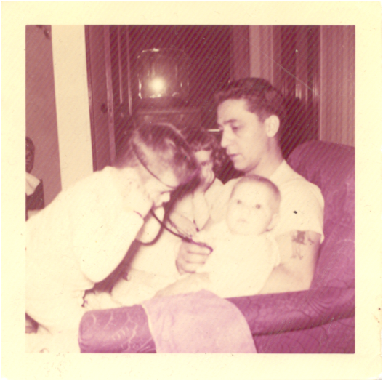
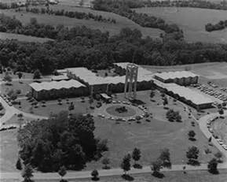
Future Chiropractic Physician

Slide 5


Slide 6


Slide 7

Sandia Mountains and high mountain deserts…

Slide 8
Opinion
Our profession must make chiropractic services more available and accessible.
Integration of chiropractic services into health care systems is one solution.
Chiropractors must collaborate with all types of health care providers.

Slide 9
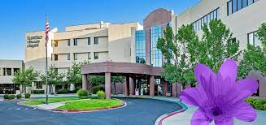

Chiropractic Integration

Slide 10


University of New Mexico

Slide 11
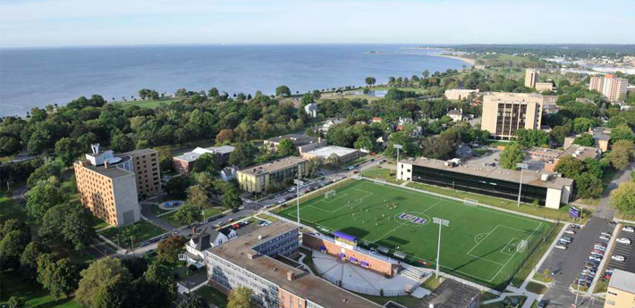

Slide 12

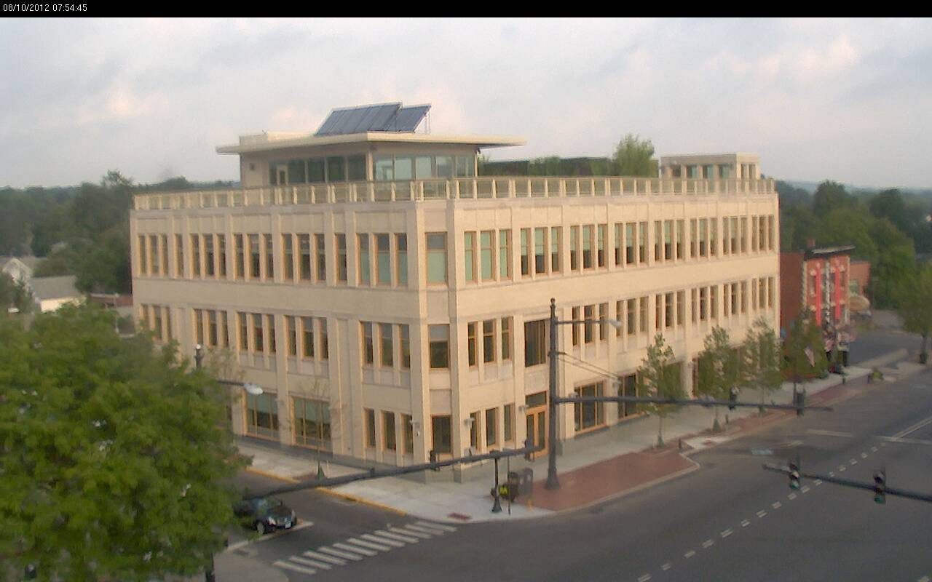
Federally Qualified Health Centers

Slide 13


Strategic Partnership

Slide 14
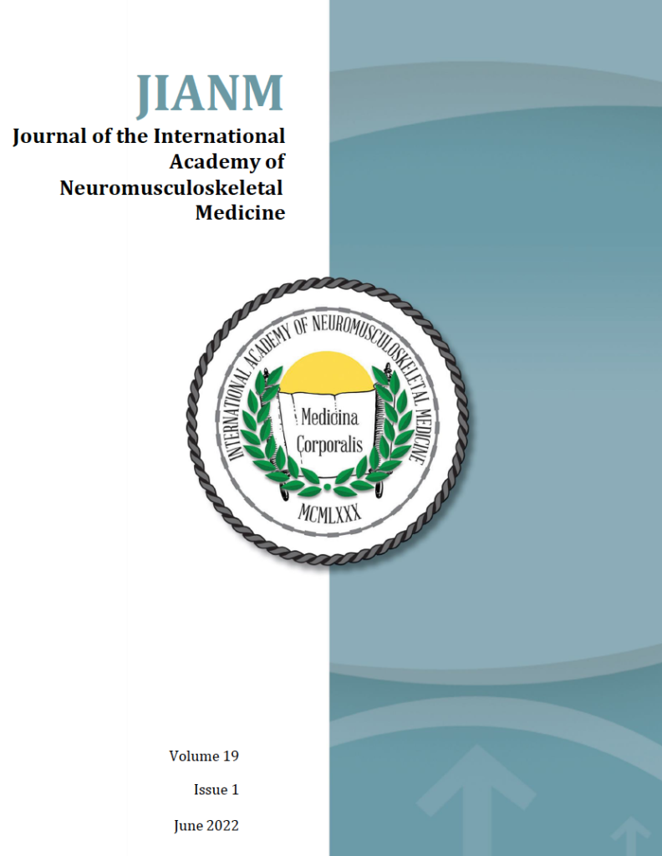

Accreditation

Slide 15
Neuromusculoskeletal Medicine Residency Training for Chiropractic Physicians
The University of Bridgeport offers a three-year, full-time, resident training program, which prepares licensed chiropractic providers to become part of the primary care team and board-certified chiropractic specialists.
The training of licensed chiropractic providers takes place within Federally Qualified Health Centers.
Chiropractic residents are credentialed as members of the medical team.
The focus of the chiropractic interventions include evaluation and management of patients suffering with acute and chronic pain caused by neuromusculoskeletal conditions.

Slide 16
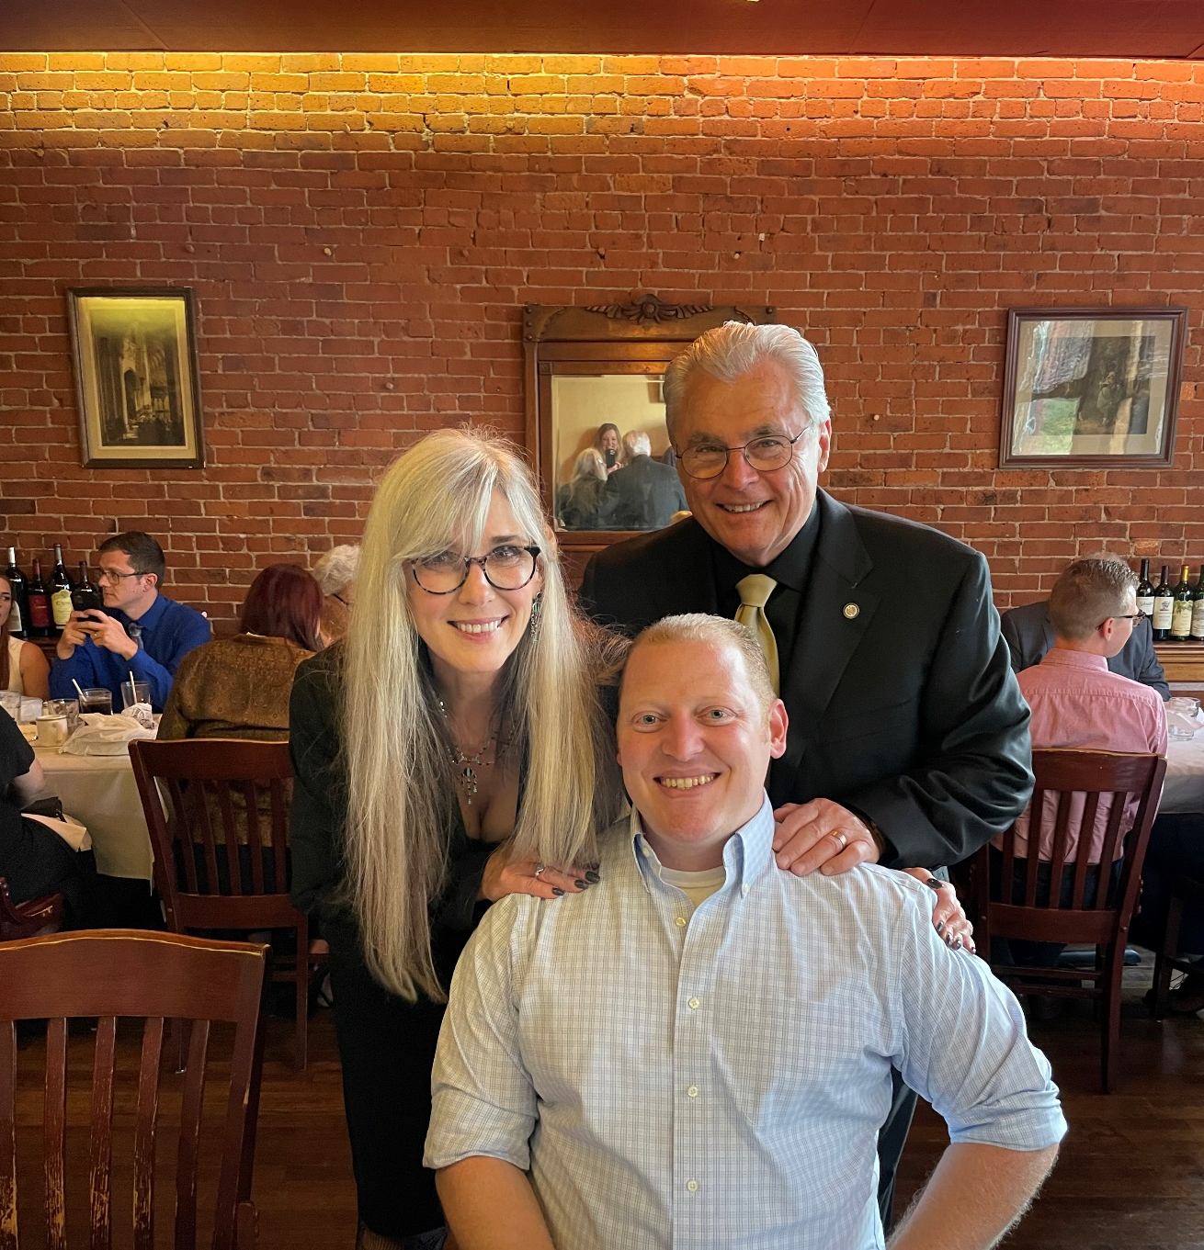
Resident Data
Since 2013, twelve doctors have been accepted into the resident training program.
Five doctors successfully completed the program.
Four doctors did not successfully complete the program.
Three are currently in process.

Slide 17
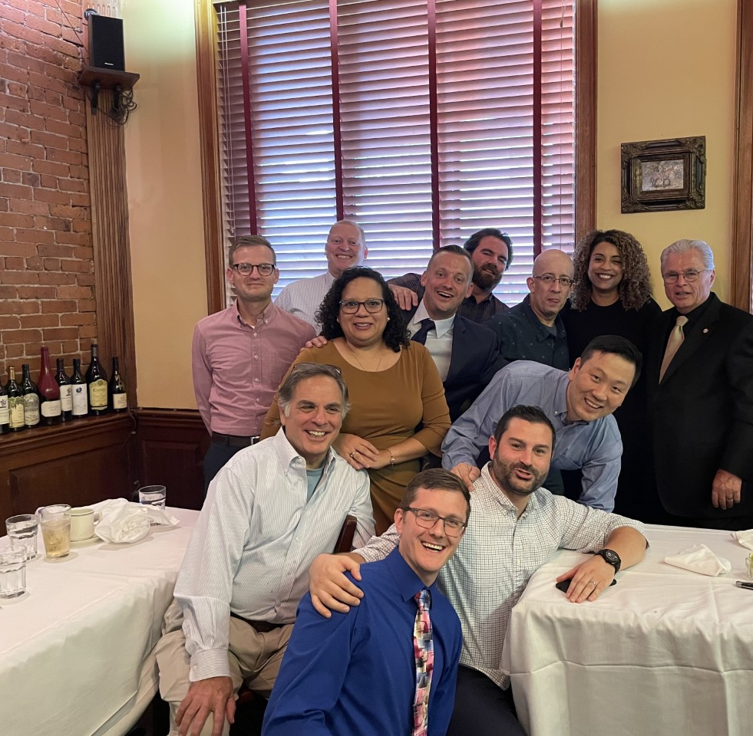
Neuromusculoskeletal Medicine
Faculty and Resident Careers
Four of the faculty have accepted positions with the VA
Two of the residents accepted positions with the VA
One of the residents accepted a position with a hospital organization and then the VA.
Three of the residents became clinician educators with the University of Bridgeport

Slide 18

Chiropractors Graduating Per Annum
According to the National Board of Chiropractic Examiners more than 2500 chiropractic students complete the four parts of the examinations.

Slide 19

Community Health Center Patient Population
Over 30,000,000 Americans per annum seek health care within community health centers.
10% of this population seeking chiropractic services for painful neuromusculoskeletal conditions = 3,000,000 patients.
4,160 patient visits per annum
Demand = 721 chiropractic specialists

Slide 20
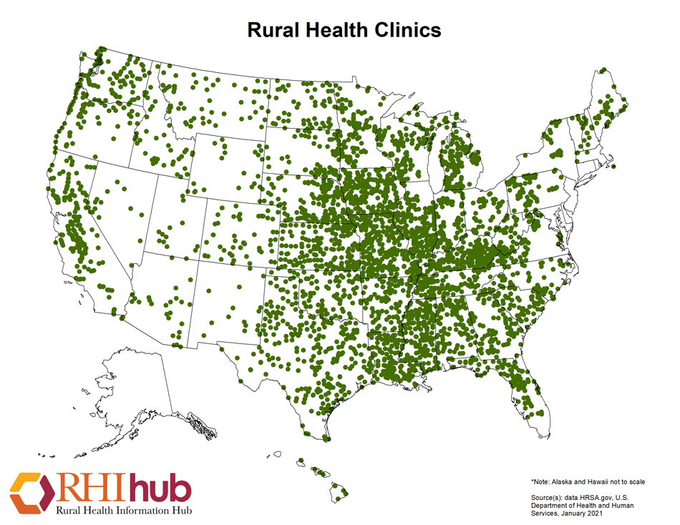
Rural Health Clinics
20% of 61 million rural Americans seek medical services from rural health clinics.
12.2 million rural Americans
10% = 1,220,000 potential chiropractic patients
4160 patient visits per annum
Demand for chiropractic specialists = 293

Slide 21

My Goal
Create a career pathway for 100 chiropractic graduates per annum that includes a three-year, full-time, resident training program that leads to board certification in chiropractic orthopedics or neuromusculoskeletal medicine and successful careers.

Slide 22
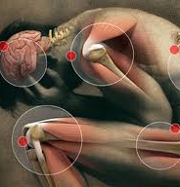
Inadequate Pain Treatment
Currently, large numbers of Americans receive inadequate pain prevention, assessment, and treatment, in part because of financial incentives that work against the provision of the best, most individualized care; unrealistic patient expectations; and a lack of valid and objective pain assessment measures.
A Call to Revolutionize Chronic Pain Care in America: An Opportunity in Health Care Reform

Slide 23

Chiropractic Specialty Training
Board Certification with the International Academy of Neuromusculoskeletal Medicine

Slide 24


Patient Outcomes
Reduced use of opioids
Improved quality of life
Patient satisfaction
Provider satisfaction
Improved function

Slide 25
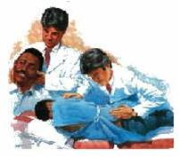
Starting a Chiropractic Residency

Slide 26

University of Bridgeport Responsibilities
Recruit residents
Oversee the program
Provide 300-hour online training
Credential the successful resident

Slide 27

Chiropractic Resident’s Career Pathway
Veterans Administration
Federally Qualified Health Centers
Rural Health Centers
Hospital organizations
Medical and Chiropractic Schools
Corporate practices

Slide 28

Student Loan Forgiveness
2007 Public Student Loan Forgiveness program
10 years of employment with a Governmental agency or a non-profit corporation.

Slide 29

Chiropractic Institution’s Responsibilities
Provide management, facilities and equipment
Provide resident’s salary and benefits
Pay the cost of online education
Pay for all liability coverage

Slide 30

Symbiotic Relationship
Collaborate with the University of Bridgeport and develop a resident training program that will attract intelligent, motivated, and patient-centered chiropractic providers from all of the North American schools of chiropractic medicine.

Slide 31
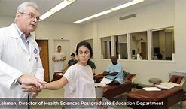
Patient Benefits
Support the training of chiropractic specialists that will provide high quality, evidence-based, and patient-centered chiropractic evaluation and management services within Community Health Center clinics.

Slide 32

Chiropractic Institution’s Revenue
Payment for each patient visit insured by Medicare or Medicaid (uninsured patients may not produce revenue)

Slide 33

Chiropractic Institution’s Costs
Salary and benefits
  $70,000 salary or more
Professional liability
  $3000 approximately
Neuromusculoskeletal Medicine Postdoctoral classes and University of Bridgeport oversight
  $12,000 over three years

Slide 34


Slide 35


