Slide 1
Internal Derangement of the Knee and Anterior Knee Pain
James J. Lehman, DC, MBA, FIANM
Associate Professor of Clinical Sciences
School of Chiropractic
Director
Community Health Clinical Education Department
University of Bridgeport

Slide 2
Learning Objectives
Correlate anatomy and the patients’ signs and symptoms in order to locate the neuromusculoskeletal lesions of the knee and properly record the findings.

Slide 3
Learning Objectives
Elicit a patient history and record the subjective findings in order to perform differential diagnosis procedures and determine use of objective testing.

Slide 4
Learning Objectives
Perform neuromusculoskeletal evaluation procedures (Posture, orthopedic and neurological) and record the objective findings in order to make an assessment/diagnosis.

Slide 5
Learning Objectives
Organize a clinical thought process while performing a neuromusculoskeletal evaluation.
Identify injured and painful tissues through careful assessment and intelligent use of neuromusculoskeletal testing and document the findings.

Slide 6

Opening Statement …
Diagnosis is the key to successful treatment!

Slide 7
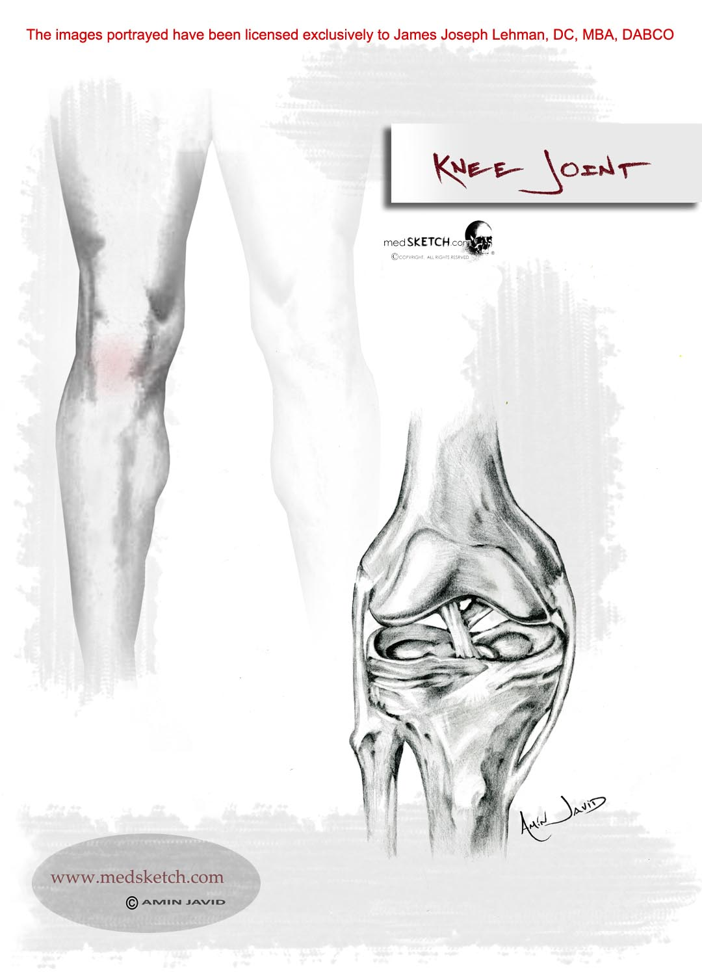
Knee pain accounts for approximately one third of musculoskeletal problems seen in primary care settings.

Slide 8
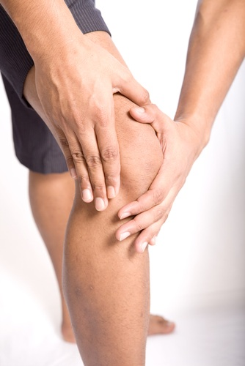
Knee pain is most prevalent in physically active patients, with as many as 54 percent of athletes having some degree of knee pain each year.
Rosenblatt RA, Cherkin DC, Schneeweiss R, Hart LG. The content of ambulatory medical care in the United States. An interspecialtycomparison. N Engl J Med. 1983;309:892–7.

Slide 9

The abbreviation, “IDK” often means “I don’t know” rather than internal derangement of the knee.

Slide 10
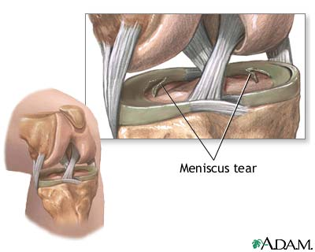
Internal Derangement of the Knee
ICDA 10 M23.91
Internal derangement of the knee (IDK) is the term used to cover a group of disorders involving disruption of the normal functioning of the ligaments or cartilages (menisci) of the knee joint.

Slide 11
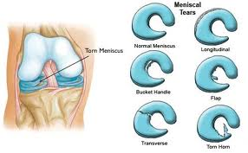

Slide 12
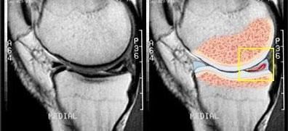
Unspecified Internal Derangement of Knee
ICD-10-CM Code M23.91

Slide 13
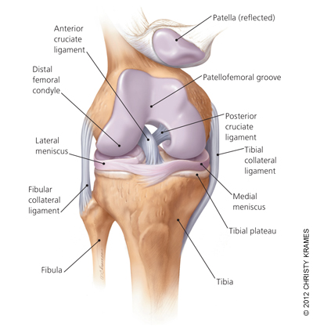
American Family Physician
Evaluating Acutely Injured Patients for Internal Derangement of the Knee.
Am Fam Physician. 2012 Feb 1;85(3):247-252.
MICHAEL GROVER, DO, Mayo Clinic College of Medicine, Scottsdale, Arizona
http://www.aafp.org/afp/2012/0201/p247.html

Slide 14
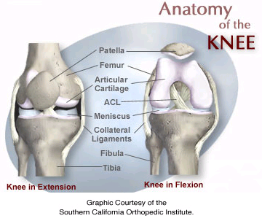

Slide 15
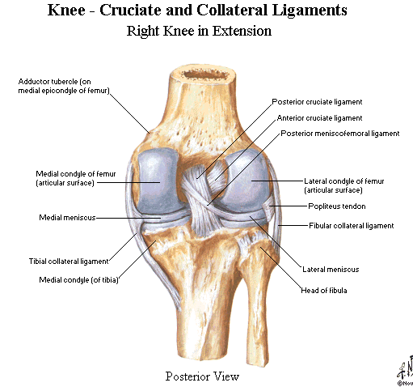

Slide 16
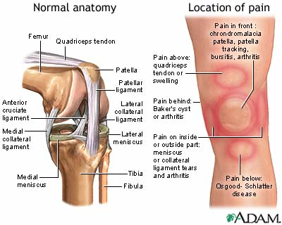

Slide 17

History:
Painful Tissue Identification Check List
Ask the patient to point to the pain
When did the pain commence?
Trauma?
What makes it better or worse?
Quality of the pain
Radiating or localized?
Pain severity rating
When is it painful
Treatments and reaction?
Previous diagnoses?

Slide 18
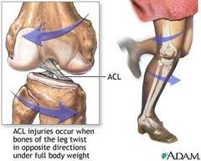
ACL Sprain Mechanism of Injury

Slide 19
Generalized Pain Description
Joint pain may be constant dull, deep ache but sharp upon motion
Muscle pain may be a dull ache, crampy or spasm sensation
Trigger points may be localized with pin point pain or diffuse with poor localization and paresthesias (formication)

Slide 20
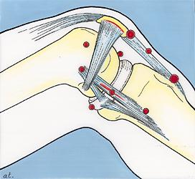
Knee Pain
Can you identify the condition with the point of pain?
Osgood Schlatter’s Disease?
Jumper’s knee?
PFA?
Collateral ligament sprain?
Meniscal tear?

Slide 21
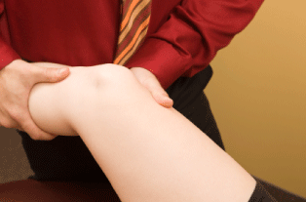
Examination Protocols
History taking or interview
Observation and inspection
Palpation
Range of motion
Special tests
3 part-PNS exam
Imaging

Slide 22
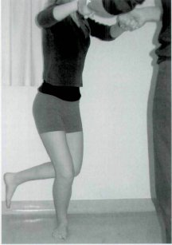
Orthopedic test
A provocative maneuver (most often) using stretching, compressing, and contracting to duplicate the pain and identify the involved tissues.

Slide 23
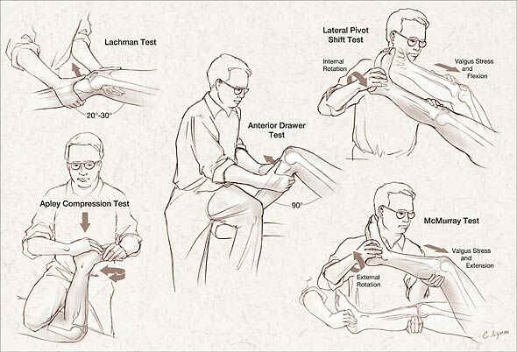

Slide 24
Diagnostic accuracy of a new clinical test (the Thessaly test) for early detection of meniscal tears. J Bone Joint Surg Am. 2005 May;87(5):955-62.
Available from: http://www.ncbi.nlm.nih.gov/pubmed/15866956
The Thessaly test at 20 degrees of knee flexion had a high diagnostic accuracy rate of 94% in the detection of tears of the medial meniscus and 96% in the detection of tears of the lateral meniscus, and it had a low rate of false-positive and false-negative recordings. Other traditional clinical examination tests, with the exception of joint-line tenderness, which presented a diagnostic accuracy rate of 89% in the detection of lateral meniscal tears, showed inferior rates.

Slide 25
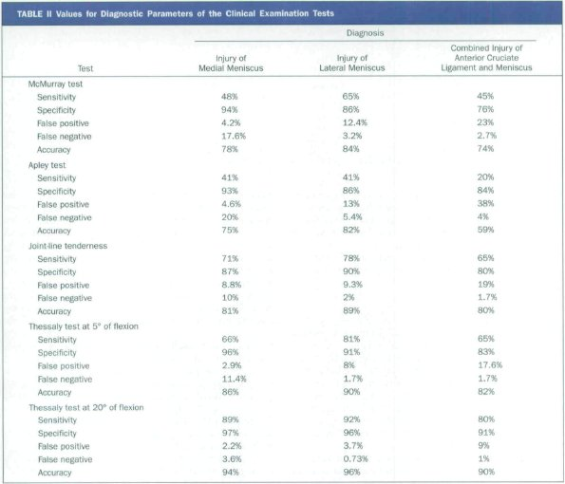

Slide 26
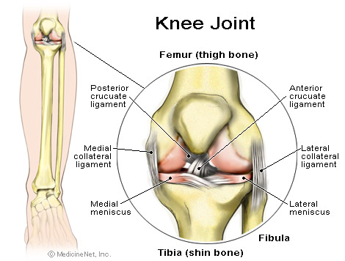
Ligament Injuries
Medial collateral and anterior cruciate ligaments are the most commonly injured.

Slide 27
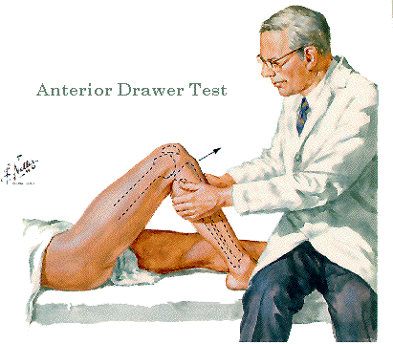
Anterior Drawer Sign
Anterior cruciate
Medial collateral ligament
ITB
Capsules & ligaments
Arcuate-politeus complex

Slide 28
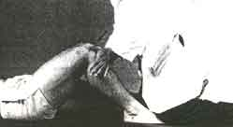
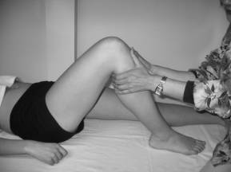
Ligament Instability
Anterior and Posterior Drawer Signs

Slide 29
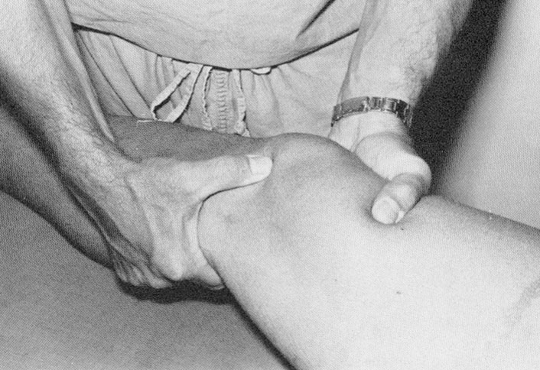
Ligament Instability
Lachman’s Test
Anterior and posterior cruciate ligament sprains
Most reliable test for anterior cruciate ligament rupture

Slide 30
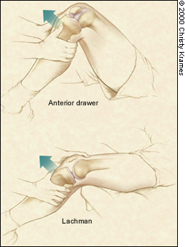
Anterior Drawer Sign and Lachman’s
Anterior Cruciate & Posterior Oblique
Anterior translation of more than 5 mm indicates injury

Slide 31
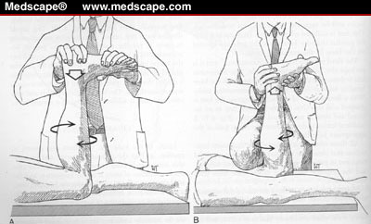
Meniscus and Ligament Instability
Apley’s compression tests meniscus
Apley’s distraction tests nonspecific ligaments

Slide 32
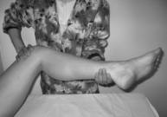
Meniscal Injury
McMurray’s Test
Flex and extend with internal and external rotation.
Stresses distorted meniscus
Palpable or audible click is positive

Slide 33
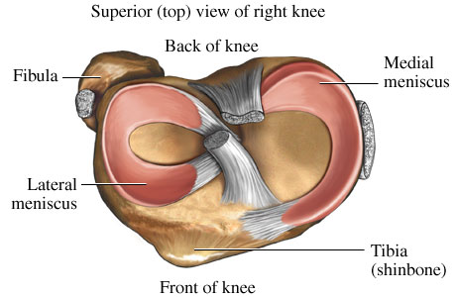
Thessaly’s Test
New test for the early detection of meniscal injury.
http://www.ejbjs.org/cgi/content/abstract/87/5/955

Slide 34
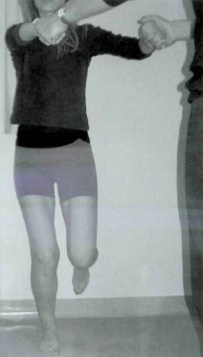
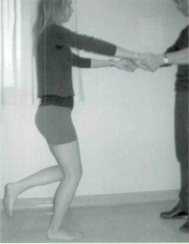
Thessaly Test for Meniscus Tear
Five degree of knee flexion
Unaffected knee first

Slide 35
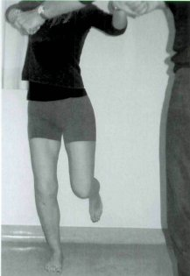
Thessaly Test for Meniscal Tear
External rotation assisted
Internal rotation

Slide 36
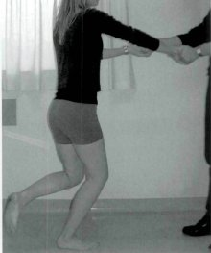
Thessaly Test for Meniscal Tear
Positive findings
Repeat process at 20 degrees
Pain medial or lateral
Clicking or locking
Most accurate at 20 degrees of knee flexion

Slide 37
Did I mention…
Diagnosis is the key to successful treatment!

Slide 38
Persistent Anterior Knee Pain
A 20-year-old military recruit presented for follow-up of anterior knee pain. Previously, he presented with three weeks of right knee pain without trauma, swelling, locking, or instability. At that visit, he was referred for physical therapy, but the knee did not improve during treatment. On recent examination, the patient had a positive “theater sign” (i.e., knee pain upon arising after prolonged sitting), positive patellar compression and inhibition tests, stable ligaments, pain with McMurray's test, and tenderness of the medial tibial plateau.

Slide 39
Question
Based on the patient's history, physical examination, and radiography results, which one of the following is the most likely diagnosis?
A. Medial plica syndrome.
B. Patellar tendinopathy.
C. Patellofemoral pain syndrome.
D. Pes anserine bursitis.
E. Proximal tibial stress fracture.

Slide 40
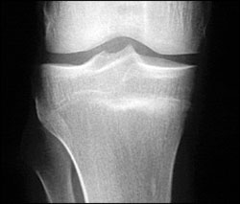
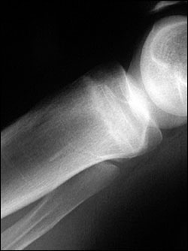
Atraumatic, Persistent, Anterior Knee Pain

Slide 41
Discussion
The answer is E: proximal tibial stress fracture. Most tibial stress fractures occur in the tibial diaphysis. However, proximal tibial stress fractures, typically involving the medial condyle, can occur in athletes. Stress fractures may result from weaker bone that fails under normal loading (i.e., an insufficiency fracture) or normal bone that fails under new or increased repetitive loading (i.e., a fatigue fracture). Athletes are more likely to experience a fatigue fracture; military recruits are also at risk.
Drabicki RR, Greer WJ, DeMeo PJ. Stress fractures around the knee. Clin Sports Med. 2006;25:105–15.
Raasch WG, Hergan DJ. Treatment of stress fractures: the fundamentals. Clin Sports Med. 2006;25:29–36.

Slide 42
Discussion
Medical history that suggests a stress fracture will include persistent pain following an acute increase in physical activity (i.e., time, distance, or pace). Physical examination may reveal tenderness at or near the medial joint line, tenderness with a leverage motion, and tenderness with hopping on the affected leg. A joint effusion may also be present.

Slide 43
Discussion
Plain radiographs can appear normal for weeks or even months. Because the metaphyseal portions of long bones are mostly cancellous bone, the typical periosteal/endosteal reaction will not be visible. In this type of bone, the features of a stress fracture manifest as a band-like area of sclerosis. If a stress fracture is suspected but radiographic results are normal, then magnetic resonance imaging (MRI) or a bone scan is the next diagnostic study. Of the two, MRI is more sensitive for diagnosing stress fracture.

Slide 45
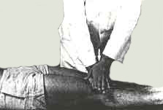
Patellofemoral Dysfunction
Patella Grinding Test
Chrondomalacia patellae
Patellofemoral arthralgia
Chondral fracture

Slide 46
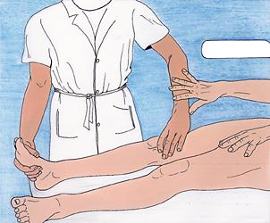
Patellofemoral Dysfunction
Patella Apprehension Test
Pain and apprehension are present
Positive test indicates lateral patellar dislocation

Slide 47
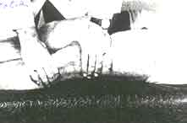
Patellofemoral Dysfunction
Clarke’s Patellar Scrape Test
Pain and crepitation may indicate patellofemoral arthralgia or chondromalcia patellae

Slide 48
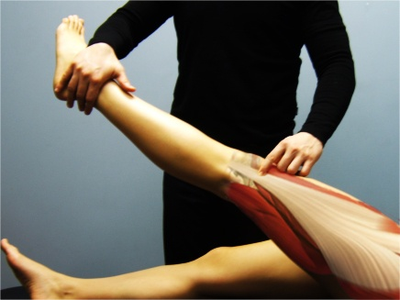
Noble Compression Test for ITBS
Patient supine
Apply thumb pressure to the lateral femoral condyle with knee flexed to 75 degrees.
Maintain thumb pressure while extending knee
At 30 degrees of flexion, patient will complain of severe pain over ITB
This is a positive test for ITBS

Slide 49
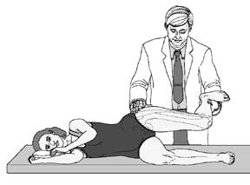
Ober Test
Iliotibial Band Syndrome
The patient lies down with the unaffected side down and the unaffected
hip and knee at a 90-degree angle. If the iliotibial band is tight, the patient will have difficulty
adducting the leg beyond the midline and may experience pain at the lateral knee .

Slide 50
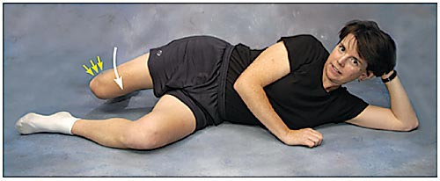
Ober Test
Iliotibial Band Syndrome

Slide 51
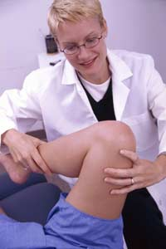
Wilson Sign for Osteochondritis
Patient is supine
Knee is passively flexed to 90 degrees and then extended with medial rotation of knee.
Near 30 degrees of flexion, the pain increases and patient may resist further extension.
Rotating the knee laterally eliminates the pain.
This is a positive test for osteochondritis of the femur.

Slide 52
Radiographic Decision Rules
The Pittsburgh decision rules were 99 percent sensitive and 60 percent specific for the diagnosis of knee fractures and could have reduced the use of radiography by 52 percent, with one missed fracture. If the rules indicated a fracture, 24.1 percent of patients actually had a knee fracture (positive predictive value); if the rules indicated no fracture, 99.8 percent of patients did not have a knee fracture (negative predictive value). The Ottawa knee rules were 97 percent sensitive and 27 percent specific for knee fractures, with three fractures missed. The authors of the comparative study concluded that the Pittsburgh decision rules were more specific, with no loss of sensitivity. Seaberg DC, Yealy DM, Lukens T, Auble T, Mathias S. Multicenter comparison of two clinical decision rules for the use of radiography in acute, high-risk knee injuries. Ann Emerg Med 1998;32:8-13

Slide 53
Pittsburgh Rules
Patient should receive knee films if:
Blunt trauma or a fall as mechanism of injury AND either of the following:
  Age younger than 12 years or older than 50 years
  Inability to walk four weight-bearing steps in the emergency department

Slide 54
Ottawa Rules
Age ≥ 55?
Isolated tenderness of the patella (no other bony tenderness)?
Tenderness at the fibular head?
Inability to flex knee to 90° ?
If any of the above criteria are met, this patient may need knee imaging.

Slide 55
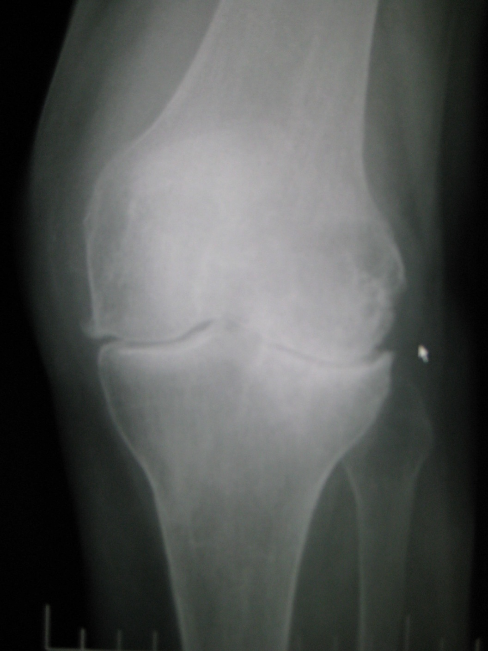
Degenerative Joint Disease of the Knee
Osteoarthritis (OA) also known as degenerative arthritis or degenerative joint disease, is a group of mechanical abnormalities involving degradation of joints, including articular cartilage and subchondral bone.

Slide 56
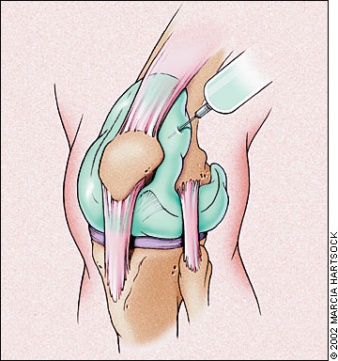
Knee Aspiration and Injection
Knee joint aspiration and injection are performed to establish a diagnosis, relieve discomfort, drain off infected fluid, or instill medication. Because prompt treatment of a joint infection can preserve the joint integrity, any unexplained monarthritis should be considered for arthrocentesis
http://www.aafp.org/afp/2002/1015/p1497.html

Slide 57
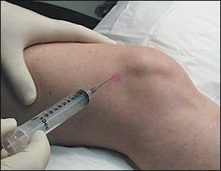
Lateral knee joint injection.
Entry should be in the soft tissue between the patella and femur.
For the medial approach, the needle enters the medial side of the knee under the middle of the patella (midpole) and is directed toward the opposite patellar midpole. In the anterior approach, the knee is flexed 60 to 90 degrees, and the needle is inserted just medial or lateral to the patellar tendon and parallel to the tibial plateau. This technique is preferred by some physicians for its ease of joint entry in advanced osteoarthritis.
http://www.aafp.org/afp/2003/0515/p2147.html

Slide 58
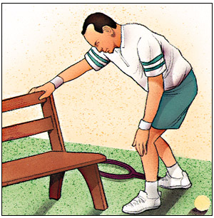
Symptoms of DJD of the Knee
The main symptom is pain, causing loss of mobility and often stiffness. "Pain" is generally described as a sharp ache, or a burning sensation in the associate muscles and tendons. OA /DJD can cause a crackling noise or crepitus when the affected joint is moved or touched, and patients may experience muscle spasm and contractions in the tendons.

Slide 59
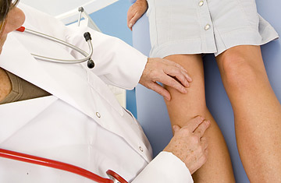
Orthopedic Evaluation
History
Observation
Palpation
Range of motion
Special tests

Slide 60

Treatment of DJD of the Knee
Modification of lifestyle
Moderate exercise
Self-management (weight loss) is more beneficial than medications
Smoking cessation
Medications:
Acetaminophen preferred over NSAIDS
Manipulation/mobilization

Slide 61

Internal Derangement of Knee (IDK)
Some physicians refer to IDK as “I don’t know.”

Slide 62
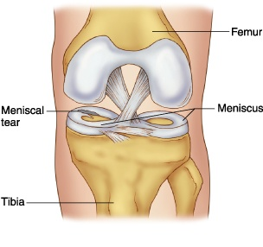
Internal Derangement of the Knee
ICDA 10 Code M23.91
Internal derangement of the knee (IDK) is the term used to cover a group of disorders involving disruption of the normal functioning of the ligaments or cartilages (menisci) of the knee joint.

Slide 63
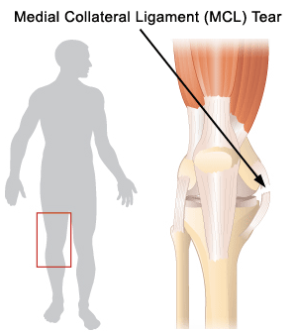
Most Common IDK Conditions
The commonest derangement met with is injury to the medial collateral ligament.
The medial meniscus and anterior cruciate ligament are next in frequency.
The lateral ligament, lateral meniscus and posterior cruciate ligament are less liable to damage.

Slide 64
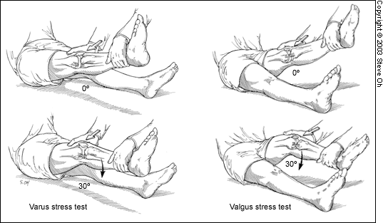

Slide 65
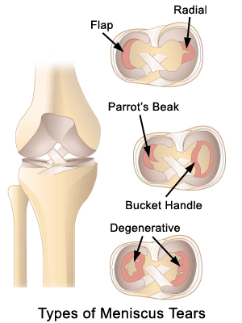
Atraumatic Degenerative IDK
Age-related degeneration of a semilunar cartilage may be met with in an older patient, say over age 50.
It may present as spontaneous occurrence of knee pain without any history of injury.

Slide 66
Internal derangement of the knee is the term used to describe the various types of disruption of the ligaments and cartilages of the knee.
By far the most frequent cause is sports injury, with footballers especially at risk.
Some disorders of the cartilages may occur without evidence of prior injury.
Osteoarthritis of the knee is commonly a late sequel of cartilage or cruciate ligament damage.

Slide 67

Question?
How do you manage internal derangement of the knee?

Slide 68
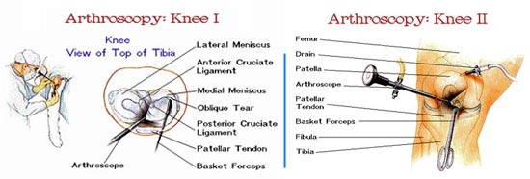

Slide 69
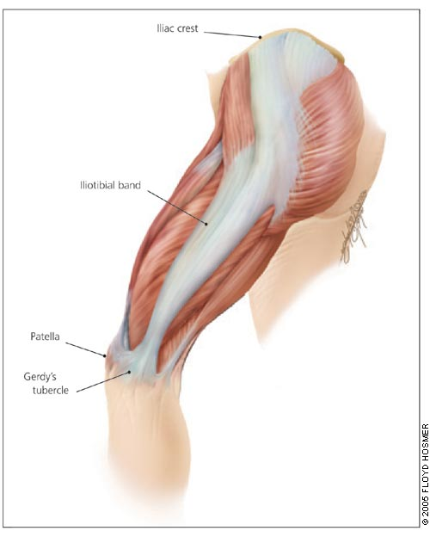
Iliotibial Band Syndrome
The iliotibial band is a thick band of fascia that extends along
the lateral thigh from the iliac crest to the knee.

Slide 70
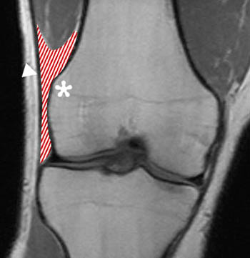
Iliotibial Band Syndrome
Iliotibial band friction syndrome (ITBFS) is a frequently encountered overuse injury caused by repetitive friction between the iliotibial band and the lateral femoral epicondyle during active flexion and extension at the knee.

Slide 71
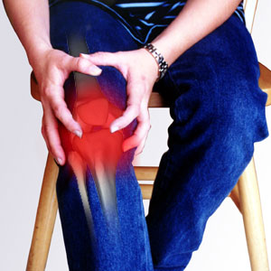
History
PAIN CHARACTERISTICS
The patient's description of knee pain is helpful in focusing the differential diagnosis.
It is important to clarify the characteristics of the pain, including its onset (rapid or insidious), location (anterior, medial, lateral, or posterior knee), duration, severity, and quality (e.g., dull, sharp, achy).
Bergfeld J, Ireland ML, Wojtys EM, Glaser V. Pinpointing the cause of acute knee pain. Patient Care. 1997;31(18):100–7.

Slide 72

Iliotibial Band Syndrome
The primary initial complaint in patients with iliotibial band syndrome is diffuse pain over the lateral aspect of the knee.

Slide 73
Iliotibial Band Friction Syndrome
Patients with iliotibial band syndrome often demonstrate tenderness on palpation of the
lateral knee approximately 2 cm above the joint line.

Slide 74

Ober’s Test
Failure to descend smoothly indicates a positive test for contracture of the TFL or ITB.

Slide 75

Iliotibial Band Syndrome
Swelling may be noted at the distal iliotibial
band and thorough palpation of the affected
limb may reveal multiple trigger points in the vastus lateralis, gluteus medius, and biceps femoris.
Palpation of these trigger points may cause referred pain to the lateral aspect of the affected knee.

Slide 76

Iliotibial Band Syndrome
The T1-weighted coronal image demonstrates intermediate signal intensity (arrows) replacing normal fat signal intensity deep to the iliotibial band (arrowhead).

Slide 77

Patellofemoral Arthralgia
Fortunately, true chondromalacia patella is relatively rare, but crepitus and subpatellar pain are probably the most common complaints seen in a sports medicine clinic, where most knee problems will have some associated patellofemoral dysfunction.
Welsh RP. Can Fam Physician. 1985 March; 31: 573–576.

Slide 78

Patellofemoral Arthralgia
Anterior knee pain, pain with stair climbing, prolonged sitting, absence of radiographic pathology

Slide 79

Mechanism
The cause of pain and dysfunction often results from either abnormal forces (e.g. increased pull of the lateral quadricep retinaculum with acute or chronic lateral PF subluxation/dislocation) or prolonged repetitive compressive or shearing forces (running or jumping) on the PF joint.

Slide 80
Patellofemoral Arthralgia
  Magnetic resonance imaging determination of tibial tubercle lateralization and patellar tilt correlates positively with the clinical diagnosis of anterior knee pain, suggesting that patellofemoral pain is caused by subtle malalignment.
  LEVEL OF EVIDENCE: Level III, development of diagnostic criteria on basis of nonconsecutive patients.
    Arthroscopy. 2007 Mar;23(3):333-4; author reply 334.

Slide 81
Patellofemoral Arthralgia
Thermography was performed on 30 patients if all the following symptoms and physical signs were present: (a) retropatellar pain related to exercise and aggravated by using stairs or by prolonged sitting with flexed knees; (b) pain on patellar compression against the femoral condyles with the knee extended; (c) medial patellar tenderness; and (d) pain on resisted patellar movement when the quadriceps was contracted whilst the patella was forcibly held downwards. Patients were excluded if they had any history of direct trauma to the patella or had had an episode of patellar dislocation.
M. D. DEVEREAUX, G. R. PARR, S. M. LACHMANN. D. P. PAGE THOMAS. B. L. HAZLEMAN THERMOGRAPHIC DIAGNOSIS IN ATHLETES WITH
PATELLOFEMORAL ARTHRALGIA. Journal of Bone and Joint Surgery
http://web.jbjs.org.uk/cgi/reprint/68-B/1/42
28 of 30 athletic patients demonstrated positive thermography findings.
Exercise and faradic stimulation to the vastus medialis
3 months post treatment produced normal thermograhic findings in all 28 patients

Slide 82


Patellofemoral Arthralgia
Abnormal findings
Normal Symmetry

Slide 83

Quadriceps Angle
“Q Angle”
Adults typically 15 degrees
Increases or decreases in the q-angles are associated in cadaver models with increased peak patellofemoral contact pressures (Huberti & Hayes, 1984).

Slide 84


Slide 85
Increased Q Angle
Femoral anteversion
External tibial torsion
Laterally displaced tibial tubercle
Genu valgus

Slide 86

Quadriceps Angle
“Q Angle”
Insall, Falvo, & Wise (1976) implicated increased q-angle, along with patella alta, in a prospective study of patellofemoral pain.

Slide 87
Patellofemoral Dysfunction
Patella Grinding Test
Chrondomalacia patellae
Patellofemoral arthralgia
Chondral fracture

Slide 88
Patellofemoral Dysfunction
Clarke’s Patellar Scrape Test
Pain and crepitation may indicate patellofemoral arthralgia or chondromalcia patellae

Slide 89

M-Brace® Jumper’s Knee Brace
For apophysitis, patellar chondromalacia, patellofemoral arthralgia, or jumper’s knee.
Alleviates pain by diminishing tension on muscles and ligaments.

Slide 90

Management
PRICEMM
NSAIDS
HVG with ice
PRE: Vastus medialis last 20-30 degrees of extension
Spinal manipulation
Myofascial trigger point pressure release
Orthotics

Slide 91
Did I mention…
Diagnosis is the key to successful treatment!

Slide 92


Slide 93
Persistent Anterior Knee Pain
A 20-year-old military recruit presented for follow-up of anterior knee pain. Previously, he presented with three weeks of right knee pain without trauma, swelling, locking, or instability. At that visit, he was referred for physical therapy, but the knee did not improve during treatment. On recent examination, the patient had a positive “theater sign” (i.e., knee pain upon arising after prolonged sitting), positive patellar compression and inhibition tests, stable ligaments, pain with McMurray's test, and tenderness of the medial tibial plateau.

Slide 94
Question
Based on the patient's history, physical examination, and radiography results, which one of the following is the most likely diagnosis?
A. Medial plica syndrome.
B. Patellar tendinopathy.
C. Patellofemoral pain syndrome.
D. Pes anserine bursitis.
E. Proximal tibial stress fracture.

Slide 95
Atraumatic, Persistent, Anterior Knee Pain

Slide 96
Discussion
The answer is E: proximal tibial stress fracture. Most tibial stress fractures occur in the tibial diaphysis. However, proximal tibial stress fractures, typically involving the medial condyle, can occur in athletes. Stress fractures may result from weaker bone that fails under normal loading (i.e., an insufficiency fracture) or normal bone that fails under new or increased repetitive loading (i.e., a fatigue fracture). Athletes are more likely to experience a fatigue fracture; military recruits are also at risk.
Drabicki RR, Greer WJ, DeMeo PJ. Stress fractures around the knee. Clin Sports Med. 2006;25:105–15.
Raasch WG, Hergan DJ. Treatment of stress fractures: the fundamentals. Clin Sports Med. 2006;25:29–36.

Slide 97
Discussion
Medical history that suggests a stress fracture will include persistent pain following an acute increase in physical activity (i.e., time, distance, or pace). Physical examination may reveal tenderness at or near the medial joint line, tenderness with a leverage motion, and tenderness with hopping on the affected leg. A joint effusion may also be present.

Slide 98
Discussion
Plain radiographs can appear normal for weeks or even months. Because the metaphyseal portions of long bones are mostly cancellous bone, the typical periosteal/endosteal reaction will not be visible. In this type of bone, the features of a stress fracture manifest as a band-like area of sclerosis. If a stress fracture is suspected but radiographic results are normal, then magnetic resonance imaging (MRI) or a bone scan is the next diagnostic study. Of the two, MRI is more sensitive for diagnosing stress fracture.

Slide 100
One Final Thought…
Diagnosis is the key to successful treatment!

Slide 101
American Association of Family Practice Journal
http://www.aafp.org/afp/2005/0315/p1169.html
http://www.aafp.org/afp/20000415/2391.html

Slide 102
http://www.aafp.org/afp/20000315/1795.html
Management of Osteoarthritis of the Knee Nonpharmacologic treatment (e.g., patient education and support, exercise, weight loss, joint protection) plus Acetaminophen (Tylenol) in a dosage of up to 4 g per day to control pain and other symptoms, and before activity Add topical capsaicin cream (e.g., ArthriCare) applied four times daily, if needed.
If joint effusion is present, consider aspiration and intra-articular injection of a corticosteroid, such as 40 mg of triamcinolone (Aristocort).
If more pain or symptom control is needed, add an NSAID in a low dosage, such as 400 mg of ibuprofen (e.g., Advil) taken four times daily, or a nonacetylated salicylate such as choline magnesium trisalicylate (Trilisate) or salsalate (Disalcid).
If more pain or symptom control is needed, use the full dosage of an NSAID, plus misoprostol (Cytotec) or a proton pump inhibitor if the patient is at risk for upper gastrointestinal tract bleeding or ulcer disease, or substitute a cyclo-oxygenase-2 inhibitor for the NSAID; some patients may benefit from intra-articular injections of a hyaluronic acid­like product.
If the response is inadequate, consider referring the patient for joint lavage, arthroscopic debridement, osteotomy or joint replacement.

Slide 103
MUA tkr
http://xnet.kp.org/permanentejournal/NIR/Publications/Articles/Early_Late_Manipulations_TKA.pdf

Slide 104
Evaluation and Management of PFA by Hammer
http://www.dynamicchiropractic.com/mpacms/dc/article.php?id=44165
http://www.dynamicchiropractic.com/mpacms/dc/article.php?id=44278
http://www.dynamicchiropractic.com/mpacms/dc/article.php?id=44232
http://www.dynamicchiropractic.com/mpacms/dc/article.php?id=17905

