Slide 1
Differential Diagnosis of Chronic Low Back Pain
James J. Lehman, DC, MBA, FACO
Associate Professor of Clinical Sciences
Director
Community Health Clinical Education
University of Bridgeport

Slide 2
Learning Objective
Identify injured and painful tissues through careful assessment and intelligent use of neuromusculoskeletal testing and document the findings of chronic low back pain.

Slide 3
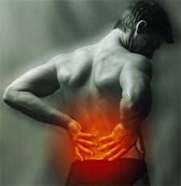
Learning Objective
Rule-in and rule-out neuromusculoskeletal conditions that might present as low back pain.

Slide 4
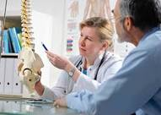
Learning Objectives
Implement the scientific method and integrate the use of an evaluation protocol practiced by evidence-based and patient-centered chiropractic physicians.

Slide 5

Opening Statement …
Diagnosis is the key to successful treatment!

Slide 6


Slide 7
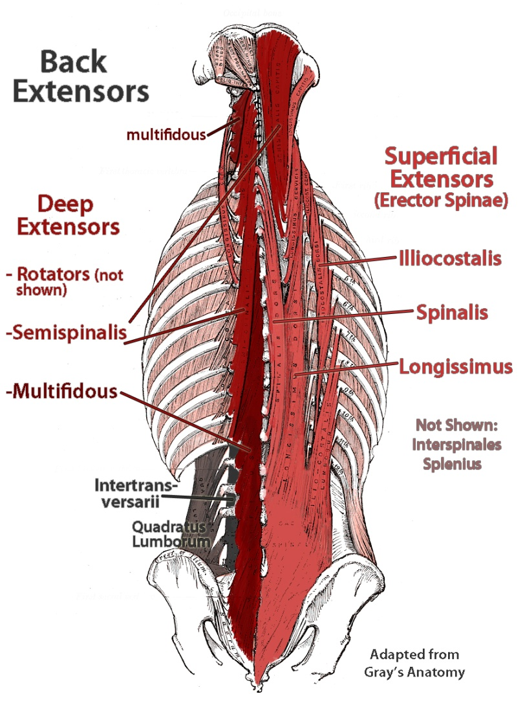
Musculoskeletal Disabilities
The leading causes of disability in people in their working years are musculoskeletal conditions.
Russell IJ. A new journal. J Musculoskeletal Pain 1(1):1-7. 1993.

Slide 8
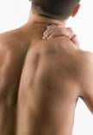
Lower Back Pain
How do you differentiate the types of tissues that may be involved with a chief concern of low back pain?

Slide 9
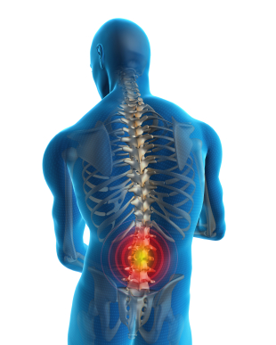
Focused History of Low Back Pain
Location
Mechanism of injury
New condition
Onset
Provocative and palliative
Quality of pain
Referred or radiating pain
Severity
Timing and treatment

Slide 10
Focused Neuromusculoskeletal Examination
Observation/Inspection
Palpation
Range of motion
Special tests/orthopedic tests
Neurological examination
  3 part peripheral nervous system exam
  CNS examination
  Cranial nerve examination
  Mental status

Slide 11
Neuromusculoskeletal Examination Videos
Timothy Conwell, DC, FACO
Central Nervous System examination
https://www.youtube.com/watch?v=kZOcz0czWs4
Peripheral Nervous System examination https://www.youtube.com/watch?v=I7YF4vCBisQ
Spine and paraspinal examination https://www.youtube.com/watch?v=HegByhhb8sI

Slide 12
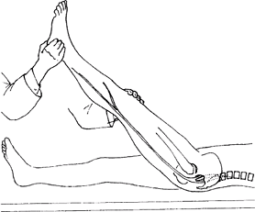
Definition of an Orthopedic Test
Most often a provocative maneuver that reproduces the patient’s chief concern pain with stretching, contracting, and/or compressing in order to identify the involved tissues.
James J. Lehman, DC, FACO

Slide 13
Low Back Pain Case
Patient strained lower back unloading a truck, which required lifting heavy boxes, twisting and placing boxes on flats three years ago.
Lower back pain persists on a daily basis and increases with bending and twisting.
Rest reduces the pain.
Medications do not relieve the constant dull ache or the intermittent sharp, stabbing pains.

Slide 14
Low Back Pain Differential Diagnosis
Please list 5 differential diagnoses
List the physical examination procedures that you would use to rule-in and rule-out your differential diagnoses.

Slide 15

Differential Diagnosis
Chronic pain syndrome-post-traumatic
Myofascial pain syndrome
Lumbar facet syndrome
Degenerative disc disease
Degenerative joint disease

Slide 16
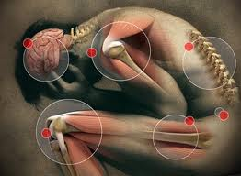
National Pain Strategy
Chronic pain - Pain that occurs on at least half the days for six months or more.
https://iprcc.nih.gov/sites/default/files/HHSNational_Pain_Strategy_508C.pdf

Slide 17
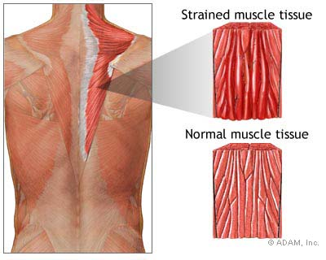
Spinal Muscle Strain
Cramps
Knots
Spasms
Dull ache

Slide 18
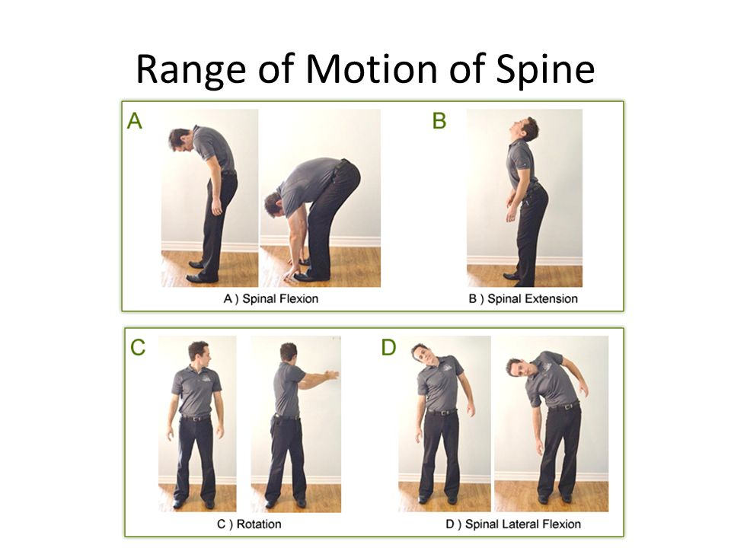
O’Donoghue’s Maneuver
Active lumbar ROM (general findings)
Resisted ROM (strain)
Passive ROM (sprain)

Slide 19
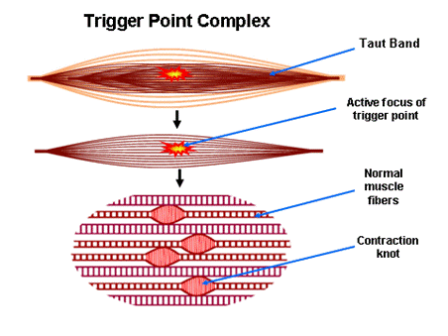
Myofascial Trigger Point Characteristics

Slide 20
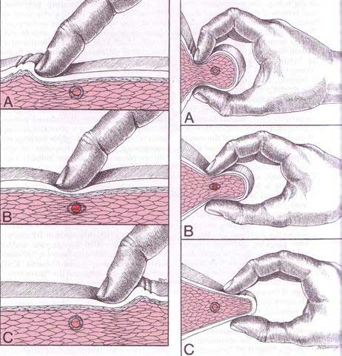
Myofascial Trigger Point Palpation
Localized pain with palpation
Active trigger point may produce referred pain

Slide 21
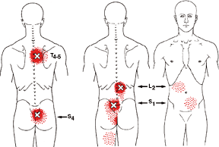
Myofascial Pain Syndrome
Referred Pain
Paresthesias
Crawling sensation (formication)
Dull or deep ache
Myotogenous
Myotomal

Slide 22
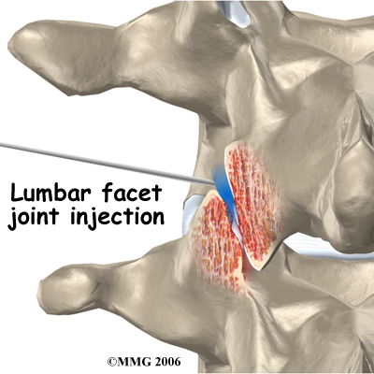
Joint Pain
Zygapophyseal or Facet Joint
Sharp pain on motion
Constant dull or deep ache
Source of chronic low back pain
Manchikanti L, et al. Prevalence of facet joint pain in chronic spinal pain of cervical, thoracic, and lumbar regions. BMC Musculoskelet Disord. 2004; 5: 15.

Slide 23
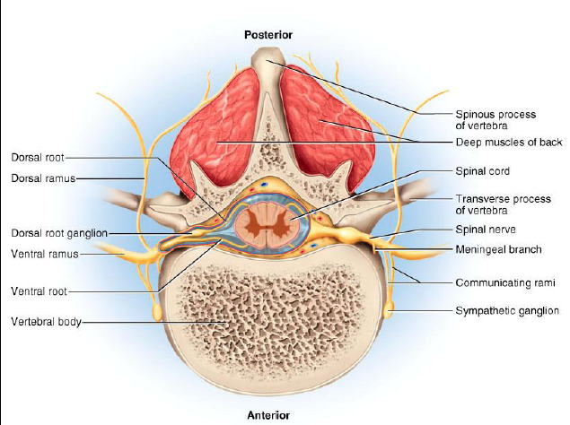

Slide 24
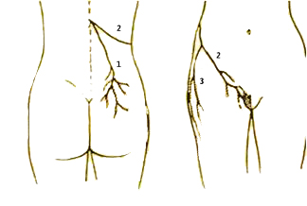
Dorsal Ramus of Spinal Nerve
Primary division of a posterior ramus of a spinal nerve has three branches

Slide 25
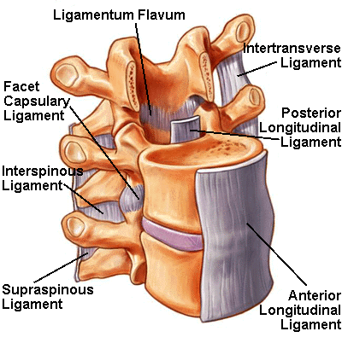
Sclerotogenous Referred Pain
Resembles radiating pain but it is a referred deep, dull ache from bone, ligaments and joints
Ivanusic JJ. The evidence for the spinal segmental innervation of bone. Clin Anat. 2007 Nov;20(8):956-60.

Slide 26
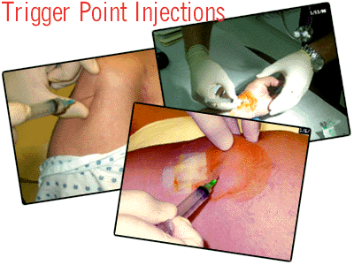
Scleratogenous or Myofascial
Triggers
Diffusely referred and hard to localize
Deep and achy quality
Kellgren & Feinstein

Slide 27
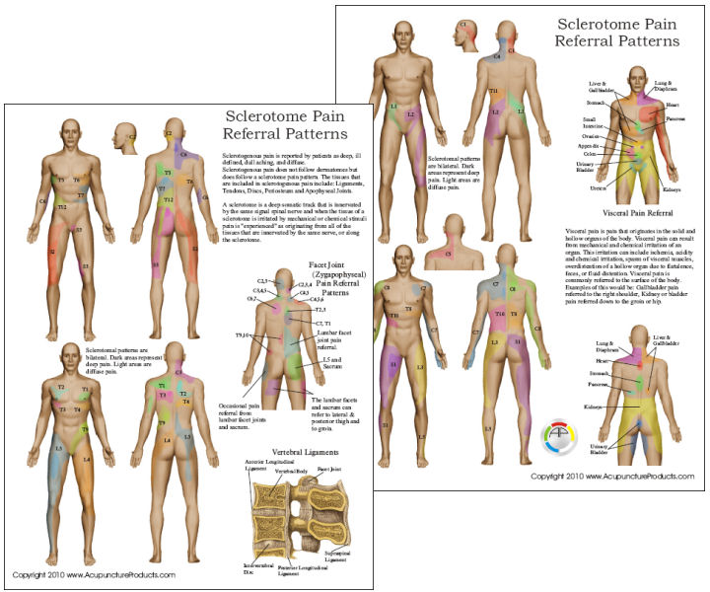

Slide 28
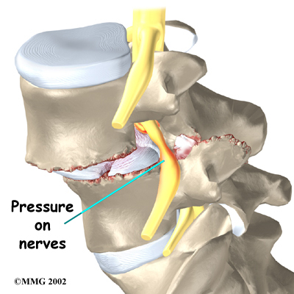
Nerve Pain
Burning and/or hot
Tingling and/or numbness
Nerve root tension signs
Lhermitte’s sign

Slide 29
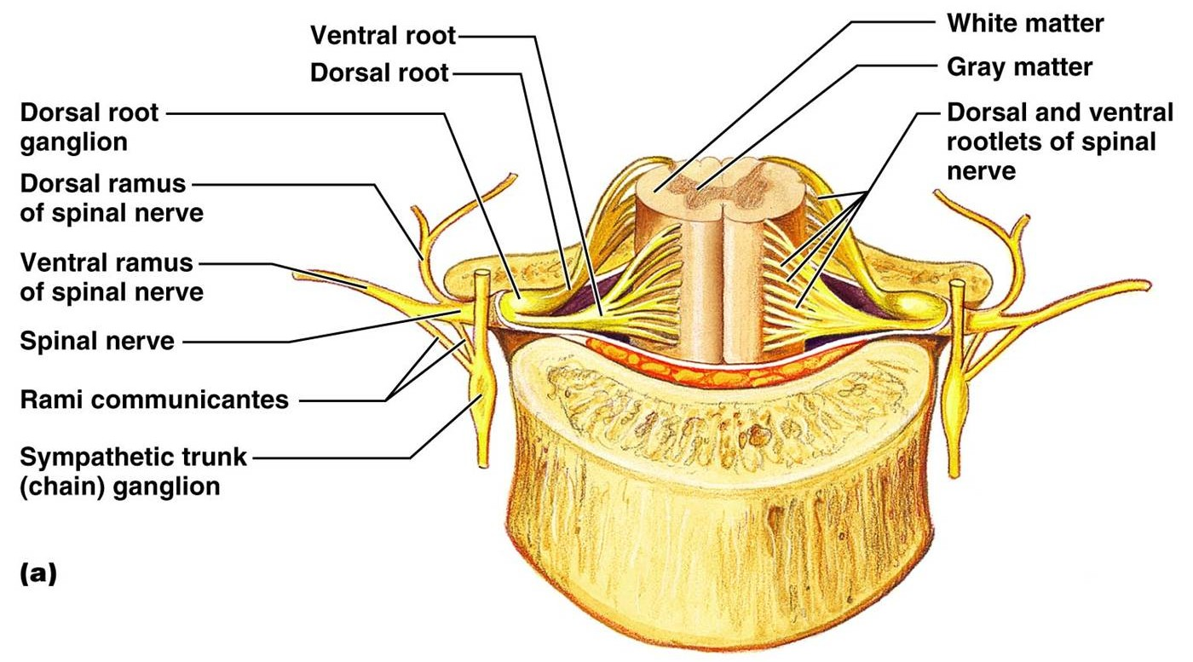

Slide 30
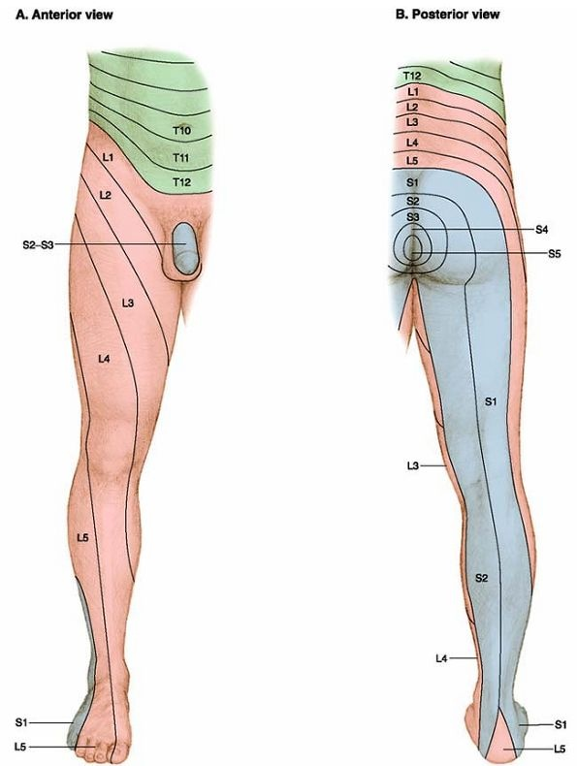

Slide 31
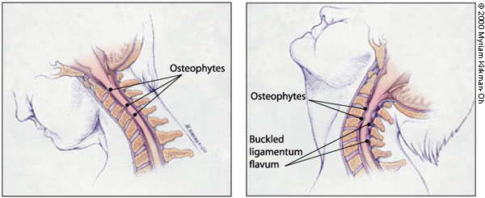
Lhermitte’s Sign
Nerve Pain
Stabbing or lightning-like pain down spine and any combination of extremities with flexion or extension

Slide 32
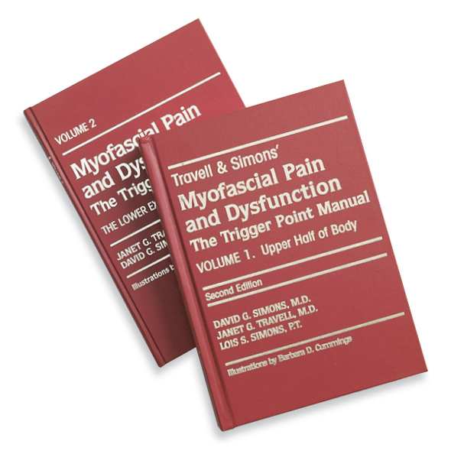
Recommended Texts

Slide 33
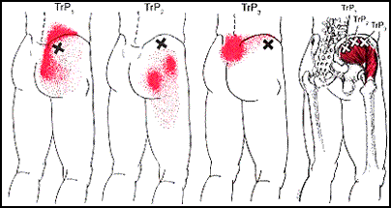
Gluteus Medius: “Lumbago Muscle”
Commonly overlooked source of referred low back pain

Slide 34
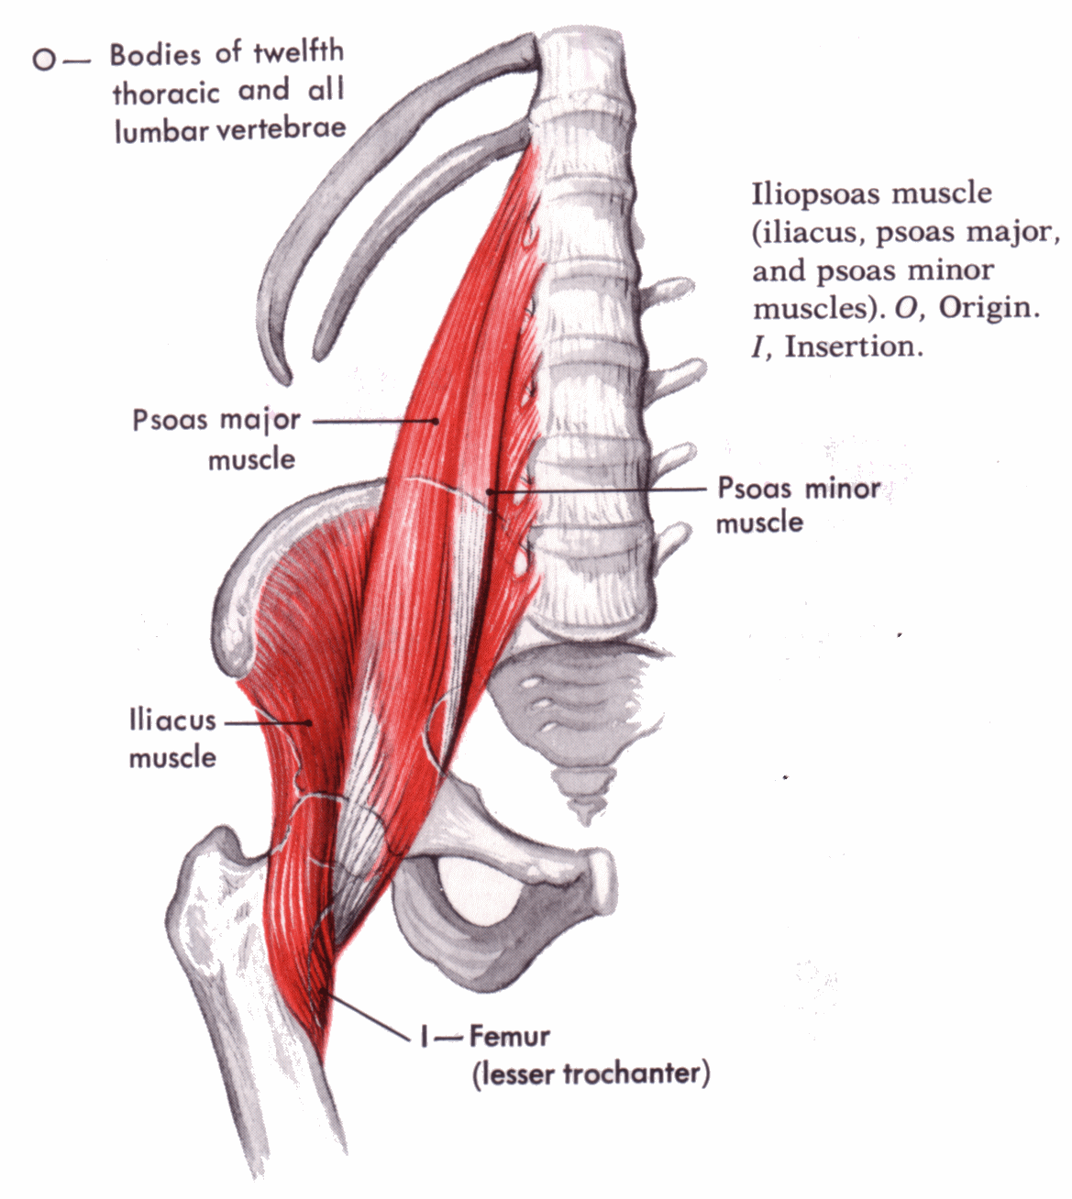
Iliopsoas: “Hidden Prankster”
Serves many critically important functions, often causes pain, and is relatively inaccessible.

Slide 35
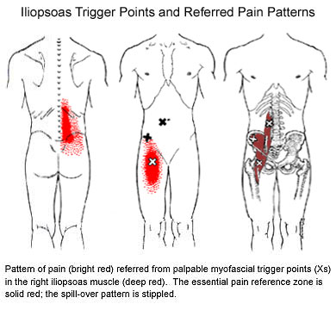

Slide 36
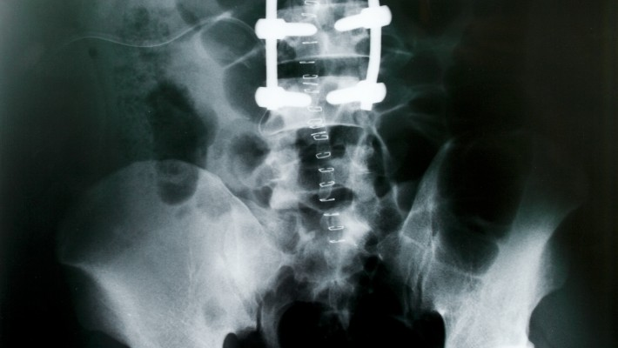
Iliopsoas: “Hidden Prankster”
Unidentified iliopsoas and quadratus lumborum trigger points are frequently responsible for a failed low back postsurgical syndrome.

Slide 37
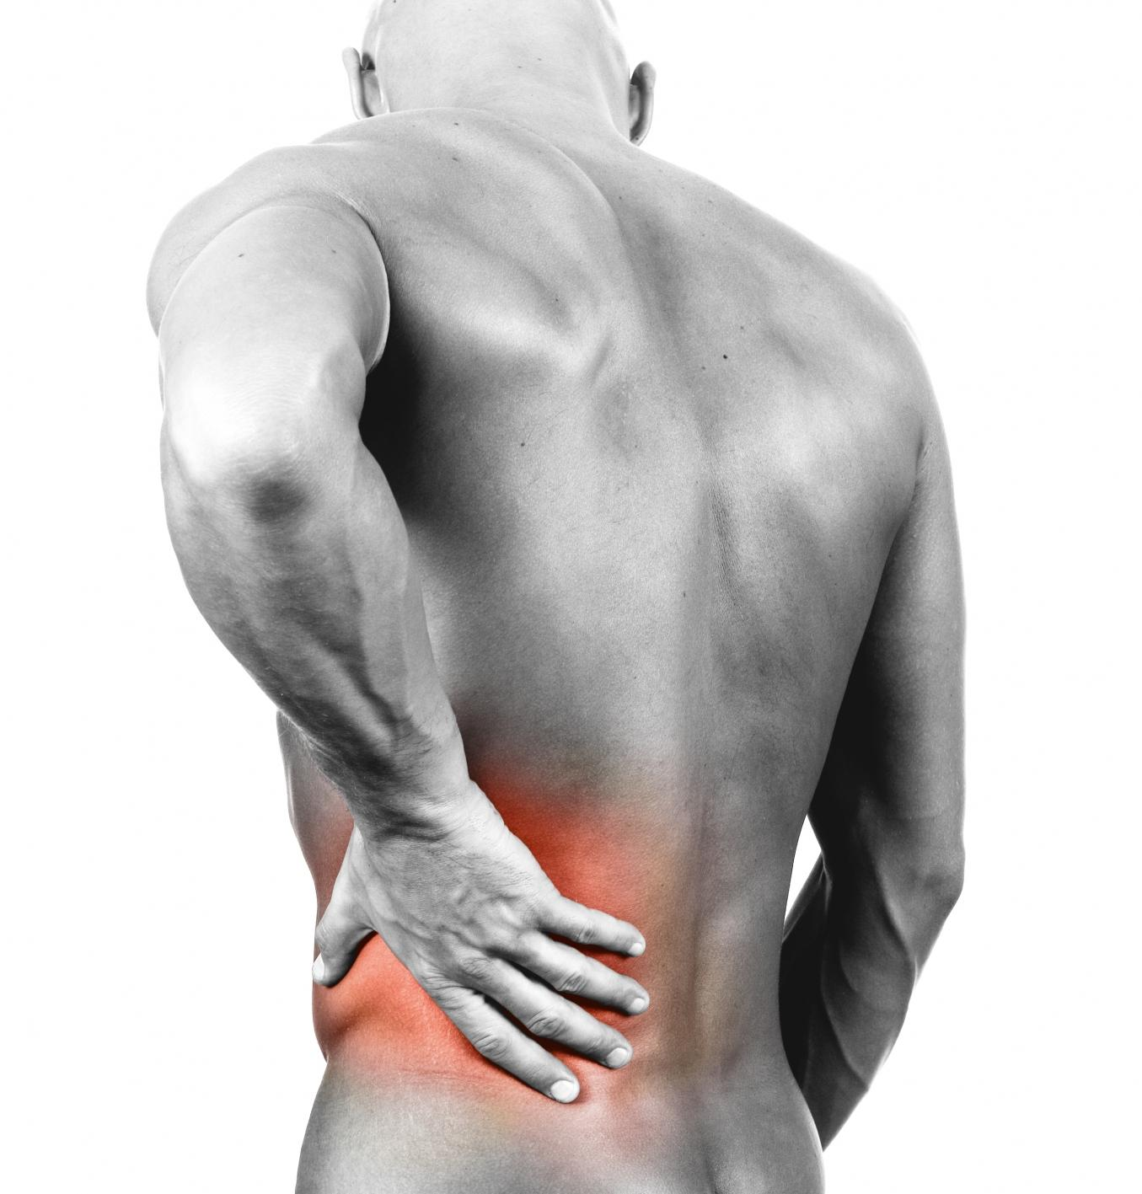
Iliopsoas: “Hidden Prankster”
When describing the low back pain they run the hand vertically up and down the spine rather than horizontally.

Slide 38
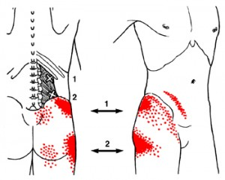
Quadratus Lumborum
“Joker of Low Back Pain”
Severe referred tenderness of the greater trochanter may disrupt sleep.

Slide 39
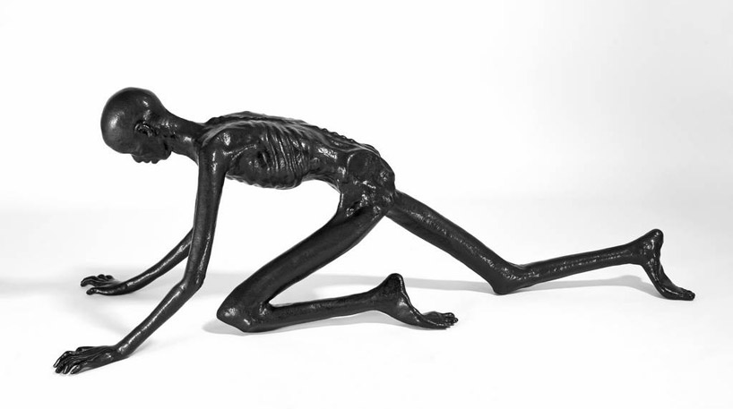
Quadratus Lumborum
“Joker of Low Back Pain”
Patient may be barely able to turn over in bed and unable to bear the pain of standing upright or walking.

Slide 40
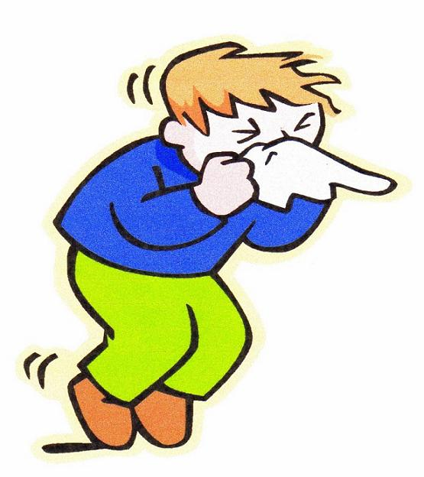
Quadratus Lumborum
“Joker of Low Back Pain”
Coughing or sneezing can be frightfully painful.
Not to be confused with Dejerine’s and a SOL

Slide 41
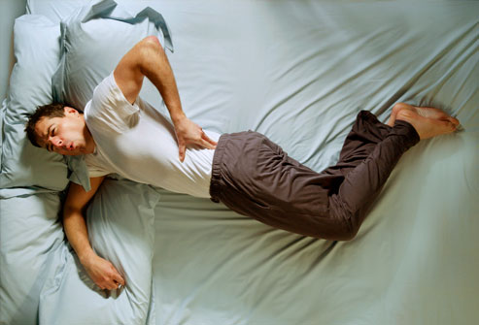
Quadratus Lumborum
“Joker of Low Back Pain”
Imagine the patient waking during the night with pain in the trochanteric area with a full bladder and unable to walk due to severe low back pain!

Slide 42


Slide 43
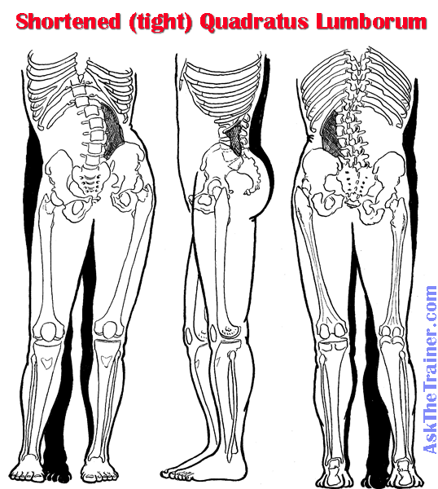
Quadratus Lumborum
“Joker of Low Back Pain”
Spasm of QL causes functional scoliosis, loss of lumbar lordosis with flattened appearance, and restricted ROM.
Flexion and extension may be abolished.

Slide 44
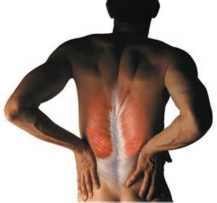
Muscle Dysfunction
Muscle strain, spasm, weakness, contractures and trigger points may cause muscle imbalances and pelvic obliquity
Winter RB, Pinto WC. Pelvic obliquity. Its causes and its treatment. Spine 1986 Apr;11(3):225-34.

Slide 45
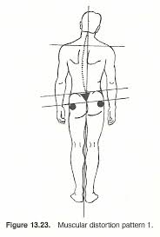
Pelvic Obliquity
Anatomical short leg or functional leg length inequality due to iliopsoas, gluteus medius and quadratus lumborum muscle contractures may cause pelvic obliquity
Grill F, et al. Pelvic tilt and leg length discrepancy. Orthopade. 1990 Sep;19(5):244-62

Slide 46
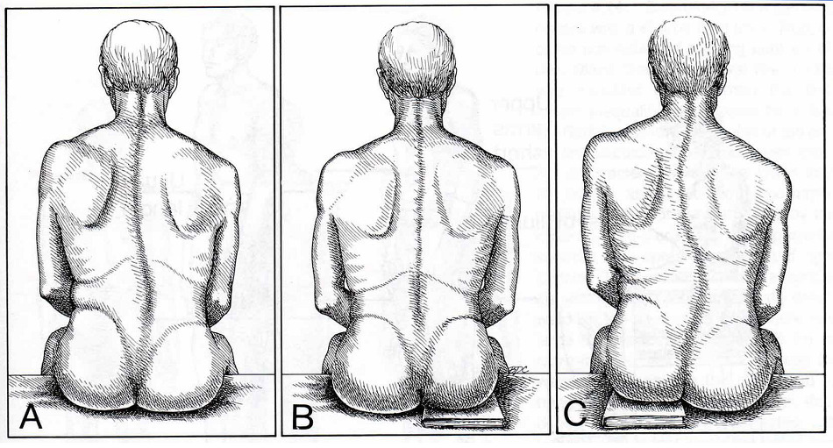
Pelvic Asymmetry

Slide 47
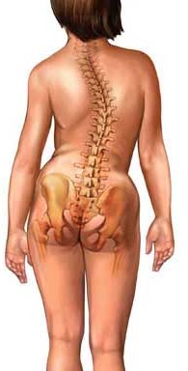
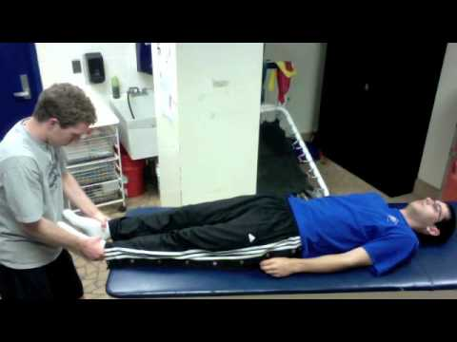
Long Sit Test

Slide 48
Long Sit Test
https://www.bing.com/videos/search?q=long+sit+test+for+leg+length+discrepancy&&view=detail&mid=FA816DBE65ED3C2FE0F2FA816DBE65ED3C2FE0F2&&FORM=VDRVRV
Terry Bemis, et al. Validation of the Long Sitting Test on Subjects with lliosacral Dysfunction. JOSPT January 1987. https://www.jospt.org/doi/pdf/10.2519/jospt.1987.8.7.336

Slide 49
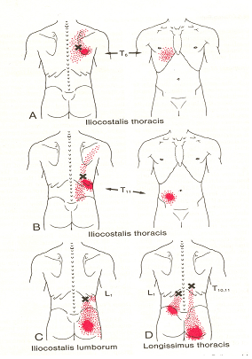
Superficial Paraspinal Muscles
Erector Spinae
Trigger points in the erector spinae muscles are a frequent cause of low back pain.
Patients might refer to the pain as “lumbago.”

Slide 50
Superficial Paraspinal Muscles
Erector Spinae
Trigger points in the erector spinae muscles may cause entrapment of the dorsal primary rami of the spinal nerves.

Slide 51
Deep Paraspinal Muscles
Multifidi
Trigger point pain is located at the spinous process of the involved segment or referred a few segments caudal to the trigger point.

Slide 52
Deep Paraspinal Muscles
Multifidi
Trigger points in the multifidi may cause articular dysfunction at 2-3 segments.

Slide 53
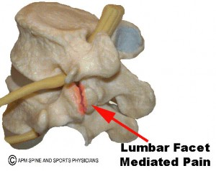
Articular Dysfunction
Multifidi trigger point symptoms mimic lumbar facet and sacroiliac syndromes.
Schneider MJ. The traction methods of Cox and Leander: neglected role of the multifidus muscle in low back pain. Chiropract Techn 3(3) 109-115. 1991.

Slide 54
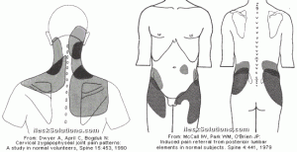
Composite Referred Pain Patterns
Z Joint Injection of Hypertonic Saline Solution

Slide 55
Case 2
Differential Diagnosis
45 year-old male presents with daily pain in the right sacroiliac, buttocks, abdominal and inguinal regions, lateral hip and right testicle since a lifting injury 5 years earlier.
Palpation reveals pain at the lower thoracic and upper lumbar spinous processes and paraspinal muscles, referred pain to the abdomen and right testicle.
Taut bands, painful nodules, localized pain in the multifidi muscles and referred pain to ipsilateral lower lumbar spine and abdomen .
Radiographic impression of lower lumbar DDD/DJD

Slide 56
Class Discussion
What five differential diagnoses would you select?
How do you support them?

Slide 57
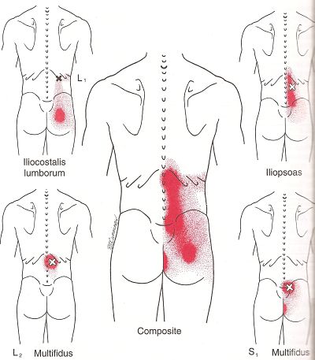
Maigne Syndrome
Thoracolumbar Junction Syndrome
Of 350 patients seen in a back pain clinic, 40% were found to have pain of thoracolumbar origin.
Maigne R. - Low back pain of thoracolumbar origin. Arch. Phys. Med. Rehabil. 1980, 61, 389-395.

Slide 58
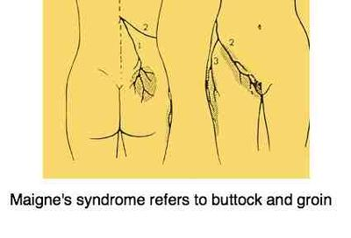
Maigne Syndrome
Thoracolumbar Junction Syndrome
Neuropathic pain is found in three well described regions and serves as the principal clinical component in diagnosing “Lumbar Dorsal Ramus Syndrome” (LDRS).

Slide 59
Maigne Syndrome
Thoracolumbar Junction Syndrome
The patient will not usually have spontaneous pain at the offending spinal level.
Pain can be provoked by palpation of the facet joints, or the level can remain veiled, with only the referred pain as evidence of the defect.

Slide 60
Maigne Syndrome
Thoracolumbar Junction Syndrome
Usually unilateral, bilateral cases have been described...
Patients will not have pain radiating below the knee, which is more typical of anterior ramus involvement.

Slide 61
Maigne Syndrome
Thoracolumbar Junction Syndrome
Radiographic evidence is non-contributory.
MRI, CT and myelography are all ineffective at localizing the at-fault level.
The typical degenerative changes seen on most images may lead to unnecessary surgery or false diagnosis.
The posterior ramus is far removed from herniating or bulging discs.

Slide 62
Maigne Syndrome
Thoracolumbar Junction Syndrome
Pain relieved by injection of local anesthetic into the correct facet joint.
This diagnostic procedure can also be therapeutic; the injection of steroids or radiofrequency denervation of the medial branch can be added for refractory cases.

Slide 63
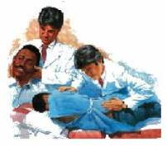
Maigne Syndrome
Thoracolumbar Junction Syndrome
“Thoracolumbar junction syndrome is particularly responsive to spinal manipulative therapy and no further treatment is required in most cases as long as it is performed adequately.”
Soo-Ryu Kim, et al. Thoracolumbar Junction Syndrome Causing Pain around Posterior Iliac Crest: A Case Report. Korean J Fam Med. 2013 Mar; 34(2): 152–155.

Slide 64
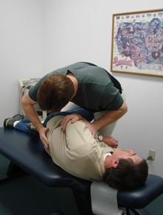
Thoracolumbar Syndrome
A Report of Two Cases
Spinal manipulation of the thoracolumbar has been demonstrated effective with relief of a chronic thoracolumbar syndrome.
Proctor D, Dupuis P, Cassidy D. Thoracolumbar syndrome as a cause of low-back pain: a report of two cases. The Journal of the CCA/Volume 29 No. 2/June 1985.

Slide 65
Active Learning Task
Form groups of 3-5 learners
Select a spokesperson
Organize a clinical thought process that would enable you to determine the pain generators with a low back pain patient
Describe your neuromusculoskeletal examination process for a patient without organic disease

Slide 66
Closing Statement …
Diagnosis is the key to successful treatment!

Slide 67
References
Scott-Charlton, W. and Roebuck, D.J. The Significance of Posterior Primary Divisions of Spinal Nerves in Pain Syndrome. The Medical Journal of Australia. 1972; 2:945–948.
Maigne, R. Low back pain of thoracolumbar origin (T11-T12-L1). In: Maigne, R., Second Edition: Diagnosis and Treatment of Pain of Vertebral Origin. Taylor and Francis Group, 2006:289–98.
McCall IW, Park WH, O’Brien JP. Induced pain referral from posterior lumbar elements in normal subjects. Spine 1979;4441–6.
Marks R. Distribution of pain provoked from lumbar facet joints and related structures during diagnostic spinal infiltration. Pain 1989;39:37–40.
Fukui, S. Distribution of Referred Pain from the Lumbar Zygapophyseal Joints and Dorsal Rami. The Clinical Journal of Pain 1997:13;303–307.
Sherrington, C.S., Experiments in Examination of the Peripheral Distribution of the Fibres of the Posterior roots of some Spinal Nerves. Philosophical Transactions of the Royal Society of London, vol. clxxxiv. 1893.
Maigne, R. Low Back Pain of Thoracolumbar Origin. Archives of Physical Medicine and Rehabilitation. 1980:61;389–395.
Soo-Ryu Kim, et al. Thoracolumbar Junction Syndrome Causing Pain around Posterior Iliac Crest: A Case Report. Korean J Fam Med. 2013 Mar; 34(2): 152–155.
Proctor D, Dupuis P, Cassidy D. Thoracolumbar syndrome as a cause of low-back pain: a report of two cases. The Journal of the CCA/Volume 29 No. 2/June 1985.

Slide 68


