Slide 1
Differential Diagnosis of Radial Tunnel Syndrome and Lateral Epicondylosis
James J. Lehman, DC, MBA, FACO
Associate Professor of Clinical Sciences
Director
Community Health Clinical Education
University of Bridgeport.

Slide 2

Learning Objectives
Correlate anatomy and the patients’ signs and symptoms in order to locate the neuromusculoskeletal lesion(s) and properly record the findings.

Slide 3
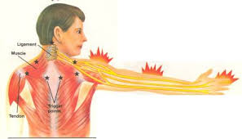
Learning Objectives
Identify injured and painful tissues through careful assessment and intelligent use of neuromusculoskeletal testing and document the findings.

Slide 4
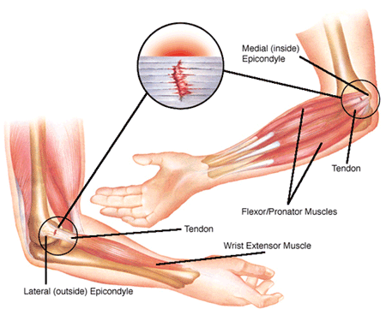
Learning Objectives
Perform neuromusculoskeletal evaluation procedures (Posture, orthopedic and neurological) and record the objective findings in order to make an assessment/diagnosis.

Slide 5
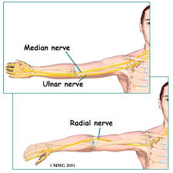
Upper Extremity Nerve Compression

Slide 6
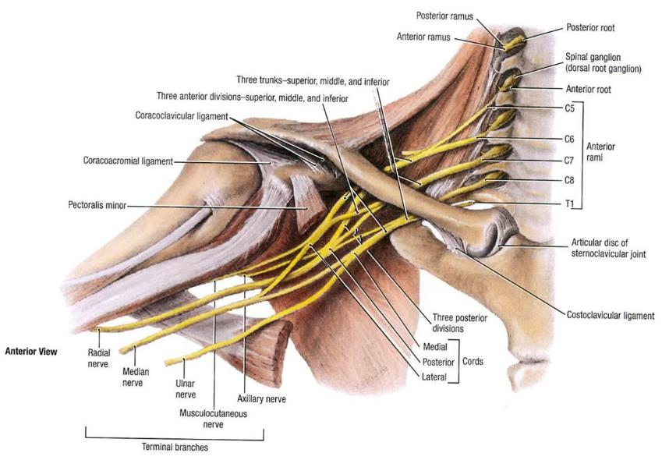
The radial nerve is formed from the posterior cord of the brachial plexus, with contributions from C6, C7, C8, and T1.

Slide 7
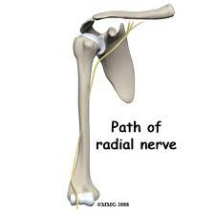
The nerve passes between the medial and lateral heads of the triceps muscle, continuing distally along the lateral side of the arm.

Slide 8
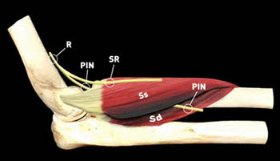
Approximately 10 cm above the elbow, the radial nerve pierces the lateral intermuscular septum and continues distally between the brachialis and brachioradialis muscles

Slide 9
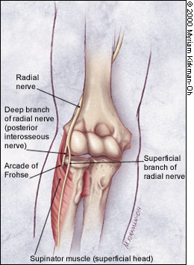
Just proximal to the radiocapitellar joint, the radial nerve bifurcates into the superficial radial nerve and deep radial nerve (posterior interosseous nerve)

Slide 10
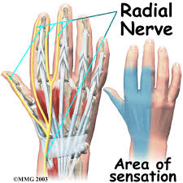
The superficial branch of radial nerve is a sensory branch, and innervates the skin of the thumb, index, and middle fingers.

Slide 11
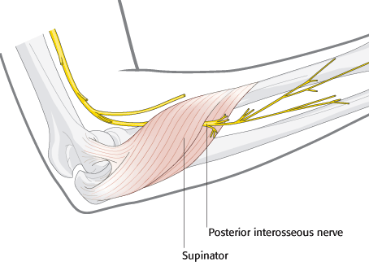
The posterior interosseous nerve is a motor branch, and supplies the wrist and finger extensors. This branch passes through the supinator muscle between its superficial and deep heads, exiting into the posterior compartment of the forearm.

Slide 12
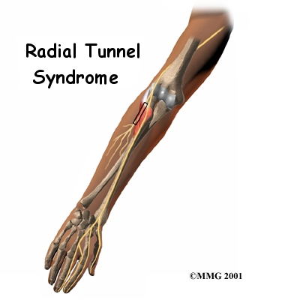

Slide 13
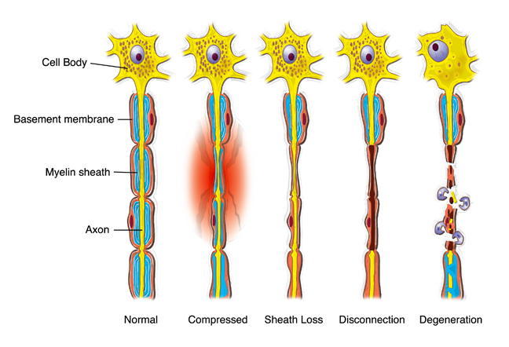
Nerve Damage

Slide 14
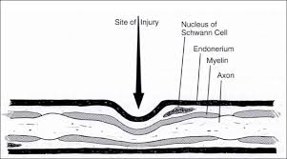
Nerve damage
The effects of compression on peripheral nerves can
be attributed to alterations of blood circulation to and
from the nerve as well as direct injury to the axonal
transport systems.

Slide 15
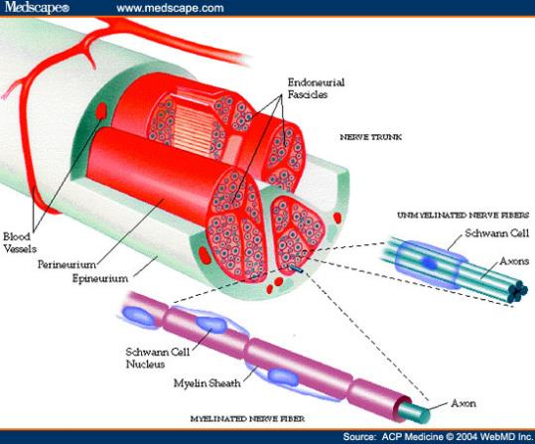
Venous blood flow from the peripheral
nerves is shown to be reduced at 20 to 30 mm Hg, whereas frank ischemia can occur at pressures of 60 to 80 mm Hg.

Slide 16
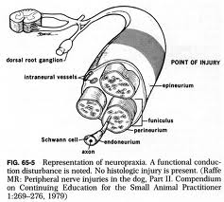
Neuropraxia
The mildest grade is called neuropraxia, a reduction or complete block of conduction across a segment of a nerve with axonal continuity conserved.

Slide 17
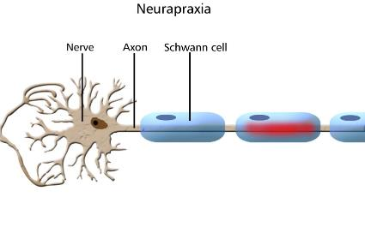
Neuropraxia
More specifically, it is dysfunction and/or paralysis without loss of nerve sheath continuity and peripheral Wallerian degeneration
Nerve conduction is preserved both proximal and distal to the lesion but not across the lesion.

Slide 18
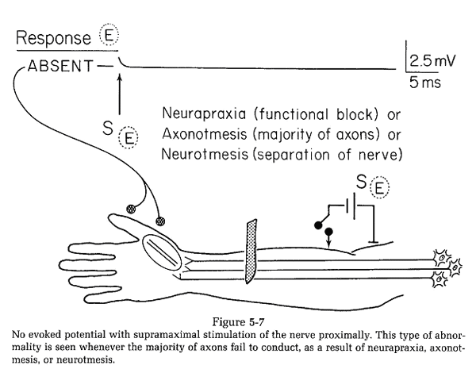
Neuropraxia
Conduction block, focal demyelination at edges of nodes of Ranvier or complete internode segments.
No axonal abnormality; therefore, no Tinel’s sign.
Full recovery with repair of conduction block or remyelination.

Slide 19
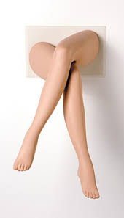
Neuropraxia
A person's foot "falling asleep" after her legs have been crossed is an example of a functional loss without abnormal change.

Slide 20
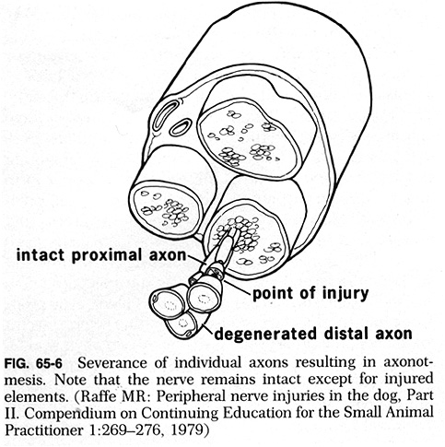
Axonotmesis
Axonotmesis is a more severe grade of nerve injury compared to neurapraxia.

Slide 21
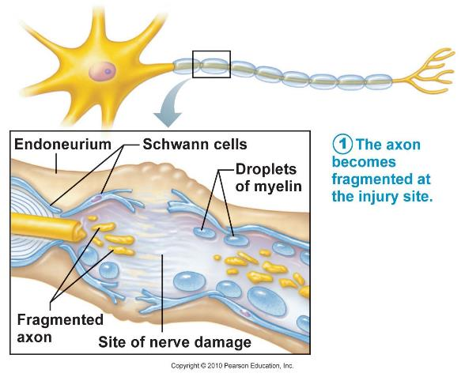
Axonotmesis is a result of damage to the axons with preservation of the neural connective tissue sheath (endoneurium), epineurium, Schwann cell tubes, and other supporting structures..

Slide 22
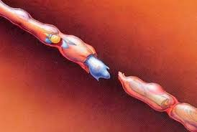
Wallerian degeneration
A compression neuropathy may begin as a mild injury to epineural vessels under mild pressure. The subsequent edema can lead to fibrosis, which increases further pressure on the nerve, leading to a progressive deterioration of the nerve.
Rydevik B, Lundborg G. Permeability of intraneural microvessels
and perineurium following acute, graded experimental nerve compression.
Scand J Plast Reconstr Surg 1977;11:179 –187.

Slide 23
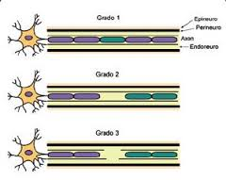
Axonotmesis
Thus, the internal architecture is relatively preserved. This can guide proximal axonal regeneration to reinnervate distal target organs. Distal Wallerian degeneration occurs in axonotmesis.

Slide 24
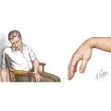
THE TERM Saturday night palsy has become synonymous with radial nerve compression in the arm resulting from direct pressure against a firm object. It typically follows deep sleep on the arm, often after alcohol intoxication.
Spinner RJ, Poliakoff MB, Tiel RL.The origin of "Saturday night palsy? Neurosurgery. 2002 Sep;51(3):737-41; discussion 741.

Slide 25
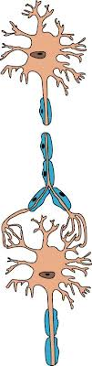
Neurotmesis is the most severe grade of peripheral nerve injury. It occurs when the axon, myelin, and connective tissue components are damaged and disrupted or transected.

Slide 26
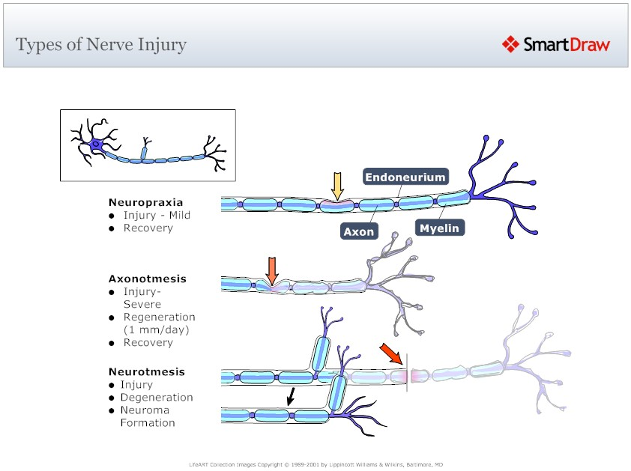

Slide 27
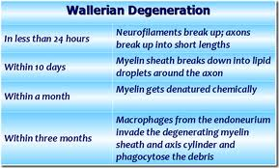

Slide 28
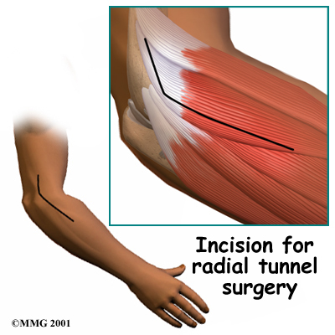
Radial Tunnel
The radial tunnel is a
potential space 3 to 4
finger breadths long, lying along the anterior aspect of the proximal radius

Slide 29

The radial nerve begins as the terminal branch of the posterior cord of the brachial plexus. The nerve begins posterior to the axillary artery
and travels through the
triangular interval and then continues along the spiral groove of the humerus.

Slide 30
The radial nerve continues to travel distally and ultimately bifurcates into deep (PIN) and superficial (SBRN) branches approximately 6.0 to 10.5 cm distal to the lateral intermuscular septum and 3 to 4 cm proximal to the leading edge of the supinator.

Slide 31
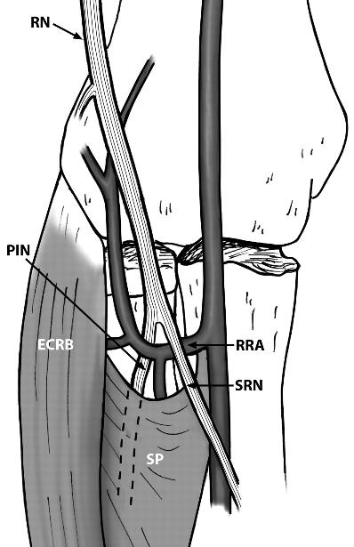
The PIN is a motor nerve that courses deep beneath the supinator muscle; the SBRN is a sensory nerve that travels anteriorly on the undersurface of the brachioradialis and, in the distal one-third of the forearm, travels subcutaneously to provide sensation to the dorsoradial hand.

Slide 32
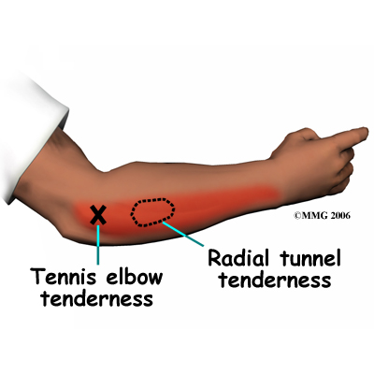

Slide 33
History
Pain along the dorsoradial aspect of the proximal forearm, which radiates proximally and distally.
Rotational activities of the forearm increase the severity of the pain.
Muscle weakness may present due to pain (SBRN) or denervation (PIN).
Deep throbbing pain at night post aggravation.

Slide 34
Risk Factors
Regular use of force of at least 1 kg for more that 10 repetitions per hour with the elbow constantly extended between 0 degrees and 45 degrees with frequent pronation and supination of the forearm would increase the chance of developing radial tunnel syndrome.
Roquelaure Y, Raimbeau G, Saint-Cast Y, et al. Occupational risk factors for radial tunnel syndrome in factory workers. Chir Main 2003;22:293-8.

Slide 35

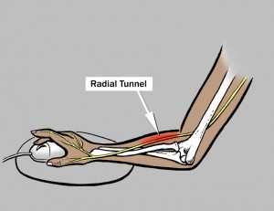
Other Risk Factors

Slide 36
Physical Examination
Localized focal tenderness over the anatomical landmark, approximately 3-5 cm distal to the lateral epicondyle over the supinator mass (Loh and “Rule of Nine”).
Cozen’s test is usually negative for pain but active forearm supination or extension of middle finger with resistance produces pain at radial tunnel.

Slide 37
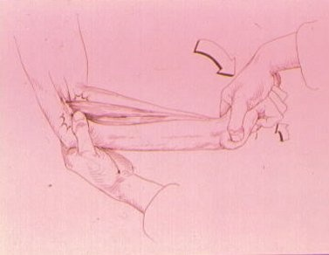
Lateral Epicondylitis/Epicondylosis/tendinopathy
Tennis Elbow Test or
Cozen’s test

Slide 38
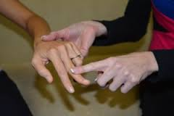
Resisted extension of middle finger will produce pain at the radial tunnel

Slide 39
Definition of an orthopedic test
Most often, a provocative maneuver that reproduces the patient’s chief concern pain by stretching, compressing and/or contracting of tissues in order to identify the involved tissues.
James J. Lehman, DC, FACO

Slide 40
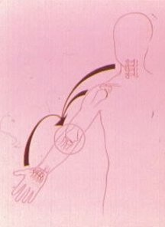
Examination of Related Areas

Slide 41
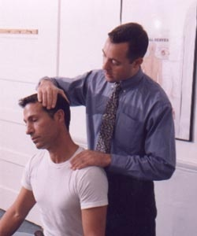
Spine Evaluation
History
Observation
Palpation
Range of motion
Special tests or Orthopedic tests
Imaging and other tests

Slide 42
Imaging and Neurodiagnostics
Routine radiographic examination is nondiagnostic but MRI might demonstrate denervation edema or atrophy within the supinator or extensor muscles.
Absence of standardized electrodiagnostic findings on both nerve-conduction velocity and EMG

Slide 43
Differential Diagnoses
Lateral epicondylosis
Posterior interosseous nerve syndrome (Deep branch of the radial nerve) “motor nerve”
Radial tunnel syndrome (Superficial branch of the radial nerve) “sensory nerve”
Ulnar neuropathy

Slide 44
Treatment
Conservative care should precede surgical intervention
Wrist splinting
Activity modification
NSAIDS
Avoid activities or treatments that increase the symptoms

Slide 45
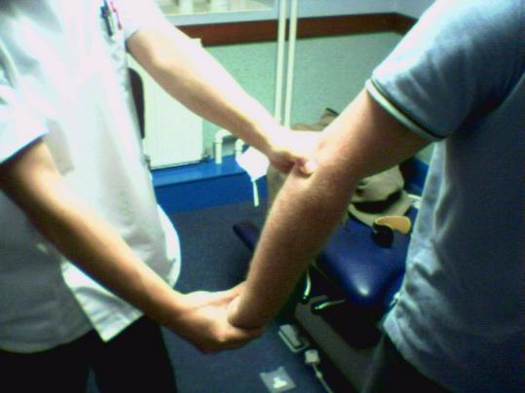
Relative Contraindication
Mills maneuver of the elbow to release adhesions of the capsule and periarticular soft tissues.

Slide 46
Absolute Contraindications
Soft tissue treatments (Instrument assisted, deep friction massage, and stretching)
Heat/Ultrasound
Tennis elbow brace
Repetitive strain activities such as progressive resistive exercises, walking dog, use of laptop and tools that require pronation of forearm

Slide 47
Active Learning Task
Form a learning group of four doctors
Select a spokesperson
Using a SOAP format, create a putative case and chart the subjective and objective findings, assessment, and plan of a patient suffering with a radial tunnel syndrome involving the superficial branch of the radial nerve (sensory nerve).

Slide 48
Active Learning Task
You will have 30 minutes to create and chart the putative case
The spokesperson will have 5 minutes to present your case to the audience
Audience will critique the presentation
Five groups will present

Slide 49
Recommended Reading
Unusual Compression Neuropathies of the Forearm, Part I: Radial Nerve
Alan C. Dang, MD, Craig M. Rodner, MD
J Hand Surg Am. 2009 Dec;34(10):1906-14.
http://nemsi.uchc.edu/clinical_services/orthopaedic/handwrist/pdfs/article_radialnerve.pdf

Slide 50
References
Rydevik B, Lundborg G. Permeability of intraneural microvessels and perineurium following acute, graded experimental nerve compression. Scand J Plast Reconstr Surg 1977;11:179 –187.
Spinner RJ, Poliakoff MB, Tiel RL.The origin of "Saturday night palsy? Neurosurgery. 2002 Sep;51(3):737-41; discussion 741.
Roquelaure Y, Raimbeau G, Saint-Cast Y, et al. Occupational risk factors for radial tunnel syndrome in factory workers. Chir Main 2003;22:293-8.
Dang AC & Craig M. Rodner CM. Unusual Compression Neuropathies of the Forearm, Part I: Radial Nerve. J Hand Surg Am. 2009 Dec; 34(10):1906-14. Available from: http://nemsi.uchc.edu/clinical_services/orthopaedic/handwrist/pdfs/article_radialnerve.pdf

Slide 51


