Slide 1
Ankle and Foot Orthopedics
James J. Lehman, DC, MBA, DIANM
Diplomate of the International Academy of Neuromusculoskeletal Medicine
Associate Professor of Clinical Sciences
University of Bridgeport School of Chiropractic

Slide 2
Ankle & Foot Anatomy
Stability of the ankle is dependent upon functional placement of the talus.

Slide 3
Case: Ankle Sprain
Ligaments are tough bands of tissue that connect bones to each other.
They provide strength and support to joints.

Slide 4
History
An unnatural twisting motion can happen when the foot is planted awkwardly, when the ground is uneven, or when an unusual amount of force is applied to the joint. Ankle sprains are common sports injuries but can also happen during everyday activities such as walking or even getting out of bed.

Slide 5
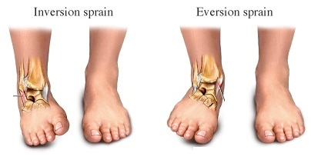

Slide 6
Grading Ankle Sprains

Slide 7
Obvious Fracture

Slide 8
Plantar Fasciitis

Slide 9
Osteoarthritis or Degenerative Joint Disease

Slide 10
Kleiger’s Test for High Ankle Sprain to the Syndesmosis or Interosseous Ligament
https://www.youtube.com/watch?v=AXPxMmChQj0

Slide 11
High Ankle Sprain

Slide 12
Ankle Sprain
Lateral ankle sprain is the most common ankle sprain

Slide 14
Observation

Slide 15
Ankle Examination Palpation and Range of Motion

Slide 16
Subtalar Examination Passive Range of Motion

Slide 17
Anterior drawer test
To assess the integrity of the anterior talofibular ligament. If the ligament is torn, the talus will subluxate anteriorly compared with the unaffected ankle

Slide 19
Drawer Foot Test
Anterior drawer test will be positive with gapping secondary to trauma
Indicates sprain of anterior talofibular ligament

Slide 20
Posterior Drawer Test
Posterior drawer employs just the opposite forces to challenge the posterior talofibular ligament.

Slide 21
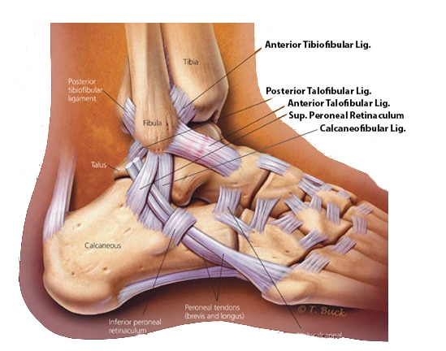

Slide 22
Lateral Stability Test Talar Tilt Test
Sprain injury to calcaneofibular and/or anterior talofibular ligaments

Slide 23
Inversion stress test or talar tilt
To assess the integrity of the calcaneofibular ligament and/or anterior talofibular ligaments

Slide 24
Talar Tilt Test
What is your diagnosis or assessment of this condition?

Slide 25
Normal Radiographic Examination of Ankle

Slide 26
Ottawa Ankle and Foot Rules
Ankle radiography is indicated only if a patient has pain in the malleolar zone and any of the following findings: bone tenderness at A or B or the inability to bear weight (four steps) immediately after injury and in the emergency department or physician's office. Foot radiography is indicated only if a patient has pain in the midfoot zone and any of the following findings: bone tenderness at C or D or the inability to bear weight (four steps) immediately after injury and in the emergency department or physician's office.

Slide 27
Ottawa Rules Zones

Slide 28
Ankle Sprain
Please describe the grades of an ankle sprain…

Slide 29
Plan: Management
What is the grade of sprain?
Which ligaments are sprained?
How should we manage this patient?

Slide 30
PRICE
The immediate goals of treating acute ankle sprain are to decrease pain and swelling and protect ankle ligaments from further injury.
The PRICE (Protection, Rest, Ice, Compression, Elevation) treatment protocol for acute ankle injury is commonly used. The protocol includes elevating the ankle and protecting it with a compressive device. Ice is applied to the injured ankle, and the patient is advised to rest for up to 72 hours to allow the ligaments to heal.
When compared with immobilization, early weight-bearing with support (elastic compression wrap or a walking boot, aircast, or walking cast) has been found to improve return to sports, return to work, persistent swelling, the range of motion, and patient satisfaction.
Diagnosis, treatment and prevention of ankle sprains: update of an evidence-based clinical guideline. Br J Sports Med. 2018 Aug;52(15):956.

Slide 31
Aircast Ankle Brace
A Cochrane review showed that lace-up or semirigid supports are more effective for ankle injury than tape or elastic bandages

Slide 33
High Ankle Sprain Mechanism

Slide 34
High Ankle or Syndesmotic Sprain Test
The crossing of the affected leg over the other leg will produce pain with a high ankle sprain of the interosseous membrane.

Slide 35
Crossed-leg test
To detect high ankle (syndesmotic) sprain.
A high ankle sprain will cause pain in the syndesmosis area(arrows) when pressure is applied to the medial side of the knee.

Slide 36
Pott’s Compression Test
Tests for fracture of the tibia/fibula or syndesmotic sprain.

Slide 37
High Ankle Sprain
Syndesmotic ligament sprain
Squeeze test
Stress radiographs
Syndesmotic screw

Slide 38
Stress Radiographic Study
Notice separation of the tibia and fibula due to syndesmotic sprain.

Slide 39
Surgical Repair
Syndesmotic screw corrects alignment and stabilizes without compressing the syndesmotic ligament.

Slide 40
Conditions of the foot and ankle
Achilles tendonitis
Shin splints
Lateral ankle sprain
Plantar fasciitis
Avulsion fracture
Stress fracture
Complete fracture
Blister
Subungual hematoma
Ganglionic cyst

Slide 41
Ankle Sprain Case Study
James J. Lehman, DC, MBA, DIANM
University of Bridgeport
School of Chiropractic

Slide 42
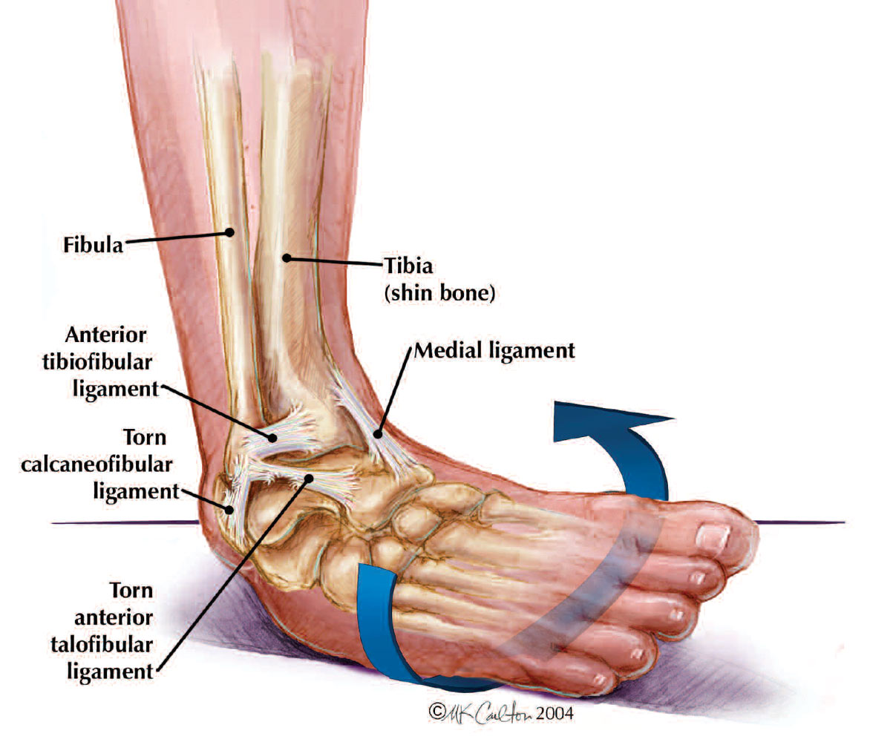

Slide 43
Differential Diagnosis List
During the history of present illness/injury you create your differential diagnosis list.
What do you list for this patient?

Slide 44
Ankle Sprain Case Report
Subjective
Chief Concern: “I hurt my ankle”
This 26-year-old Asian male is a chiropractic student at UBSC. He self-referred for evaluation and management of “Right ankle pain.” He injured the right ankle while playing basketball in Queens on Saturday morning, two weeks ago. “I jumped up and came down and my right foot rolled out.” “Almost immediately, I felt throbbing with ache all around the ankle.” He discontinued playing basketball and a friend drove him home. He did notice that his right sneaker became tighter.
He applied ice to the ankle within one hour of the injury. The ice was applied for 15 minutes 4 times on Saturday and Sunday. The right ankle was wrapped with an Ace bandage and elevated after the ice treatment. Relief of pain was experienced for 1-2 hours post ice. He has not used any medications. Movement of the foot increases ankle pain.
He rated the severity of the pain at 6/10 on Saturday and 4-5/10 on Sunday. Today, he rates the severity at 4/10 and improvement at 30%. “I limp around. On Saturday, I could not walk. I have bruising and swelling too, all around the foot and ankle. It did not appear until yesterday. It is still pretty swollen.” He has a history of a sprain to the left ankle with an avulsion fracture, which took place two years ago.

Slide 45
Diagnosis

Slide 46
Differential Diagnosis List Ruling in and ruling out
The Objective Data helps you to rule in or rule out the different diagnoses.

Slide 47
Differential Diagnosis List Ruling in and ruling out
What physical examination procedures would you perform to rule in and rule out diagnoses?

Slide 48
Physical Examination
Observation of the ankle and gait.
Is there a limping gait?
Is there edema and/or discoloration? Where?

Slide 49
Location of Edema and Discoloration

Slide 50
Ruling in and Ruling out
Palpation for pain.
Identification of the painful tissues.
Are muscles, ligaments, and/or bones the pain generators?

Slide 51
Lateral Stability Test Talar Tilt Test
Sprain injury to calcaneofibular and/or anterior talofibular ligaments

Slide 52
Talar Tilt Test

Slide 53
Objective Data
I noticed a RLE limping gait and discoloration (purple/blue) of the medial and lateral right ankle/foot. The patient experienced pain in the medial and lateral ankle with ambulation. The medial ankle pain was more severe than the lateral ankle.
Circumference of ankles: left = 10 ¼” right = 11”
Palpation of right foot: Pain at lateral and medial malleoli with severity of 7/10 medial malleolus and 5-6/10 lateral malleolus, extensor muscle pain at 3/10, and Achilles tendon at 2/10.
Passive inversion of the right foot produced pain at the lateral ankle with severity of 4/10.
Passive eversion of right foot produced pain at the medial ankle with severity of 5/10.
Sensory evaluation: (Sharp pain and light touch) Right foot- intact L5 and S1 dermatomes but hypesthesia of medial aspect of foot (L4 dermatome). Left foot- intact L4-5 and S1 dermatomes.
Motor: 5/5 left foot and 4/5 right foot with extension, eversion, and inversion due to pain.
Drawer test: Right ankle stable, left ankle demonstrated increased translation compared to the right ankle
Squeeze of the RLE (Pott’s) without signs of high ankle sprain

Slide 54
Diagnosis

Slide 55
Diagnosis
Assessment
Acute, moderate, medial/lateral sprain of right ankle.
Rule out fracture of distal aspects of tibia and fibula.
Chronic left ankle instability – Status post severe ankle sprain with avulsion fracture.

Slide 56
Ankle Sprain Diagnoses
https://instituteforathleticmedicine.com/specialties/foot-and-ankle/ankle-sprains/

Slide 57
Treatment Plan

Slide 58
Treatment Plan
I discussed diagnosis and treatment options with the patient. He consented to treatment after a full explanation of diagnosis and treatment.
Applied HVG to right foot in water with a 20-minute duration and 2 pads near medial and lateral malleoli in water. Settings: 50-330 pulses per second at a 65 intensity. Treatment was well tolerated by the patient with reduction in circumference of ankle from 11” to 10 5/8” and patient perception of 50% improvement of pain relief with ambulation. The patient was able to ambulate with less pain and a reduced limp.
Provide a “Soken” HVG unit for home use with instructions to treat 4 times per day for the next two days and apply ice following HVG.
I advised him to have a radiographic examination at the ER to rule out fractures today. He agreed to have the radiographic examination performed on January 17, 2023, if his pain is not significantly reduced.
Exam time: 24 minutes
Treatment time: 20 minutes
Time: 10:44 a.m

Slide 59
Review of Ankle Evaluation and Management
https://instituteforathleticmedicine.com/specialties/foot-and-ankle/ankle-sprains/

Slide 61
The End…

