Slide 1
Spinal Imaging and the Differential Diagnosis of Permanent Spinal Ligament Laxity and Its Clinical Correlation
James J. Lehman, DC, FACO
Associate Professor of Clinical Sciences
Director, Community Health Clinical Education
University of Bridgeport

Slide 2
Dr. James J. Lehman
PowerPoint presentations: Bridgeport.edu/nmsm
Cell: 505-238-9501
Email: jlehman@bridgeport.edu

Slide 3
Learning Objectives
Recognize that cervical sprains may cause laxity of spinal ligament and hypermobile/unstable joints.
Differentiate stable, hypermobile, and unstable post-traumatic cervical spine injuries.
Justify the technology necessary to evaluate cervical spines for post-traumatic instability.
Explain the impairment rating for cervical spine subluxations and instability.
Recognize value of prolotherapy for chronic neck pain with lax ligaments.

Slide 4
Diagnosis is the key to successful treatment! Richard C. Ackerman, DC, FACO

Slide 5
Whiplash Type Injury
Despite a large number of rear-end collisions on the road and a high frequency of whiplash injuries reported, the mechanism of whiplash injuries is not completely understood.
Chen HB, Yang KH, Wang ZG. Biomechanics of whiplash injury. Chin J Traumatol.2009 Oct;12(5):305-14.

Slide 6
Whiplash Type Injury
One of the reasons is that the injury is not necessarily accompanied by obvious tissue damage detectable by X-ray or MRI.
Chen HB, Yang KH, Wang ZG. Biomechanics of whiplash injury. Chin J Traumatol.2009 Oct;12(5):305-14.

Slide 7
James A. Mertz, DC, DACBR

Slide 8
Whiplash Type Injury
An extensive series of biomechanics studies, including injury epidemiology, neck kinematics, facet capsule ligament mechanics, injury mechanisms and injury criteria, were undertaken to help elucidate these whiplash injury mechanisms and gain a better understanding of cervical facet pain.
Chen HB, Yang KH, Wang ZG. Biomechanics of whiplash injury. Chin J Traumatol.2009 Oct;12(5):305-14.

Slide 10
Kinematic Studies
Based on kinematical studies on the cadaver and volunteers, there are three distinct periods that have the potential to cause injury to the neck.
Chen HB, Yang KH, Wang ZG. Biomechanics of whiplash injury. Chin J Traumatol.2009 Oct;12(5):305-14.

Slide 11
Three Distinct Periods of Cervical Trauma
First stage: flexural deformation of the neck is observed along with a loss of cervical lordosis;
Second stage: the cervical spine assumes an S-shaped curve as the lower vertebrae begin to extend and gradually cause the upper vertebrae to extend;
Final stage: the entire neck is extended due to the extension moments at both ends.
Chen HB, Yang KH, Wang ZG. Biomechanics of whiplash injury. Chin J Traumatol.2009 Oct;12(5):305-14.

Slide 13
Whiplash Type Injury
These results form the biomechanical basis for a hypothesis that the facet joint capsule is a source of neck pain and that the pain may arise from large strains in the joint capsule that will cause pain receptors to fire.
Chen HB, Yang KH, Wang ZG. Biomechanics of whiplash injury. Chin J Traumatol.2009 Oct;12(5):305-14.

Slide 14
Capsular Ligament Laxity and Cervical Spine Instability
The capsular ligaments are the main stabilizing structures of the facet joints in the cervical spine and have been implicated as a major source of chronic neck pain.
Steilen D, Hauser R, Woldin B, & Sawyer S. Chronic Neck Pain: Making the Connection Between Capsular Ligament Laxity and Cervical Instability. Open Orthop J. 2014; 8: 326–345.

Slide 15
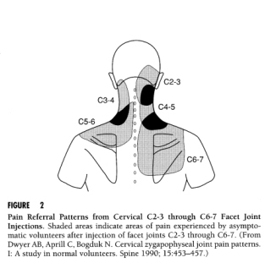

Slide 16
Whiplash Type Injury and Chronic Pain Syndrome
Only 50% of patients fully recover from a whiplash-type injury.
Ritchie C, Henrickz J, Kenardy J, & Sterling M. Derivation of a clinical prediction rule to identify both chronic moderate/severe disability and full recovery following whiplash injury. Pain. 2013 Oct;154(10):2198-206.

Slide 17
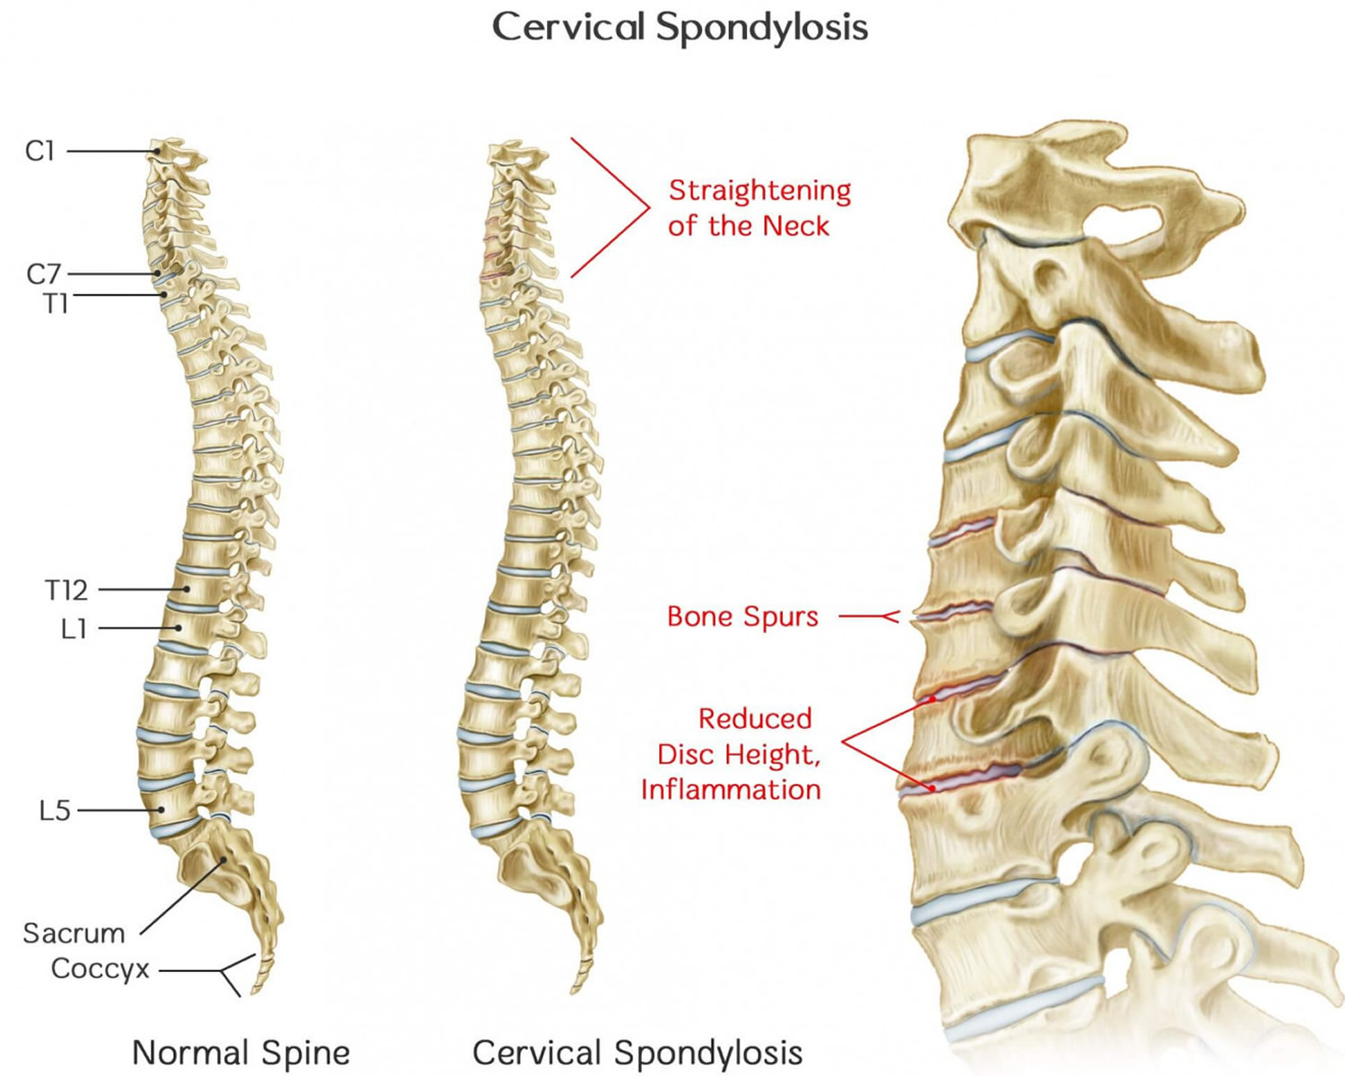

Slide 18
Chronic Neck Pain
The use of conventional modalities for chronic neck pain remains debatable, primarily because most treatments have had limited success.
Steilen D, Hauser R, Woldin B, & Sawyer S. Chronic Neck Pain: Making the Connection Between Capsular Ligament Laxity and Cervical Instability. Open Orthop J. 2014; 8: 326–345.

Slide 19
Chronic Neck Pain
A review of the literature on the diagnostic and treatment modalities of disorders related to chronic neck pain and concluded that, despite providing temporary relief of symptoms, these treatments do not address the specific problems of healing and are not likely to offer long-term cures.
Steilen D, Hauser R, Woldin B, & Sawyer S. Chronic Neck Pain: Making the Connection Between Capsular Ligament Laxity and Cervical Instability. Open Orthop J. 2014; 8: 326–345.

Slide 20
Chronic Neck Pain and Cervical Spine Instability
Chronic neck pain often reflects a state of instability in the cervical spine and is a symptom common to a number of conditions described herein, including disc herniation, cervical spondylosis, whiplash injury and whiplash associated disorder, post-concussion syndrome, vertebrobasilar insufficiency, and Barré-Liéou syndrome.
Steilen D, Hauser R, Woldin B, & Sawyer S. Chronic Neck Pain: Making the Connection Between Capsular Ligament Laxity and Cervical Instability. Open Orthop J. 2014; 8: 326–345.

Slide 21
Chronic Neck Pain and Cervical Spine Instability
When the capsular ligaments are injured, they become elongated and exhibit laxity, which causes excessive movement of the cervical vertebrae.
Steilen D, Hauser R, Woldin B, & Sawyer S. Chronic Neck Pain: Making the Connection Between Capsular Ligament Laxity and Cervical Instability. Open Orthop J. 2014; 8: 326–345.

Slide 22
Chronic Neck Pain and Prolotherapy
Based on clinical studies and experience with patients who have visited our chronic pain clinic with complaints of chronic neck pain, we contend that prolotherapy offers a potentially curative treatment option for chronic neck pain related to capsular ligament laxity and underlying cervical instability.
Steilen D, Hauser R, Woldin B, & Sawyer S. Chronic Neck Pain: Making the Connection Between Capsular Ligament Laxity and Cervical Instability. Open Orthop J. 2014; 8: 326–345.

Slide 23
Clinical Instability
Clinical instability is defined as the inability of the spine under physiological loads to maintain its normal pattern of displacement so that there is no neurological damage or irritation, no development of deformity, and no incapacitating pain.
Panjabi MM. The stabilizing system of the spine. Part II. Neutral zone and instability hypothesis. ] Spinal Disord. 1992;5:390-397.

Slide 24
Capsular Ligament Laxity
In the upper cervical spine (C0-C2), this can cause a number of other symptoms including, but not limited to, nerve irritation and vertebrobasilar insufficiency with associated vertigo, tinnitus, dizziness, facial pain, arm pain, and migraine headaches.
Olson KA & Joder D. Diagnosis and Treatment of Cervical Spine Clinical Instability. Journal of Orthopaedic & Sports Physical Therapy 2001;31(4):194-206.

Slide 25
Alteration of Motion Segment Integrity (AOMSI)
Alteration of motion segment integrity is determined by exact mensuration procedure published in the AMA Guides to the Evaluation of Permanent Impairment.

Slide 26
Ligament Instability
The AMA Guides to the Evaluation of Permanent Impairment, 3rd, 4th ,5th and 6th editions have described the measurement method to determine ligament instability.

Slide 27
George’s Line
A moderate (greater than 3.5 mm) break in George's Line on the flexion and extension lateral X-ray films is a permanent impairment, equivalent to a post-surgical fusion of two cervical vertebra.

Slide 28
Listhesis and Ligament Laxity
Most chiropractors see small anterolisthesis and/or retrolisthesis on the films and ignore it or fail to appreciate its significance.

Slide 29
Quantification (mm)
Loss of motion segment integrity is defined as an anteroposterior motion of one vertebra over another that is greater than 3.5 mm

Slide 30
Unstable Cervical Spine
Total translation of greater than 3.5 mm in the cervical spine is a DRE Category IV permanent impairment of 25 percent to 28 percent whole person in the AMA Guides.

Slide 31
Alteration of Motion Segment Integrity AOMSI
When the range of motion of adjacent motion segments differs by 11 degrees or greater it is classified as AOMSI .
This is a direct consequence of a loss of ligament integrity.

Slide 33
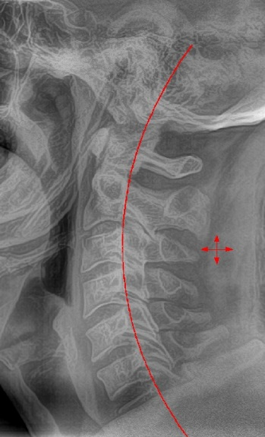
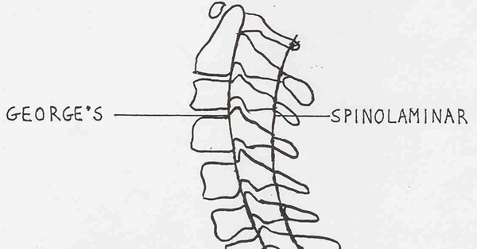
George’s Line, since 1919, is relevant to ascertaining alignment in order to detect post-traumatic cervical injuries. (Locate)

Slide 34
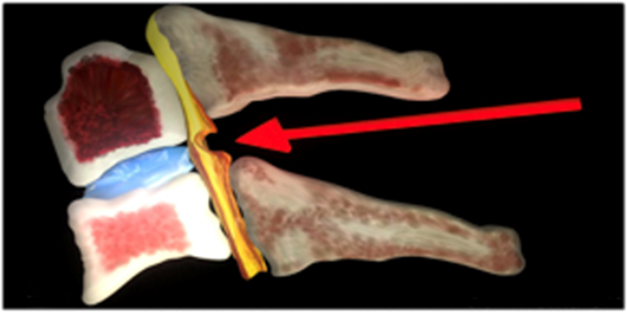
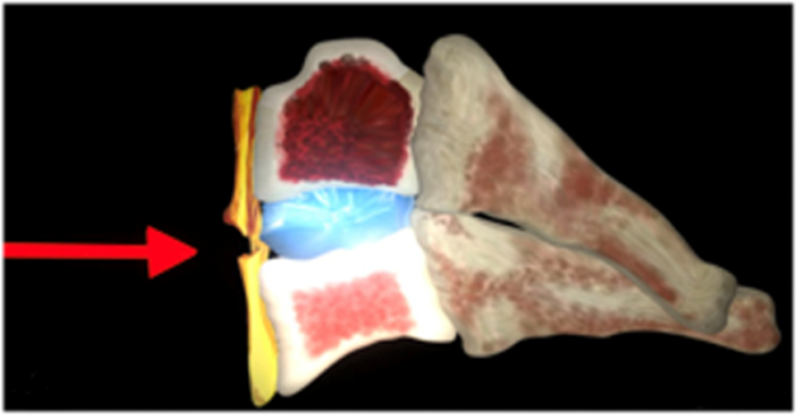
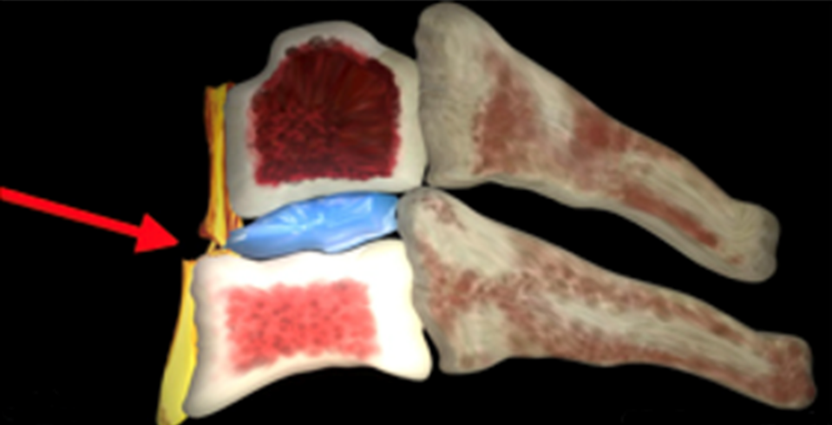
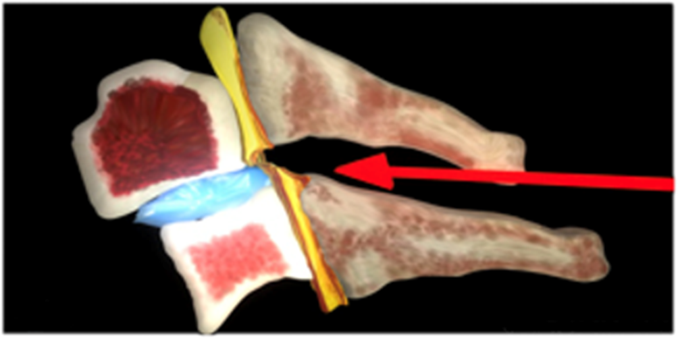
SUBLUXATIONS (DEFINE)
ANTEROLISTHESIS
FLEXION
RETROLISTHESIS
EXTENSION

Slide 35
BIOMECHANICS: TRANSLATION & ANGULATION (Quantify)
Translation cannot be more than 3.5 mm and
Angular variation cannot be more than 11° in the cervical spine. (unbiased evaluation)

Slide 36
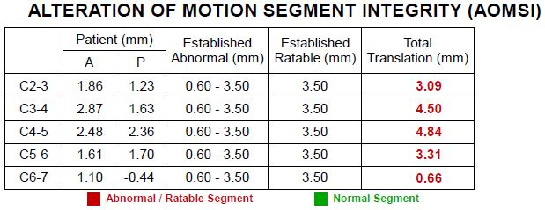

Slide 38
AMA GUIDES
…LOSS OF MOTION SEGMENT INTEGRITY IS RARE,
UNLESS ACCOMPANIED BY TRAUMA…
MOTION OF THE SPINE SEGMENTS CANNOT BE DETERMINED BY A PHYSICAL EXAMINATION BUT IS EVALUATED WITH FLEXION/EXTENSION ROENTGENOGRAMS (X-RAYS)…

Slide 39
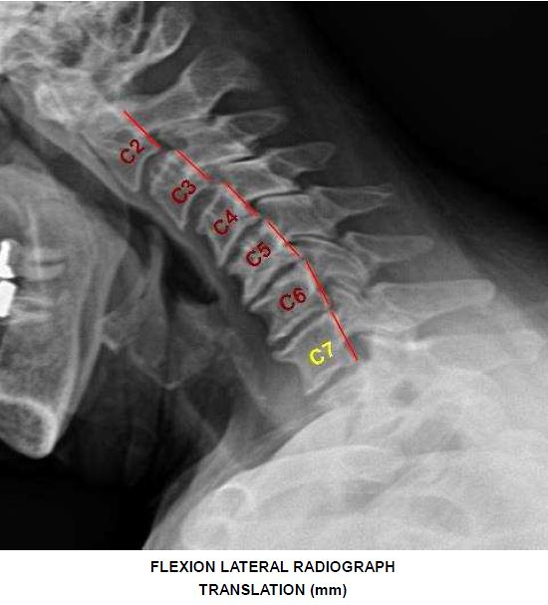
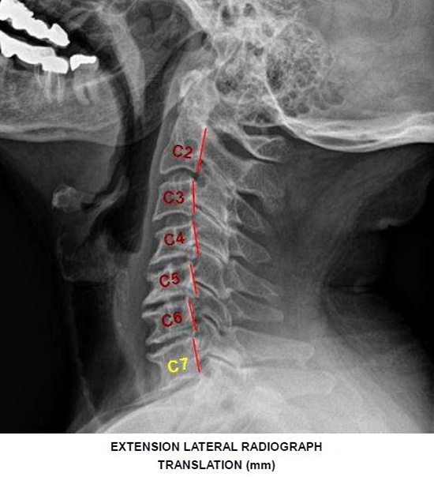
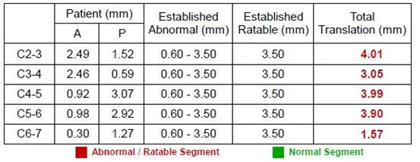
Notes:
DOA: 5.2.12 & 8.27.14

Slide 40
Master the AMA Guides
Criteria for AOMSI has been revised to reflect current scientific knowledge
Muscle spasm, guarding alone, asymmetry of ROM, Non verifiable Radicular pain, Abnormal-reflex = 5-8%
Weakness/sensory loss, atrophy, radiculopathy, electro-diagnostic verification of radicular deficits = 10-13%
Alteration of Motion Segment Integrity
AOMSI = 20-23%

Slide 41
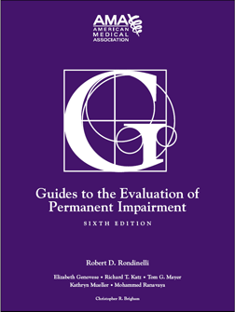
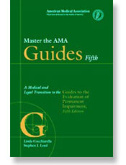
(6th Edition - AMA Guides)
Flexion/Extension x-rays (stress views) provide useful information on AOMSI at a given level
(5th Edition – AMA Guides)
Dominant motions at the cervical and lumbar spine, where most clinical pathology occurs, are flexion and extension.

Slide 42
Medically Necessary
Stress views and Computed Radiographic Mensuration Analysis (CRMA) in the cervical region are reasonable, appropriate, and medically necessary following cervical trauma with chronic pain and signs of hypermobility or instability.

Slide 43
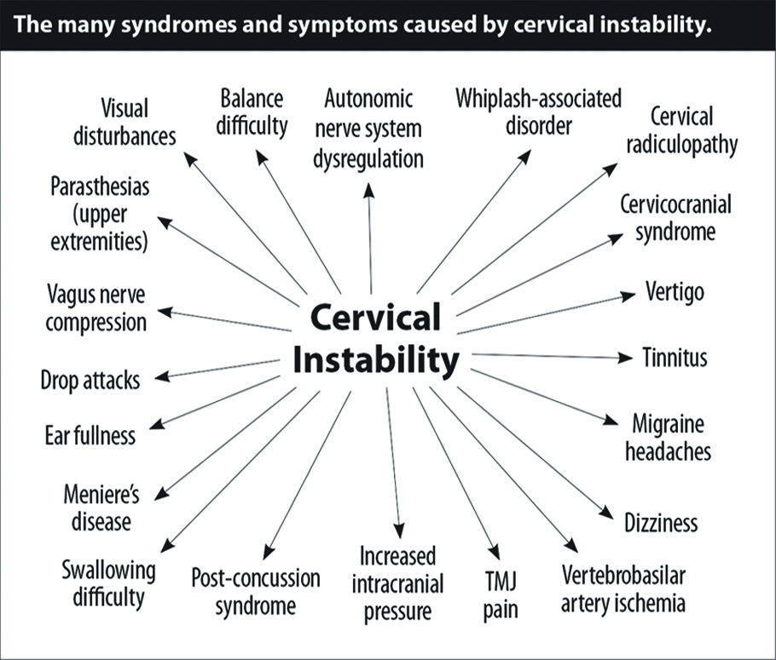

Slide 44
Upper Cervical Ligament Sprain Injuries Leading to Chronic Pain
Sharp Purser Maneuver test for upper cervical spine instability.
Severity of alar ligament injury, head position at time of impact, Neck Disability Index (NDI) scores and reproduction of pain and excessive mobility with manual examination.
Kaale BR, Krakenes J, Albrektsen G, Wester K. Whiplash-associated disorders impairment rating: neck disability index score according to severity of MRI findings of ligaments and membranes in the upper cervical spine. J Neurotrauma. 2005;22:466-475.

Slide 45
Atlanto Axial Instability
https://www.bing.com/videos/search?q=Cervical+Spine+dmx+prolotherapy&&view=detail&mid=0966E83926D2222D70B10966E83926D2222D70B1&rvsmid=EB375AC9D51327A0224FEB375AC9D51327A0224F&FORM=VDQVAP

Slide 47
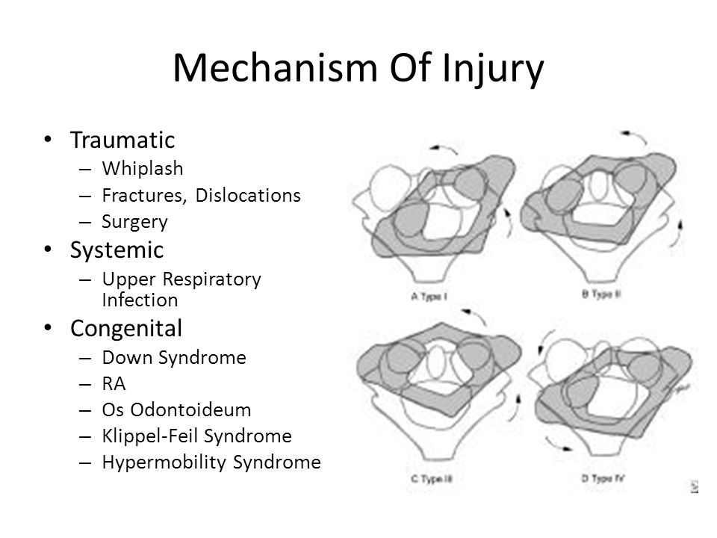

Slide 49
DMX Unstable Upper Cervical Spine
https://www.bing.com/videos/search?q=Cervical+Spine+dmx&&view=detail&mid=9C8198E4945406AFA75F9C8198E4945406AFA75F&rvsmid=7308C3962278AD0E01667308C3962278AD0E0166&FORM=VDQVAP

Slide 50
DMX, Prolotherapy, Upper Cervical Spine Instability, and Dr. Hauser
https://www.bing.com/videos/search?q=Hauser+prolotherapy&&view=detail&mid=EFD854B5FA17D088BBA7EFD854B5FA17D088BBA7&&FORM=VRDGAR

Slide 51
Capsular Ligament Laxity
In the lower cervical spine (C3-C7), this can cause muscle spasms, crepitation, and/or paresthesia in addition to chronic neck pain.
Olson KA & Joder D. Diagnosis and Treatment of Cervical Spine Clinical Instability. Journal of Orthopaedic & Sports Physical Therapy 2001;31(4):194-206.

Slide 52
Cervical Lines of Measurement

Slide 53
Digital Motion X-Ray Study (DMX)
https://www.bing.com/videos/search?q=Cervical+Spine+dmx&&view=detail&mid=1802D84042E937A87A801802D84042E937A87A80&&FORM=VRDGAR

Slide 54
Kinematic MRI of the Cervical Spine and Digital Motion X-ray (DMX)
https://www.bing.com/videos/search?q=cervical+spine+digital+motion+imaging&&view=detail&mid=FBCA6035A3679EAD40D0FBCA6035A3679EAD40D0&&FORM=VRDGAR
https://www.bing.com/videos/search?q=spinal+fluoroscopy&&view=detail&mid=1802D84042E937A87A801802D84042E937A87A80&&FORM=VDRVRV

Slide 55
DMX Artificial Discs
https://www.bing.com/videos/search?q=Cervical+Spine+dmx&&view=detail&mid=7CFDC96C2175174118BE7CFDC96C2175174118BE&&FORM=VRDGAR

Slide 56
Chiropractic Forensics Subspecialty
200 hours of NMSM online
100 hours of Forensic Sciences online
https://www.bridgeport.edu/academics/continuinged/health-sciences-postgraduate-education-programs/chiropractic-continuing-education/
https://cdi.edu.au/forensics/info.php

Slide 57
References
Steilen D, Hauser R, Woldin B, & Sawyer S. Chronic Neck Pain: Making the Connection Between Capsular Ligament Laxity and Cervical Instability. Open Orthop J. 2014; 8: 326–345.
https://www.ncbi.nlm.nih.gov/pmc/articles/PMC4200875/
Olson KA & Joder D. Diagnosis and Treatment of Cervical Spine Clinical Instability. Journal of Orthopaedic & Sports Physical Therapy 2001;31(4):194-206.
https://www.ncbi.nlm.nih.gov/pubmed/17959284
Chen HB, Yang KH, & Wang ZG. Biomechanics of whiplash injury. Chin J Traumatol. 2009 Oct;12:305-14.
https://www.ncbi.nlm.nih.gov/pubmed/19788851
Panjabi MM. The stabilizing system of the spine. Part II. Neutral zone and instability hypothesis. ] Spinal Disord. 1992;5:390-397.
Olson KA & Joder D. Diagnosis and Treatment of Cervical Spine Clinical Instability. Journal of Orthopaedic & Sports Physical Therapy 2001;31(4):194-206.
Kaale BR, Krakenes J, Albrektsen G, Wester K. Whiplash-associated disorders impairment rating: neck disability index score according to severity of MRI findings of ligaments and membranes in the upper cervical spine. J Neurotrauma. 2005;22:466-475.

